Slide 1



Business Process –
First aid at work (updated standard)
NR/L2/OHS/00110
Technical briefing
Notes:
Title slide

Slide 2

Instructions for this briefing
Click play on the speaker icon on each slide to hear audio
The slides in this presentation will provide a summary of the updates to the First Aid at Work standard
There is an audio attached to each slide, which provides additional information for the viewer, to assist with gaining greater understanding of the changes
The audio will start when you click play on the speaker icon at the top of the slide
Please make sure your device’s sound is on and not muted
Following this set of instructions, the audio does not duplicate the content of each slide. So please take the time to read the content of each one, before moving onto the next
If you prefer to not use the audio, please refer to the supporting notes for additional information
The presentation will take approximately 15 minutes to complete
Notes:
The content of the First Aid at Work standard has been revised.
The slides in this presentation will provide a summary of the updates to the standard
There is an audio clip attached to each slide, which provides additional information for the viewer, to assist with gaining greater understanding of the changes
The audio will start when you click play on the speaker icon at the top of the slide
Please make sure your device’s sound is on and not muted
Following this set of instructions, the audio does not duplicate the content of each slide. So please take the time to read the content of each one, before moving onto the next
If you prefer to not use the audio, please refer to the supporting notes for additional information
The presentation will take approximately 15 minutes to complete

Slide 3
Click play on the speaker icon on each slide to hear audio
This Network Rail standard is mandatory and shall be complied with by Network Rail from 03 March 2018.
Network Rail is committed to protecting health and wellbeing of its employees. The implementation of the processes defined within the standard will enable this and allow compliance with the Health and Safety at Work etc. Act 1974 and it’s associated regulations.
Notes:
The review of this standard was undertaken to meet the requirements of the HSE First Aid at Work Regulations, and align with the updated guidance.
The implementation phase ahead of March 2018, is to allow for an extended briefing period. This is required due to the far-reaching nature of the standard, which affects all areas of the business.

Slide 4
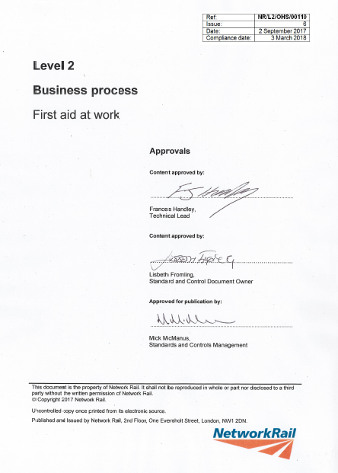
Why do we need a company standard?
Click play on the speaker icon on each slide to hear audio
  This standard sets out:
  The arrangements for the provision of first aid in the workplace or at site of work
  The method for assessing risks to determine what first aid equipment and facilities are required
  The standard applies to all staffed Network Rail workplaces, sites of work and employees, regardless of function or location.
Notes:
Network Rail has a legal duty to provide adequate first aid provision for employees, and morally, to consider contractors and the public.

Slide 5
What is the purpose of the standard?
Click play on the speaker icon on each slide to hear audio
To provide employees with access to suitable and sufficient first aid equipment and facilities while they are at work
To provide an effective and consistent process for the provision of first aid in accordance with relevant legislation
To mitigate the risk of insufficient first aid provision to manage illness or injury in the workplace, or at site of work
Notes:
The revision will bring an improved risk-based approach to assessing Network Rail’s first aid needs; based on work activity, potential severity of injury and access to emergency services.

Slide 6
Accountable and responsible roles
Click play on the speaker icon on each slide to hear audio
Head of Route, Safety, Health and Environment, Head of Safety and Sustainable Development, Principal Safety, Health, Environment and Quality Manager, or person nominated by the executive leader in business function
Accountable for
Using accident and incident data to confirm the suitability of first aid provision
Making recommendations to altering first aid provision (Quality Assurance)
Responsible Person
Appointed Person and Designated First Aider
Responsible for
Completion of first aid risk assessments
Provision of first aid arrangements for their area/s of responsibility
Self-assurance of first aid provision
Assigning appointed persons and first aiders
Responsible for
Checking that first aid equipment is maintained in a state of readiness
Taking charge of any medical emergency by calling for an ambulance
Organising or administering first aid, based on competence level
Notes:
This slide details the accountable and responsible roles within the standard.
As you’ll see in the top box on this slide, there has now been a person identified for making recommendations to alter first aid provision, based on accident and incident data.
In the left-hand lower box for the Responsible Person, refer to Table 1 on page 9 of standard for the suggested Responsible Persons for each workplace. The Responsible Person may continue to nominate a deputy to undertake duties on their behalf. Please check with your line manager if you are unsure of who the Responsible Person is for your workplace or site of work.
In the right-hand lower box, the Appointed Person or Designated First Aider is the individual nominated by the Responsible Person, with the specific responsibilities listed in this box.

Slide 7
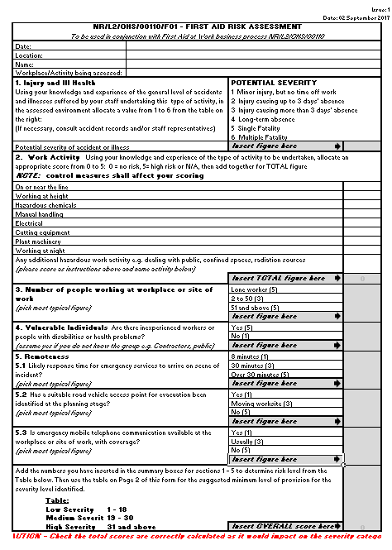
What are the key updates?
Click play on the speaker icon on each slide to hear audio
First aid risk assessments for all workplaces
The level of first aid provision required at temporary and fixed workplaces should be determined by the potential severity of foreseeable injury or ill health present at that location, or for that activity.
The Responsible Person shall use the first aid risk assessment form NR/L2/OHS/00110/F01 to determine the level of risk at a workplace or site of work. They shall do this at least every two years, or when there is a change in building occupation, activity or building structure.
The Responsible Person shall review the first aid risk assessment:
At the planning stage of work to confirm that the first aid provision is suitable and sufficient
Whenever there is a change to any of the factors reviewed as part of the risk assessment e.g. accident data or RIDDOR
The first aid risk assessment has been updated to provide a simple and more prescriptive assessment, based on work activities and remoteness from emergency services.
Notes:
This slide details the first aid risk assessment requirements for all workplaces.
Generic risk assessments can continue to be used for routine activities. However, they shall be reviewed at the planning stage of work, in order to identify the required first aid arrangements before work commences. These arrangements are detailed in the Safe Work Pack, and are in accordance with the NR/L2/OHS/019 standard.
Further guidance on first aid risk assessments for; multi-occupancy buildings, construction sites, buildings with multiple floors or segregated buildings and managed stations, can be found in the standard in clause 5. There is also further guidance on planning for a first aid emergency in the operational environment.
The operational environment is the collective term in the first aid standard for a higher risk environment covering; the operational railway, on or near the line, lineside, and in sidings or depots where maintenance work is carried out.

Slide 8
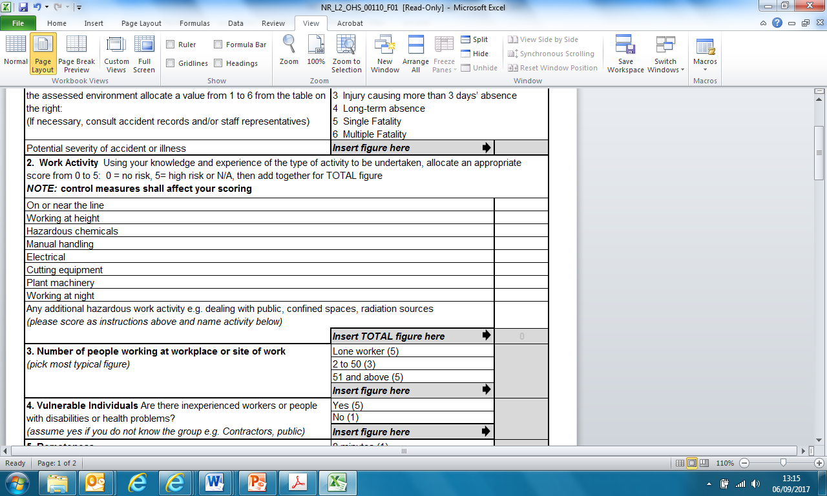
What are the key updates?
Click play on the speaker icon on each slide to hear audio
Additional guidance for assessing the work activity; section 2:
In the context of first aid, this risk assessment focuses on the consequences (potential severity) of an injury or illness.
Therefore, select an appropriate score of 0 - 5 after a consideration of current control measures in place.
Use N/A for not applicable to activity or workplace
Use 0 for could be applicable to the activity, but not in this assessment
Please note; 0 and N/A do not affect the score, but can assist when reviewing this assessment.
Think not just of the specific heading, but of the risk arising with this type of activity. See examples below -
Electrical – To include working directly on electrical equipment, or in close proximity to the conductor rail.
Cutting equipment – To include welding/grinding activities, or rotating blades on strimmers/brush cutters.
Notes:
Here, you’ll find additional guidance on completing the work activity section of form F01.
Our first aid provision needs to be suitable for the potential severity of an injury or illness. The risk assessment has therefore been updated to focus more on the activity risk. This will then help to determine the first aid personnel and the equipment required.
The assessment requires no special training to complete, but the person completing the first aid risk assessment needs to know the people involved, understand the work activity undertaken and the environment.

Slide 9
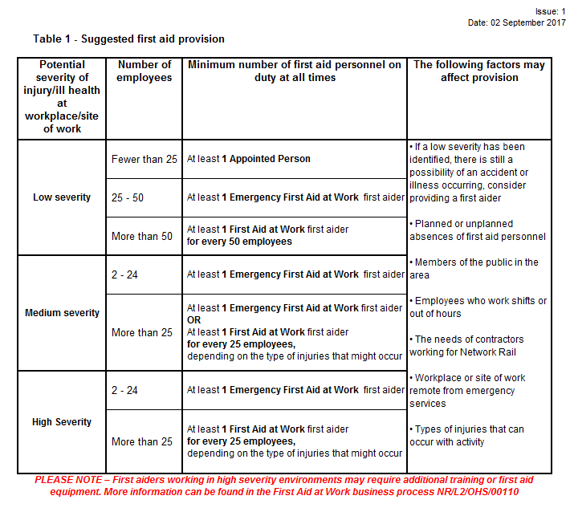
What are the key updates?
Click play on the speaker icon on each slide to hear audio
First aid provision
Table 1 in NR/L2/OHS/00110/F01 provides the suggested minimum level of first aid personnel required, based on the results of the first aid risk assessment.
When calculating the number of first aiders to be provided, take into account:
The needs of the public
The needs of contractors working for Network Rail
Cover for annual leave, absence, shift work etc.
As a minimum, each workplace or site of work shall have:
A person appointed to take charge of first aid arrangements
A suitably stocked first aid kit
Information for all employees on what to do in an emergency
There is no legal obligation for Network Rail to provide first aid to the public, though the Health and Safety Executive (HSE) recommends that the needs of the public are considered in the first aid provision at a place of work. Therefore, first aiders should be encouraged to administer first aid to members of the public, if it is safe to do so.
Notes:
This slide sets out the guidance on first aid provision.
The suggested minimum levels of first aid personnel in Table 1 of NR/L2/OHS/00110/F01, are based on the severity level identified by the first aid risk assessment, and applies to our employees.
The prompts in the table, and content in the standard, encourage additional considerations to be made. For example, to provide first aid provision for the public, and to have cover for planned and unplanned absence of first aiders. It is important for all employees to know what to do in the case of an emergency, so start having regular conversations on your first aid arrangements.

Slide 10
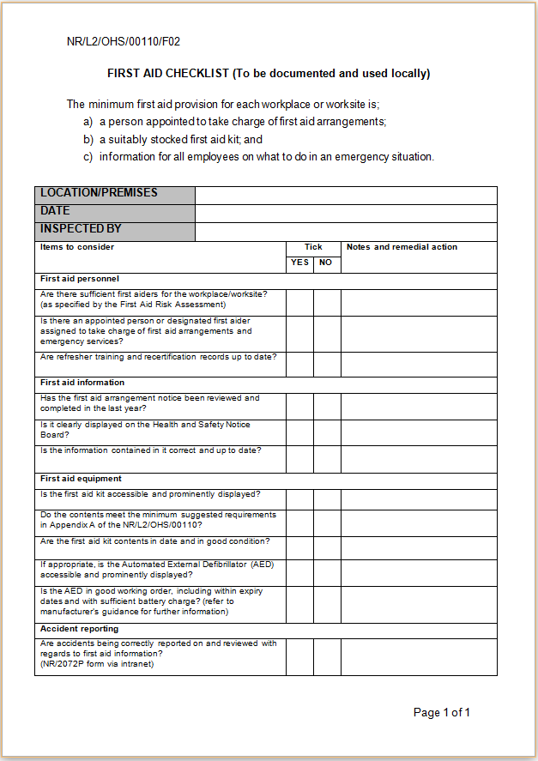
What are the key updates?
Click play on the speaker icon on each slide to hear audio
Provision of first aid equipment
The Responsible Person shall arrange for first aid equipment to be provided at all times when people are at work.
The Responsible Person shall appoint an Appointed Person or Designated First Aider to check first aid equipment, restock items missing and document the checks locally using the first aid checklist in form NR/L2/OHS/00110/F02:
Every four weeks; or
For low risk environments locations, up to every three months
Requirements and guidance on approved first aid equipment, including personal issue first aid kits, can be found in Appendix A of the standard. Table A.2 in Appendix A contains guidance on the additional items which could be included in first aid kits depending on the work activity and possible injuries.
Face shields, disposable gloves and other first aid kit items can be purchased via our Office Supplies online catalogue on Oracle.
The standard also contains information and guidance on the installation, use and maintenance of Automated External Defibrillators (AEDS).
Notes:
The standard continues to provide requirements and guidance on first aid equipment, and the process of checking that equipment is maintained in a state of readiness, along with the provision and contents of first aid rooms.
The first aid checklist has been updated to incorporate the checking of Automated External Defibrillators (AEDs) where they are installed.
Following updated guidance from the European Resuscitation Council; additional kit items, such as haemostatic dressings and tourniquets are now recommended as items which could be appropriate for first aid kits, where the risk of a catastrophic bleed is identified. However, they do require additional training. Please refer to the First Aid page on Safety Central for information on arranging additional training.

Slide 11
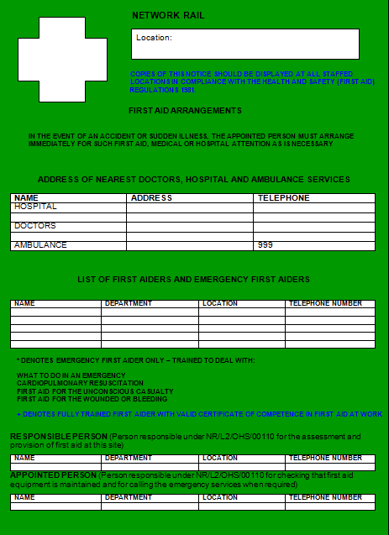
What are the key updates?
Click play on the speaker icon on each slide to hear audio
Briefing first aid arrangements and signage
The Responsible Person shall be accountable for informing employees of arrangements for first aid provision in the workplace.
This can be carried out at inductions, briefings and through health and safety notice boards.
Where the workplace is on or near the line, or a construction site, or not in a permanent location, the Person in Charge or Responsible Person should brief employees before the start of every job on:
Who their First Aider or Appointed Person is
The location of first aid equipment
The medical emergency procedure
The Responsible Person shall make arrangements for the names and contact details of first aiders to be displayed throughout workplaces on Health and Safety notice boards. The Responsible Person shall review every three months and update as arrangements change.
Notes:
It is a requirement as an employer to inform employees on what to do in the case of an emergency, and there are various ways that this can be communicated.
The first aid arrangements template/poster can be found on Safety Central. The link is included at the end of the briefing.
First aiders should also be easily identifiable, for example wearing a first aid armband, lanyard, badge, vest, or similar means of suitable identification.

Slide 12
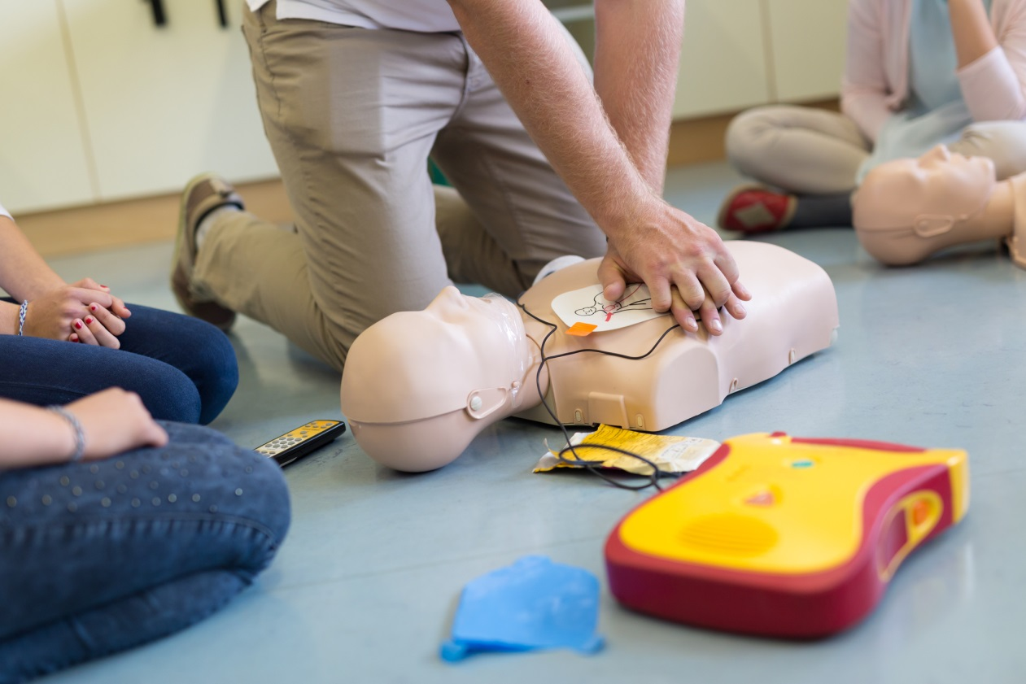
What are the key updates?
Click play on the speaker icon on each slide to hear audio
First aid training and competence
To qualify as a first aider, an individual shall successfully complete a first aid course provided by an organisation whose training and qualifications are approved by Network Rail.
A first aider competence lasts for three years.
To maintain the competence, the First Aider shall undergo requalification training before the expiry date of the competence.
All first aiders are advised to maintain competence in basic life support skills and to practice other first aid skills in between requalification.
First aid training should be arranged through Oracle from a Network Rail approved training provider.
Notes:
The training toolkit provides the competence level and courses required for complying with the First Aid at Work standard.
Please see Safety Central for support material to keep first aider knowledge and skills up to date in between recertification, and also how to arrange any additional training which may be required at your workplace.

Slide 13
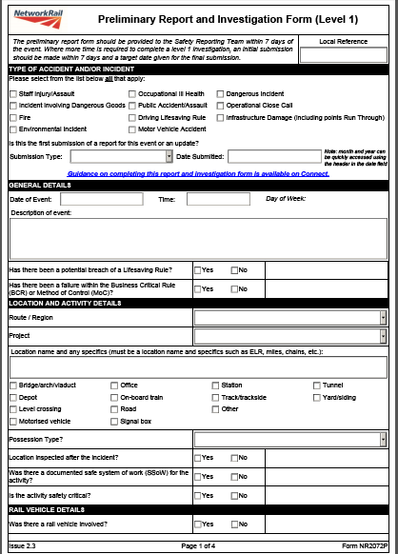
What are the key updates?
Click play on the speaker icon on each slide to hear audio
Post incident process
Communication should be made with the emergency services following any incident involving them, to identify any lessons learnt and improve their knowledge and understanding of the railway network and specific hazards.
The preliminary investigation report (form NR2072P on Connect) should be used for all accident reporting, and should be completed as soon as is practicable following an incident.
Following an incident, first aiders should be given opportunity to discuss the incident and the treatment provided.
See NR/L2/OHS/052 Traumatic Incident Management for information on supporting first aiders following their involvement in a potentially traumatic incident.
Notes:
There is now increased guidance on the post incident process within the standard, which includes first aider support and reporting requirements.
You can find the link to a Coping with Trauma page on Safety Central.

Slide 14

How is compliance measured?
Click play on the speaker icon on each slide to hear audio
Audit and compliance measures
The functional Audit Programme requires that a sample check is made on:
First aid risk assessments
The level of first aid provision
First aid risk assessment reviews
First aid equipment condition and storage
The annual line manager’s self-assurance questionnaire refers to first aid arrangements and the appointment of first aiders.
If requested, Responsible Persons should be able to provide samples of the completed first aid risk assessment NR/L2/OHS/00110/F01 and completed first aid checklist NR/L2/OHS/00110/F02 to demonstrate that the updated First Aid at Work standard is being followed.
Notes:
The audit and RIDDOR review process section has been updated. This is to result in the review and identification of where any changes are required to first aid provision or training, as part of a continuous improvement cycle.

Slide 15
Further Support
Click play on the speaker icon on each slide to hear audio
Safety Central
https://safety.networkrail.co.uk/healthandwellbeing/supporting-wellbeing-at-work/first-aid/
First aid page containing:
This standard update briefing
Signposting for further support
First aid arrangements poster template
Reference material for first aiders to refresh knowledge
Information for arranging additional workplace training
Network Rail Standards and Controls
http://networkrailstandards/index.aspx
NR/L2/OHS/00110 First Aid at Work standard
NR/L2/OHS/00110/F01 First Aid Risk Assessment
NR/L2/OHS/00110/F02 First Aid Checklist
Notes:
And finally, here are the links to where further information can be found to support First Aid at Work.
Thank you very much for taking the time to listen and take part in this briefing.

