Slide 2

Our Vision: The rail industry volunteering one million hours to help support people who are struggling to cope.
Our Mission: Over the next five years the rail industry
is coming together to volunteer one million hours to help Samaritans achieve their vision that fewer people die by suicide. The Million Hour Challenge will help Samaritans be there for even more people who are struggling to cope and also aims to improve the mental health and wellbeing of rail industry employees.

Slide 4
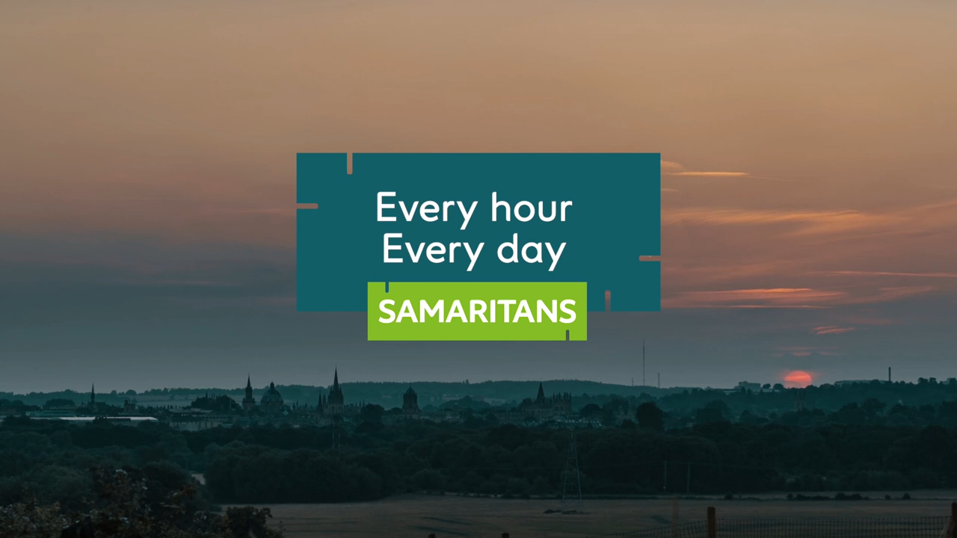

Slide 5


Ian Prosser is the HM Chief Inspector of Railways and Director,
Railway Safety and sponsor of Million Hour Challenge.
We can build on the success of the partnership between the
rail industry and the Samaritans further through the Million Hour Challenge which will encourage volunteering from across the
whole sector.
This will not only help the Samaritans as they seek to cope with increased demand for their vital services but will also be beneficial for the mental health of all of us in the sector who volunteer our time, not least by encouraging us to talk with each other, and the wider community,
about the issues involved.

Slide 6
15.4m
million working days were
lost to work-related stress in
2017/18, compared with 12.5
million the previous year
1.6
the rate of suicide is 1.6 times
higher in the rail and construction
sectors than the UK average
among professions
£316m
the economic cost of mental
health related sickness
absence in rail
95%
of frontline employees have
experienced workplace abuse
3 out of 5
people have experienced mental
health issues due to work. But just
one in ten tell their manager
44%
of employers are seeing an
increase in reported mental
health problems
12.6%
of all sickness absence days
in the UK can be attributed
to mental health conditions

Slide 7
Supporting the MHC doesn’t just benefit others, it benefits you too.
People who volunteer through work are happier, healthier and likely
to be more engaged with their employer.
Gain skills and experiences that will help in life and in your career
Meet and socialise with like-minded people
Improve your own health and wellbeing
Increase your self confidence
Volunteering combats depression and makes you happier
Feel a sense of achievement and purpose from giving something
back to society and making a positive difference in people’s lives

Slide 8
Get involved
The challenge provides a range of ways to get involved.
You can do as much or as little as you like.
Online training – The toolkit is an interactive set of videos and online
resources created to help you understand the power of asking someone
if they’re ok.
Guiding you to start a conversation
Helping you recognise the signs and signals of distress
Giving tips on looking after your own wellbeing
93% say it helped them to recognise emotional distress in others.

Slide 9
Samaritans Branch support
You can use your skills and knowledge in areas such as IT, marketing
or finance. The Samaritans branches are always looking for volunteers
who know how to run things efficiently. Your skills can help a branch
streamline processes, plan rotas or manage the budget.
Team volunteering
Samaritans branches are often in need of team support, to hand out
leaflets at a local station, paint offices or raise awareness in the local
community. Planning a fundraising event is also a great way to work
together as a team whilst raising crucial funds.

Slide 10
Local ambassadors
Become a local ambassadors in your organisation and lead the way. Engage your
colleagues in the challenge or arrange regular morning teas to raise awareness of
mental health and wellbeing within your organisation.
Social media champions
Raising awareness online is a key channel to reach out to the industry and promote the challenge. Becoming a social media champion is a simple but effective way to support Samaritans and the Million Hour Challenge.
Local branch champion
Become your local branch champion by highlighting and promoting opportunites within
your organisation, either via newsletters or in team meetings. Word of mouth is a simple
but powerful way to support the challenge and make a difference.

Slide 11

Listening volunteer
Every six seconds Samaritans receives a call from
someone in emotional distress.
Samaritans volunteers are the backbone of the charity.
There are 201 branches across the country run solely
by volunteers. They are available 24 hours a day, 7 days
a week, answering calls and emails from people who
need someone to talk to. Callers are experiencing a
range of difficulties and Samaritans listening volunteers
can offer a confidential, independent and non-judgemental support.

Slide 12
Herbie - Samaritans volunteer
One thing that I always take away
from a shift is the ‘feel-good factor’. Working
in an environment with positive people and occasionally being told that just being there
made all the difference to someone’s life is reward enough for me.

Slide 13
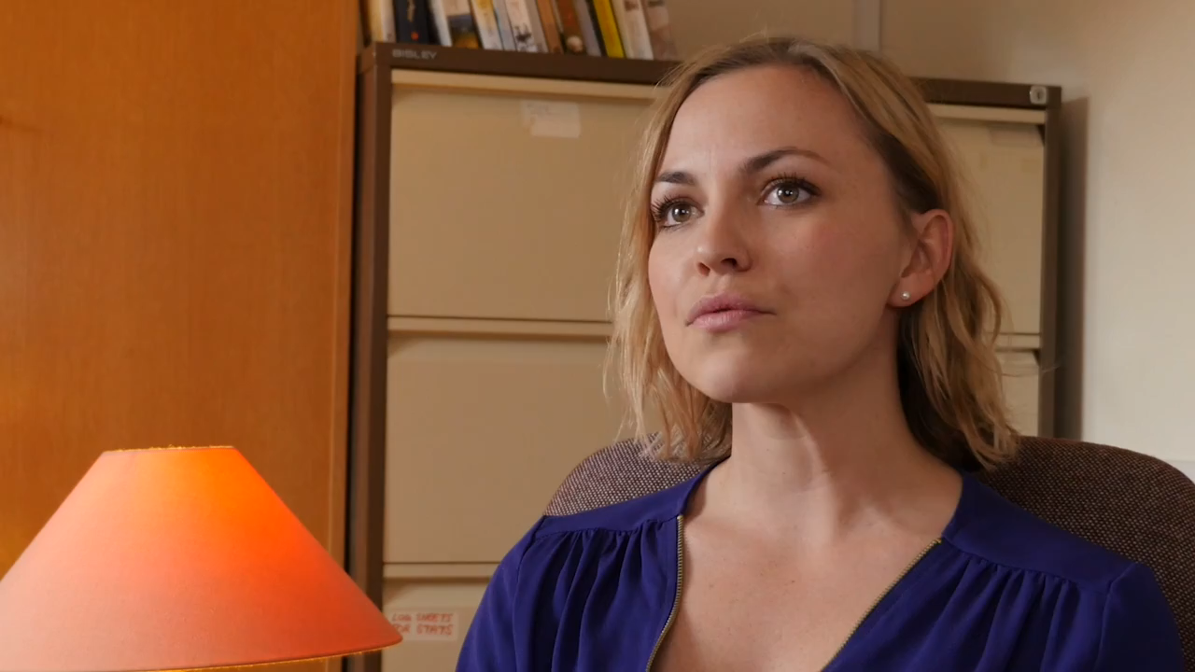

Slide 14
Sign up and start logging your hours – every hour counts
Register
Visit our website millionhourchallenge.com
to register and log your hours. Find out more
on how you can volunteer including opportunities
at your local branch and links to wellbeing toolkit,
fundraising ideas and more.

Slide 15
Corporate Volunteer leave
Why not use your corporate volunteer leave to support Samaritans.
Employees are entitled to up to five days paid volunteer leave per calendar year
Volunteer leave can be taken in slots of 0.25 days
Please book your volunteer leave on Oracle, or via the application form available on the volunteering page on MyConnect if you don’t have access to Oracle
Don’t forget to visit our website millionhourchallenge.com to register and log your hours.

Slide 16
Employee assistance
The Validium Employee Assistance Programme service is a valuable support for all Network Rail employees. This offers a 24/7 helpline for you to call about issues affecting you at home or in the workplace.
They are available 24 hours a day seven days a week on 0800 358 4858 or 0330 332 9980
Focus on mental health
Network Rail’s Mental Wellbeing toolkit and materials can be found on the Hub
https://ohw.hub.networkrail.co.uk/Pages/Mental-Wellbeing.aspx

Slide 17
"Our values, as chosen by you and our colleagues are to be caring, to work as a team, to be safe and to be empowered. All of these things are bound to ours and our colleague's mental health.
Caring for yourself and for each other, whether it's your physical or mental well-being means that we can be the best versions of ourselves".​
Andrew Haines, chief executive

