Slide 1
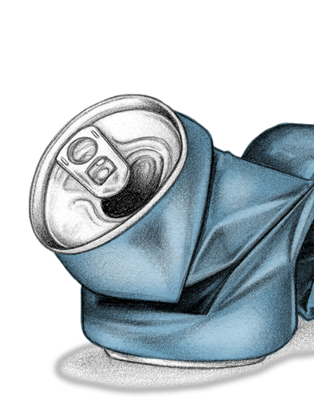
Let’s all be clear – guidance notes
Familiarise yourself with this team-talk toolkit to understand the changes to the Drugs & Alcohol standard (NR/L2/OHS/00120).
Go through the slides with your team at your next team meeting or safety briefing. The last slide has suggested questions for a group discussion, and prompts (if needed) in the ‘Notes’ section. Please leave time for this important safety conversation.
Share the ‘change on a page’ document with your teams
If you or any of your team are concerned about D&A misuse, please seek support from your line manager.
Contact your health and safety manager if you have any concerns or questions about the standard changes
Present from the next slide

Slide 2
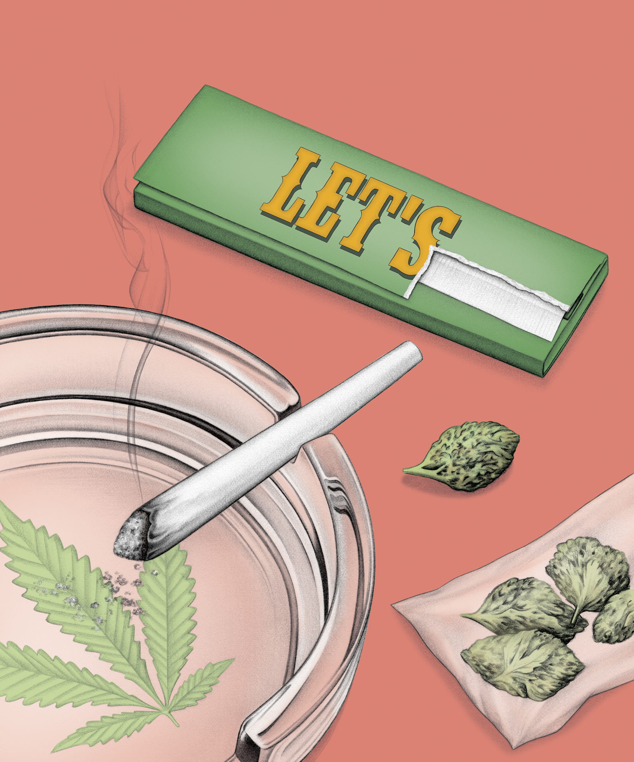

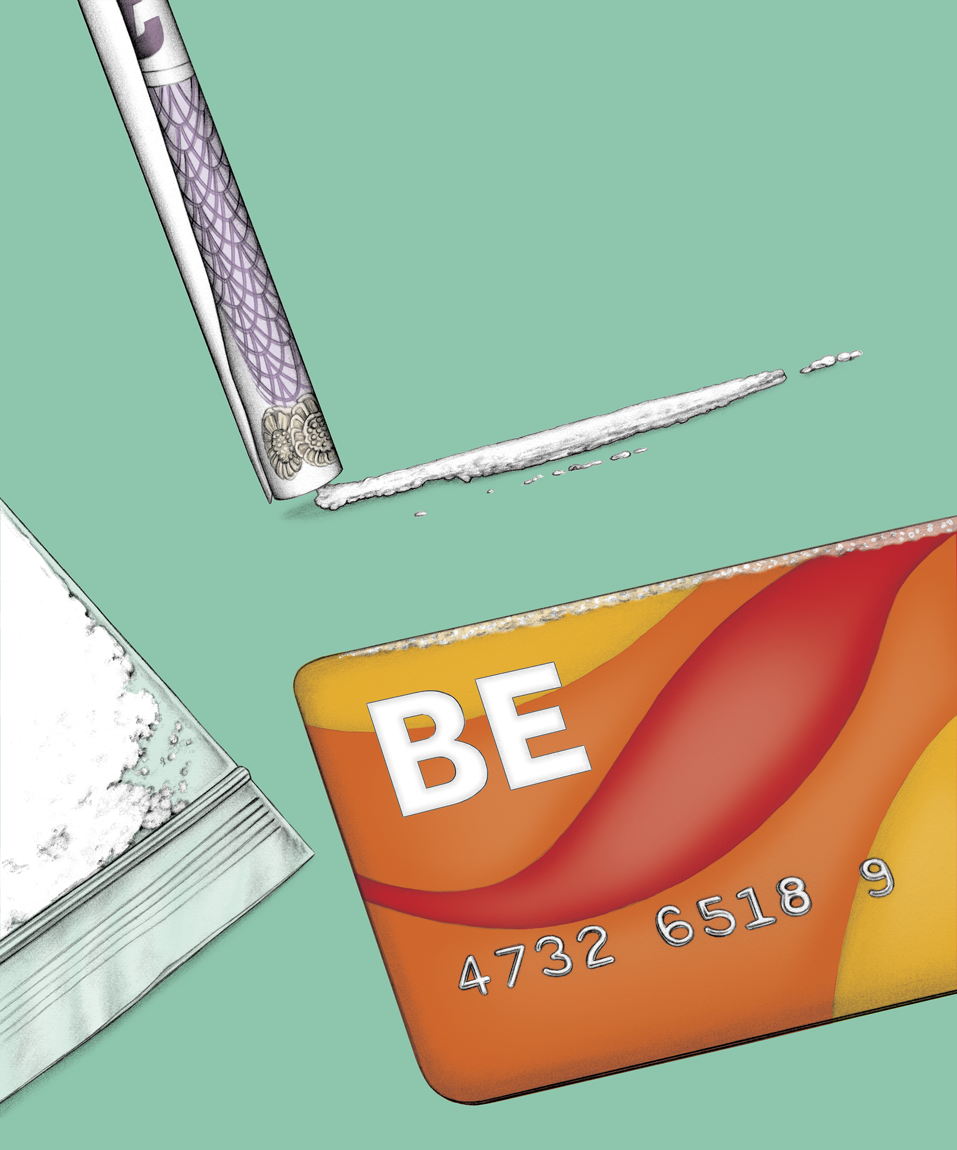
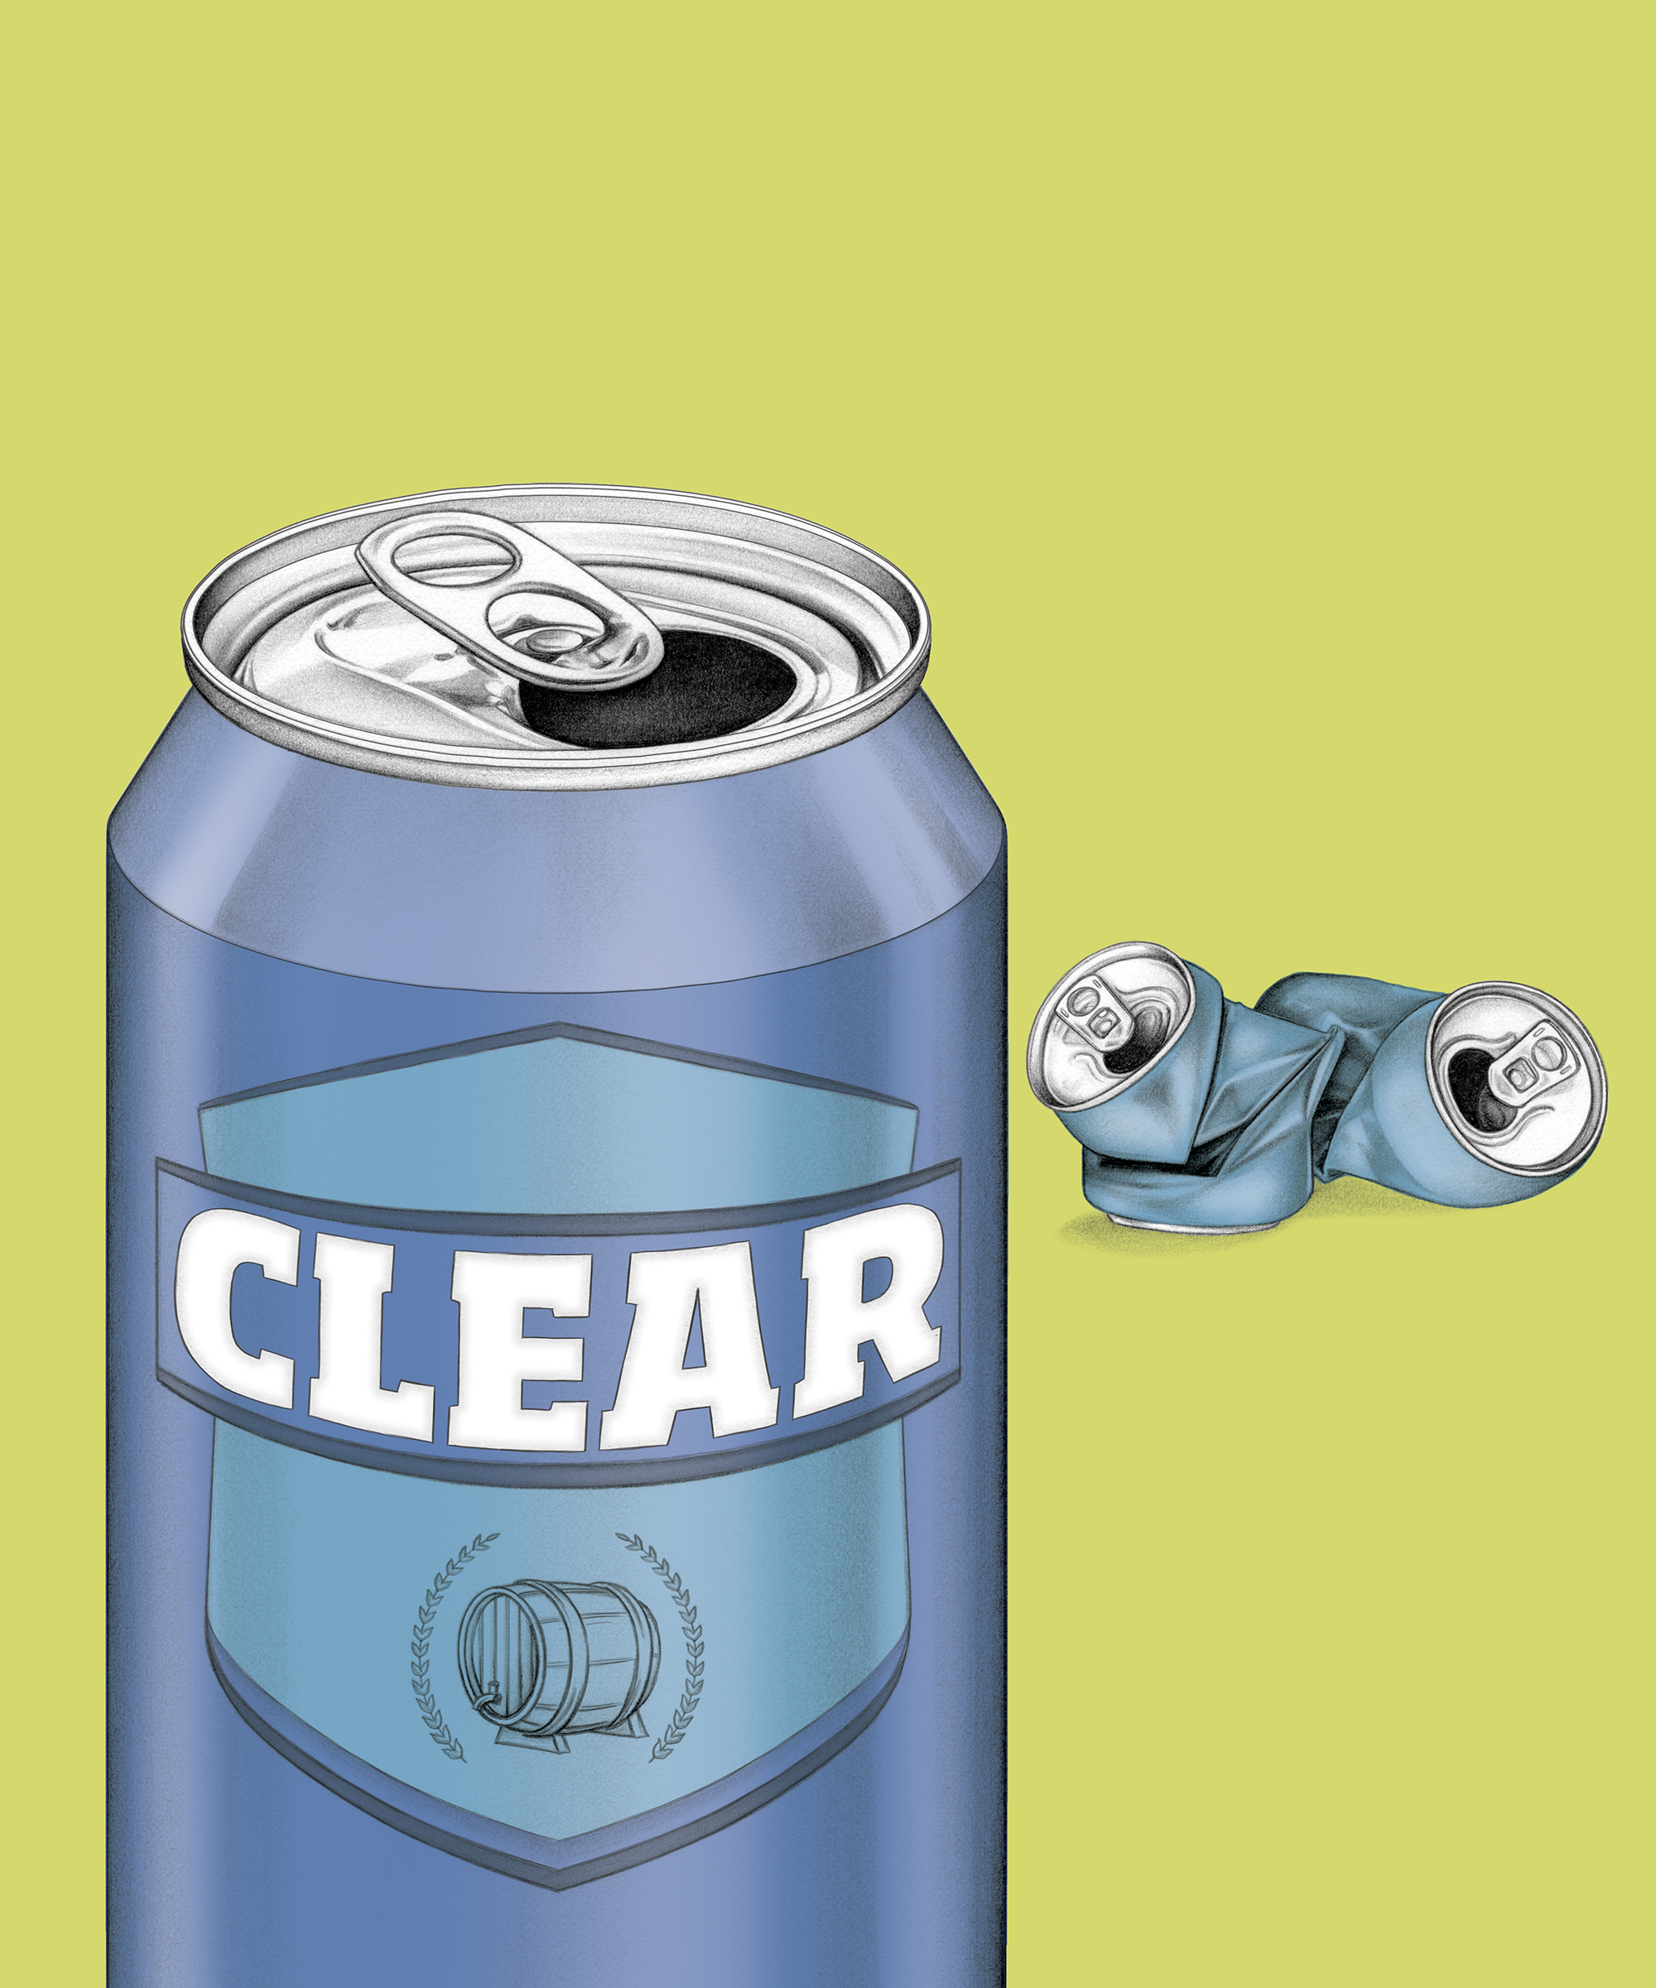
Drugs, Alcohol and Substance
Misuse in the Workplace
Our updated Drugs and Alcohol (D&A) Standard - what you need to know for the Network Rail Supply Chain
Let’s all be clear on our Drugs & Alcohol standard
Version 1.0

Slide 3
Contents
Network Rail’s lifesaving rules – a reminder
Role of D&A testing
Effects of D&A in our workplace
What’s changing and why?
Consequences of a positive test result
Let’s talk about being clear (discussion)
All drugs and alcohol testing records
will be securely stored on the Sentinel database and in line with GDPR.

Slide 4



Our lifesaving rules
Safe behaviour is a requirement of working for or on behalf of Network Rail
Our lifesaving rules are in place to keep us safe and must never be broken
Our lifesaving rules apply to everyone - including suppliers or contractors who work for and on behalf of Network Rail
Never work or drive while under
the influence of drugs or alcohol

Slide 5

How does D&A testing help this?
Testing protects the safety of our colleagues, contractors and passengers who work or travel on the railway
Helps to ensure our employees and contractors are safe and fit to work
Enables Network Rail to legally comply with Transport and Works Act 1992
However, since 2018 D&A failures have been increasing and across the Supply Chain failures are higher. It is clear we needed to change our testing processes to keep everyone safe.
Year | Network Rail | Supply Chain
2020/21 | 0.9% | 1.3%

Slide 6

What are the effects of drugs and alcohol?
At work
Increased accident risk
Unsafe to drive or operate machinery
Unable to carry out work safely
Put themselves, colleagues and passengers at risk
Poor attendance and time-keeping
Poor quality of work
Inability to follow instructions
To the individual*
Poor concentration
Irritable/aggressive
Anxious or stressed
Confusion
Poor decision making
Physical health issues (e.g. cancer, depression, anxiety, addiction)
Long term mental health conditions (e.g. depression, anxiety, addition)
*Effects on the individual will vary depending on their response to the type or quantity of D&A used. The observable changes may not always be linked to D&A use and could be linked to other factors affecting their health and wellbeing.

Slide 7
What is changing between 3 September 2022 and 3 March 2023?
What’s changing? | Reason
20% of all safety critical colleagues will be randomly selected for a D&A test each year (up from 5% of safety-critical colleagues) | To increase the likelihood of any colleague being randomly tested
Drugs tests can be conducted using Point of Contact Testing (POCT) or back to laboratory testing (BTL) | POCT may quickly identify employees who are safe and fit to continue working and those who could have a substance in their body (safety risk)
Ketamine and Tramadol have been added to the substance testing panel. Propoxyphene has been removed. | Ketamine and Tramadol can have psychoactive effects and have addictive properties. These two substances are trending in misuse.
All drugs and alcohol testing records
will be securely stored on the Sentinel database and in line with GDPR.

Slide 8
Consequences of breaching the D&A standard
The consequences for any colleague or prospective candidate who records
a positive D&A test result, including an employee who refuses to undergo
a test when required to do so, are:
Subject to disciplinary processes and procedures
(all colleagues)
Personal Track Safety (PTS) certificate and permission to work in a safety critical capacity on NR managed infrastructure revoked for five years (all employees)
Sentinel card (passport to work on the railway) cancelled for five years (all Sentinel card holders)
Job offer rescinded (prospective candidates for a Safety Critical role only)

Slide 9

Let’s talk about being clear (Discussion)
Why do colleagues take the risk?
How would you feel if you were tested and the result
was positive for drugs and/or alcohol? What impact would
it have on you?
Would you feel confident to declare a drugs or alcohol misuse issue, or if you were unsafe to attend work due to drugs or alcohol? If not, what would stop you? What would you do instead?
How would you feel about to raising a concern about a colleague you suspect is under the influence?
Notes:
1. Why do we think some colleagues take the risk of coming into work, even though they could have alcohol or drugs in their system?
(Prompts: can you always tell you have substances in your system, what impact could this have on you? Your colleagues? Our passengers?)
2. How would you feel if you were tested and the result was positive for drugs and/or alcohol? What impact would it have on you? (Prompts: Types of impact to talk through: physical, financial, mental health, personal reputation and pride etc. What words would you use to tell your family or team if you had lost your job? What, if anything, would you wish you had done differently?
3. Introduction to this question: ‘If you suspect you are under the influence of drugs or alcohol and are due to attend work, you should call in sick and not come to site.) Would you feel confident to tell your manager if there was a chance you were under the influence and won’t be attending work? If no, why not? Prompts: What could make you feel more confident? What can be done to break down any barriers that exist?
4. Question: How would you feel about raise concerns about a colleague you suspect is under the influence? Prompts: we have a duty of care for one another to look out for our safety. What could make us more comfortable? What could be the impact of not speaking up? How would you feel if you didn’t make the call and an incident occurred?

