Slide 1

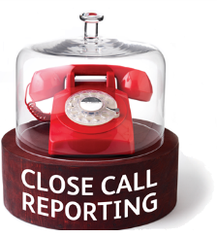
Better Close Calls for a safer Network
Good Call

Slide 2
Good Calls for a safer network
Changing behaviours
116,811
Close
Calls
Reported
One 24/7 Call Centre
Reducing Risk<<<
56% closed in 28 days
22K colleagues using the App
2000 Responsible Managers
Safer ways of working

Slide 3
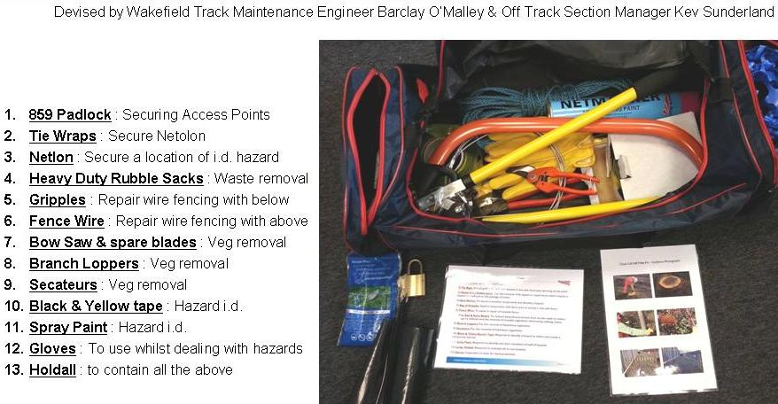
Reducing future risk

Slide 4
Close Call definitions
Close Calls - Anything that has the potential to cause harm or damage to a person, the environment, or railway infrastructure, plant, vehicles, tools and equipment - this time no-one was hurt and nothing was damaged, but next time the outcome could be different.
Faults – a fault on the railway infrastructure that that could cause immediate harm or damage
Irregular working/Operational Close Calls – an unsafe behaviour or condition that that poses an immediate threat to the safe operation of the railway which if left unresolved may directly affect the safe operation of the railway and therefore requires immediate action

Slide 5
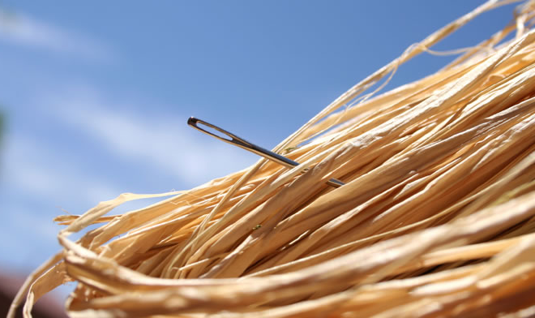
What makes a bad call?
Loose screw at Reading Station

Slide 6



Good Call: Physical
Problem
Cause
Impact
Solution
Action
Owner
Location
Geographic
Detailed
ELR Mileage Chains
Up or Down
Type
Speed sign obscured by foliage
Cut down excess foliage
100 yards
from Signal Box
toward
lights
Speed restriction unclear unsafe line
Request Route Team

Slide 7
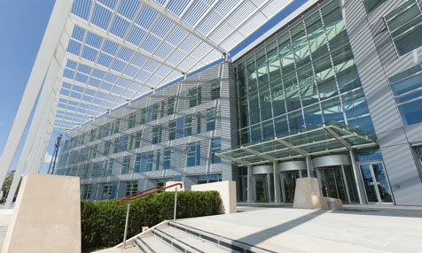
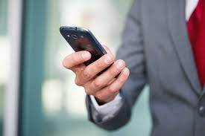
Good Call: Behavioural
Problem
Cause
Impact
Solution
Action
Owner
Location
Geographic
Detailed
The
Quadrant: MK
Elder Gate, Milton Keynes MK9 1EN
Colleague texting whilst walking down stairs
Reminded colleague of safe working
Furzton
Floor 2
Stairwell by main lifts
Trip Hazard
Closed by reporter

Slide 8

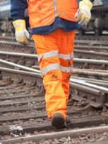

Who to call first?
I
Immediate
Danger
Threat to safety
of the line
Near miss or unsafe working
Potential
for harm
Report
to
Signaller
Report
To
Route Control
Report Close Call
Then
Report
the Close Call
Then
Report
the Close Call

Slide 9
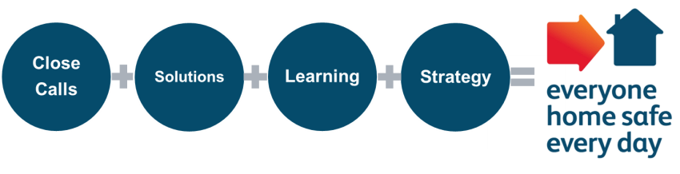
Close Call process
Close Call Reporter
Spot risk
Close Call Reporter
Raise a Close Call:
App - Phone Email
Closes at source if possible
Responsible Manager
Review Close Call
Facilitate Solution
Escalate if needed
Responsible Manager
Record action taken
Close the Close Call
System provides feedback to Reporter
Close Call Reporter
Receives Feedback
Text
Close Call Closed
Local Teams
Safety Briefings
Develop action plans based on trends & behaviours to reduce future risk
Chief Health & Safety Officer and National Safety Council
Insight used to shape safety policy, design or strategy
NSC Call Centre
Review information
Risk Rank & Categorise
Assign Close Call to RM
TU Safety Reps
Area Safety Council Learning used to shape area safety plans to reduce future risk

Slide 10

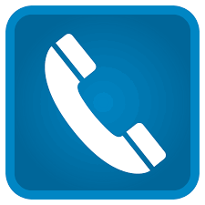

Make a Good Call
App
Phone
Email
NR
app catalogue
01908
723500
Closecall reporting
@network rail.co.uk
Add 01908 723500 to your mobile contacts

Slide 11
Reducing future risk
First things first: Is there immediate danger trackside? | Yes: Call it in to Signaller first (or Route Control) …then report the Close Call No: Go ahead and report the Close Call
Your full name
Your email address
Your mobile number (for feedback)
Location information Help someone pinpoint the exact location | Trackside: ELR, mileage, chains. Line/track ID. Bridge Number. Station. Crossing.
 | Non Trackside: Property name, address, postcode, floor, room number, desk area.
Detailed location information | Add more information so someone could find the EXACT location once they are in the right location
Detailed situation description | Describe what is wrong? Describe what could happen as a result?
Have you resolved the Close Call? | Yes or No
What action is required? What action have you taken (if any) | Describe what action is needed to remove the risk Describe what action you have taken to remove the risk
Who should resolve the Close Call? | Suggest who you think is responsible for resolution. Function, team, manager or individual.
Have Network Rail Route Control been informed? | Yes or No
Do you want feedback? | Yes or No Feedback sent via text to mobile number you provide

Slide 12
Your Call

