Slide 1
Safety Critical Communications
MODULE: FOUNDATION

Slide 2
Briefer’s Introduction:
Welcome to the Foundation module for rail industry communications.
This module introduces key concepts for successful communications in the rail industry:
The importance of communication
Understanding what Safety Critical Communications is
The Contract-Communications concept
Personal responsibility
Safety and performance pressure

Slide 3
How the Course Works:
The programme consists of six modules. We recommend that they are delivered in order, but you may select a particular module if required:
Foundation
Protocols 1
Structure and Lead Responsibility
Protocols 2
Confirming Understanding
Communication Skills
*Please read the Briefing Notes prior to delivering a module. They provide background information to enable you to manage the exercises and discussions.
*You will also be required to perform a short assessment at the end of the course to make sure attendees understand the content. See the Briefing Notes.

Slide 4


Welcome

Slide 5


Safety Critical Communications
VO

Slide 6
Yeah – we all know the Phonetic Alphabet…

Slide 7

1 in 5
accidents involves a communication error.
VO

Slide 8
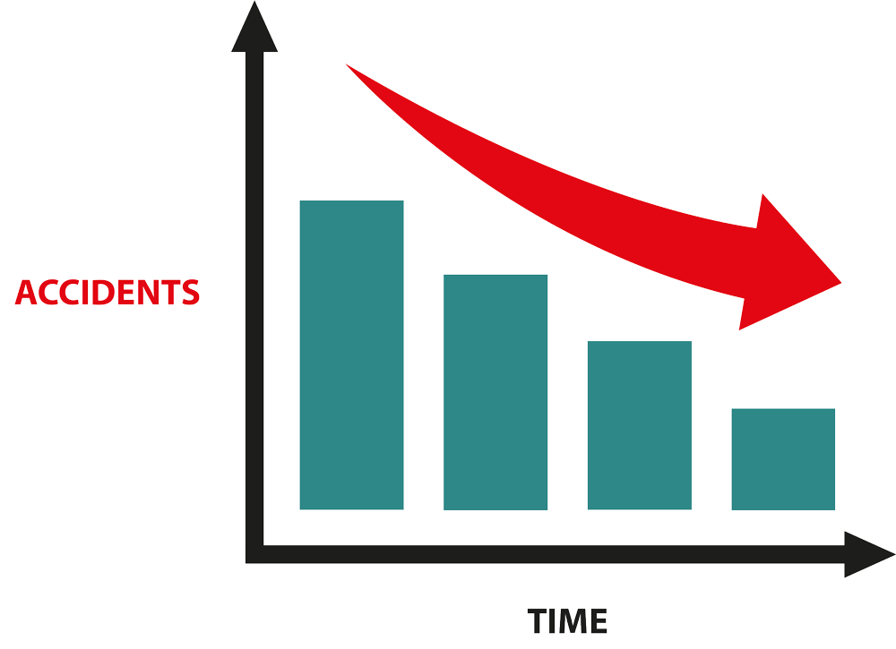
VO

Slide 9




Errors include:
Not communicating when you should
Leaving out important details
Saying something vague
Not following basic protocols
…VO

Slide 10

Analysis done as part of this training shows that communications mistakes occur across the rail industry and are not the fault of one group of workers.
VO…

Slide 11

What to do?

Slide 12

a = alpha, b = bravo, c = charlie…
VO

Slide 13
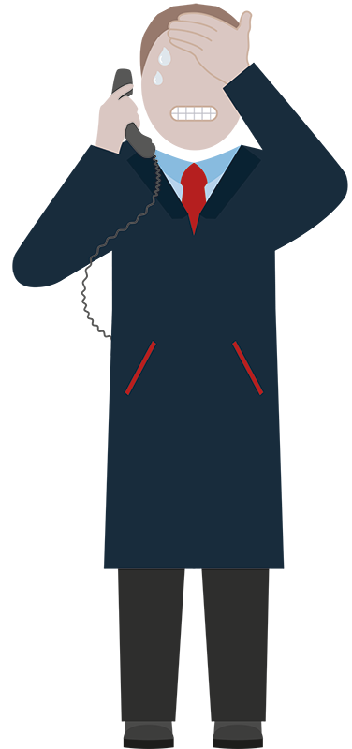
“repeat back… repeat back… repeat back…”
VO

Slide 14
VO

Slide 15
01
Understand what safety critical communications is
02
Learn and use the agreed protocols
03
Structure our conversations correctly
04
Improve our thinking and people skills
05
Stay on the case – refreshing our knowledge and honing our skills
VO

Slide 16

National
MINIMUM
Standard
VO

Slide 17
Your briefer will deliver a short test at the end of this module.
VO…VO

Slide 18

What is Safety Critical Communication?

Slide 19


WHAT IS
Safety Critical Communication?
…VO

Slide 20

All operational communication by front line staff is safety critical.
VO

Slide 21

By operational and front line we mean:
Maintenance
TOC & Network Rail Control
Signalling
Station Operations
Driving
Shunting
By ‘operations’ we mean anything relating to train movement, signals, track, stations, infrastructure…
…VO

Slide 22



Communication can take place in a number of ways
Written
Visual
Verbal
In this course we’re focusing on verbal communications, many of which take place over the telephone.

Slide 23
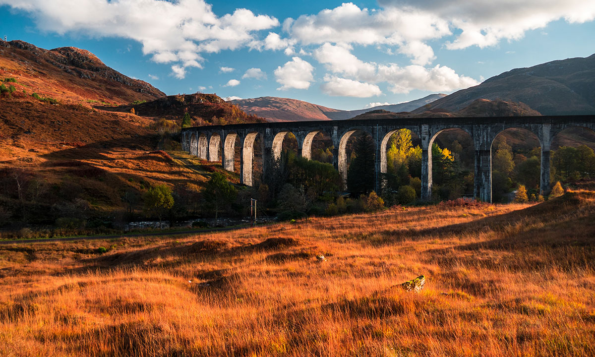
Shunter Example

Slide 24
A safety-critical communication?
VO

Slide 25
Conversation takes place face-to-face in a large freight yard.

Slide 26
YARD SUPERVISOR:
MORNING. GOOD JOURNEY IN?
SHUNTER:
NAH. TRAFFIC UP AT FAWSLEY AGAIN. GONNA NEED TRY TO FIND A DIFFERENT ROUTE.
YARD SUPERVISOR:
YEAH. ME TOO. DIRE.
SHUNTER:
WHAT’S UP FIRST THEN. THE USUAL?
YARD SUPERVISOR:
YEP. HE’S COMMIN’ IN LATE THOUGH. HOLD HIM IN FIVE SO THAT WE CAN BRING THE BALLAST TRAIN IN.
SHUNTER:
SURE, BUT I THINK IT’LL TAKE MORE THAN FIVE MINUTES FOR THAT BALLAST TO COME PAST.
YARD SUPERVISOR:
NO, YOU PLONKER. HOLD HIM ON FIVE ROAD, WHILE WE GET THE BALLAST TRAIN INTO THREE ROAD AND THEN MOVE HIM DOWN. YEAH?
SHUNTER:
OH, RIGHT. YEAH.
VO

Slide 27
Shunter Example - Analysis
VO

Slide 28
smalltalk to WORK TALK
VO

Slide 29

Information poorly given
Information misunderstood
Actions imprecise
VO

Slide 30
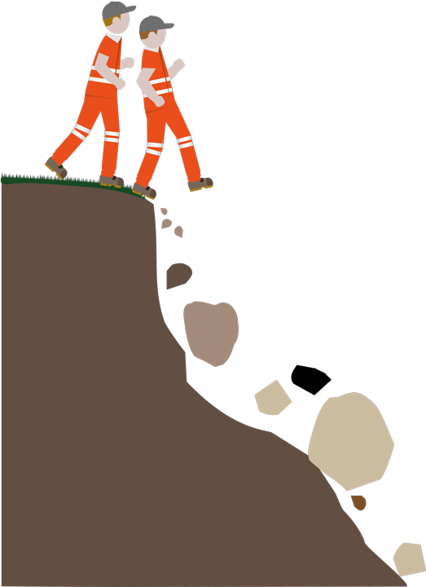
VO

Slide 31
Recognise when safety critical communication is happening.
VO

Slide 32

All operational communication by front line staff is safety critical.
VO…VO

Slide 33


Optional Exercise:
Re-script the shunter’s conversation to manage the change from casual to safety critical.
Here’s our model answer:

Slide 34

Contract Communications
VO

Slide 35

Agreeing a
CONTRACT

Slide 36



For example:
Car Loan
Flat Rental
Employment Contracts
VO…

Slide 37
Identify the parties involved
Provide information about the situation
Agree the actions to be taken
Confirm our agreement
VO

Slide 38
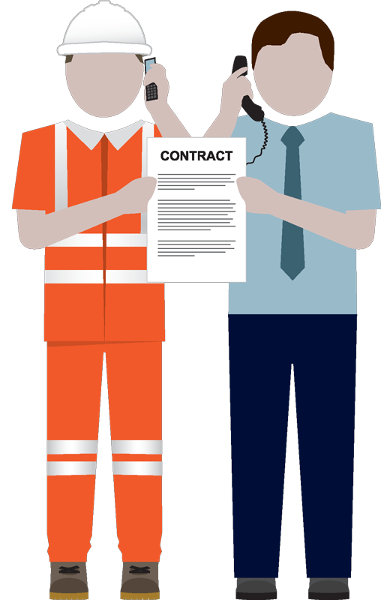
VO

Slide 39
Contract Communications

Slide 40
Play the recording and answer the questions
(next page)

Slide 41

Why might the signaller be so poor with his communication?
Did the driver agree the contract?
What should the driver have done?

Slide 42
Contract Communications
VO

Slide 43
Every time we hold an operational conversation, we are agreeing a verbal contract
(even if the contract is unclear and dangerous!)
we need to keep our contracts tight.
VO

Slide 44
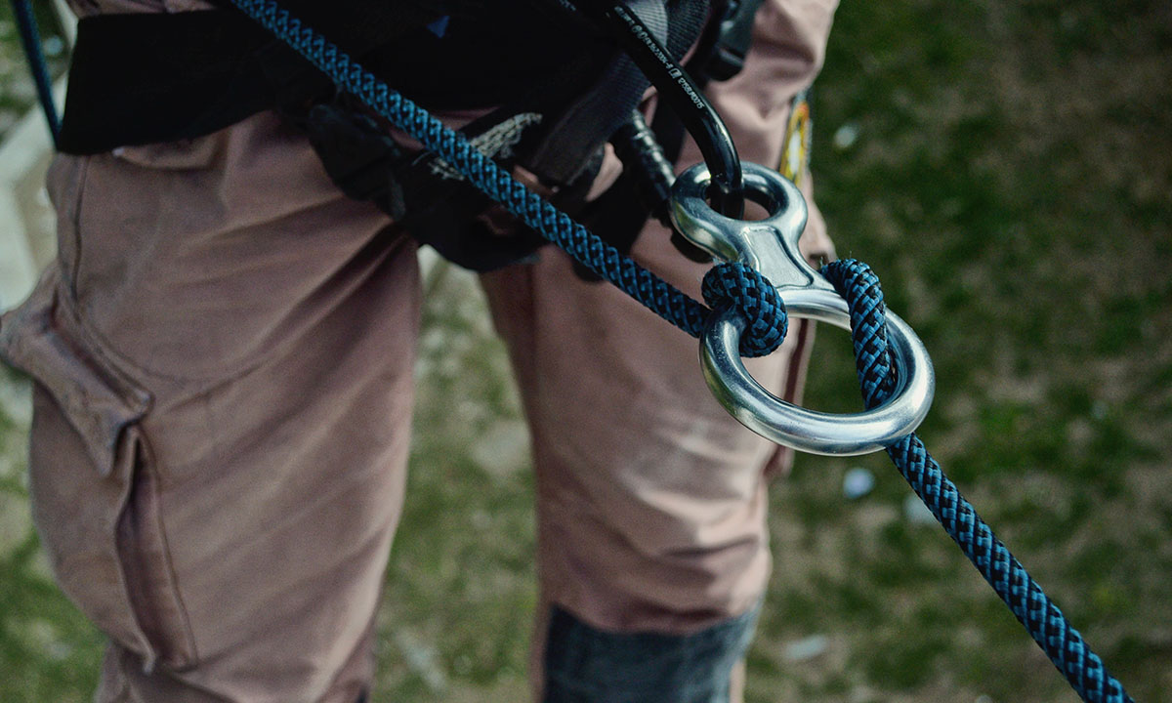
Responsibility
VO

Slide 45
Where does the responsibility lie?

Slide 46

Personal Responsibility

Slide 47
Lead Responsibility?
VO

Slide 48
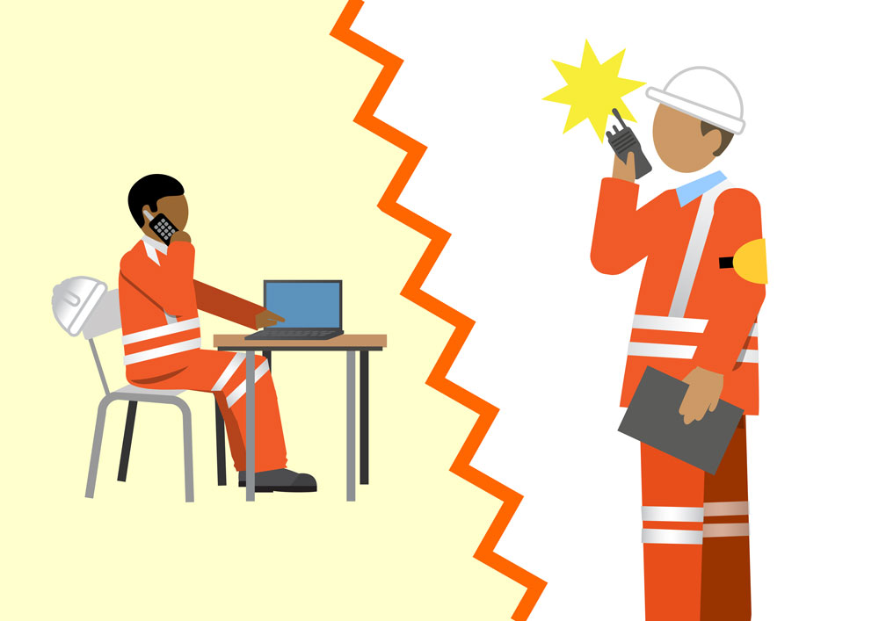
Don’t worry if you are unfamiliar with PICOP and ES. They are simply example trackworker roles.
VO…

Slide 49

VO

Slide 50

Personal Responsibility
VO

Slide 51
Rail Industry Professionals
Note, module 3 of the course is Structure and Lead Responsibility
VO…

Slide 52

Responsibility and Professionalism
VO

Slide 53

VO…

Slide 54
Use the protocols
Structure our conversations
Listen correctly
Confirm understanding
These are covered in
These are covered in detail in later modules
VO…

Slide 55

“… and this is the third time this week it’s happened. Ridiculous. Why doesn’t someone do something? It’s making all our lives a misery…”
…VO

Slide 56
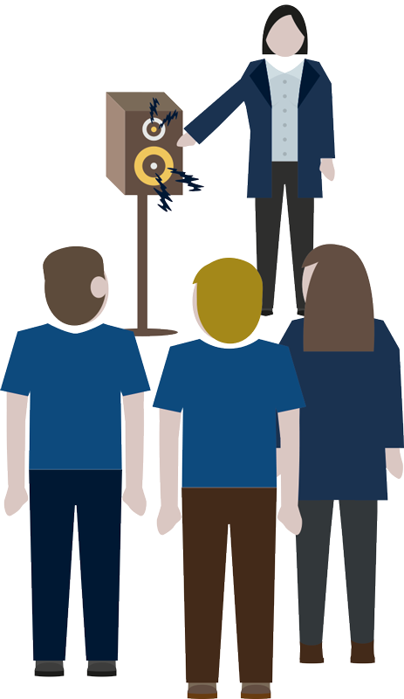
VO…

Slide 57
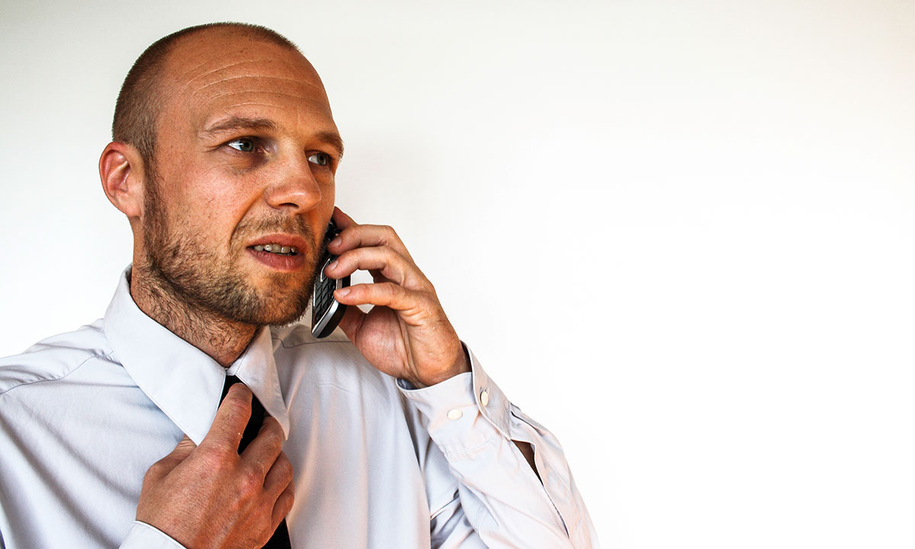
Challenging Poor Communications
VO

Slide 58
Play the recording and answer the questions (next page).

Slide 59
What should the driver have done?
What does he need to be careful of?

Slide 60
Personal Responsibility
VO

Slide 61
As professionals, we must all take responsibility for safety critical communications.
VO

Slide 62
Safety is the Priority
VO

Slide 63
Safety always takes priority over operational performance.
VO

Slide 64
“OK, me again. Granting you a blockage now, as we did last time. Need it back in twenty.”
VO

Slide 65
“OK, me again. Granting you a blockage now, as we did last time. Need it back in twenty.”
What should the above communication look like?
Why would standards slip like this?
Hint: this isn’t the first time the Signaller has made this call.
VO

Slide 66

Safety Under Pressure
VO

Slide 67




In pressure situations:
Think about what we need to say
Speak slowly and clearly
Use the protocols
Confirm understanding
VO

Slide 68
We must take time to communicate well – no matter what the situation.
VO

Slide 69

Module Review
VO

Slide 70
Recognise when safety critical communication is happening (all operational communication by front line staff is safety critical).
1
2
Every time we hold an operational conversation, we are agreeing a contract.
3
As professionals, we must all take responsibility for safety critical communications.
4
We must take time to communicate well – no matter what the situation.
VO

Slide 71

Module Conclusion
VO

Slide 72
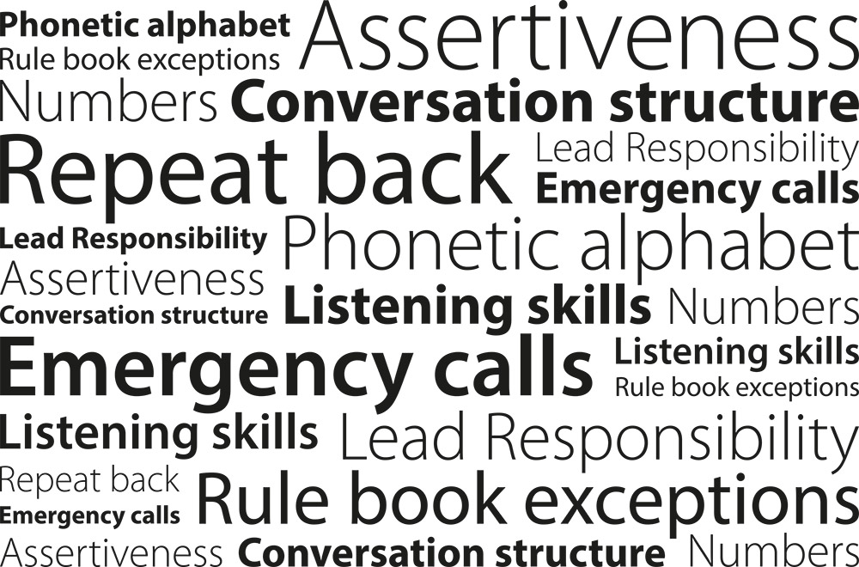
VO

Slide 73

Every time we hold an operational conversation, we are agreeing a contract
- keep the contract tight
Your briefer will now conduct a short test to confirm understanding.
VO

