Slide 1
Let’s all be clear – guidance notes
Familiarise yourself with this team-talk toolkit to understand the changes to the Drugs & Alcohol standard.
Go through the slides with your team at your next team meeting or safety briefing. The last slide has suggested questions for a group discussion, and prompts (if needed) in the ‘Notes’ section. Please leave time for this important safety conversation.
Share the online briefing schedule with your team – ask colleagues absent from the briefing to attend.
Need further information or guidance? Go to this page - more materials will be added over the next few weeks. You can also view the updated D&A standard.
If you or any of your team are concerned about D&A misuse, please seek support – managers or PAM Assist can help. Speak Out is also available.
Contact healthandwellness@networkrail.co.uk if you have any concerns or questions – or to tell us how your session went!
Present from the next slide

Slide 2
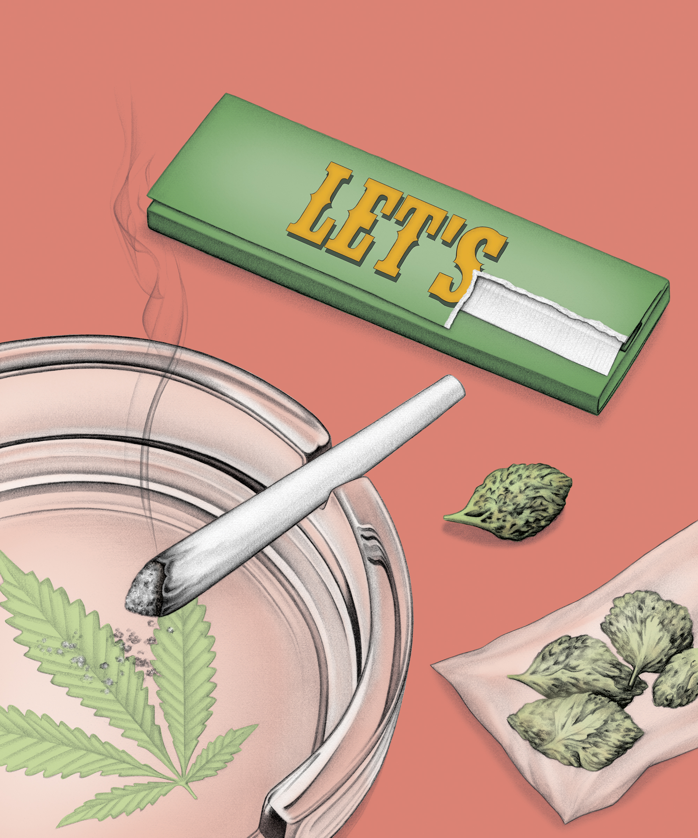
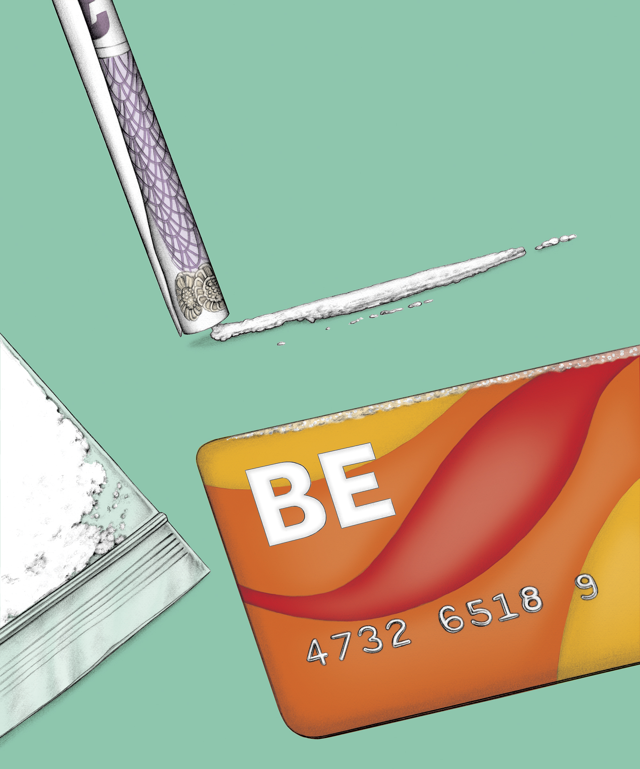
Drugs, Alcohol and Substance Misuse in the Workplace Our updated Drugs and Alcohol (D&A) Standard - what you need to know
Let’s all be clear on our Drugs & Alcohol standard
Version 1.0

Slide 3
Contents
Our lifesaving rules – a reminder
Role of D&A testing
Effects of D&A in our workplace
What’s changing and why?
Consequences of a positive test result
Our D&A Support Programme (DASP)
Next steps
Let’s talk about being clear (discussion)
All drugs and alcohol testing records will be securely stored on the Sentinel database and in line with GDPR.

Slide 4
Our lifesaving rules
Safe behaviour is a requirement of working for Network Rail
Our lifesaving rules are in place to keep us safe and must never be broken
Our lifesaving rules apply to everyone - including suppliers or contractors who work for and on behalf of Network Rail
Never work or drive while under the influence of drugs or alcohol

Slide 5
How does D&A testing help this?
Testing protects the safety of our colleagues, contractors and passengers who work or travel on the railway – in line with our lifesaving rules
Helps to ensure our employees are safe and fit to work
Enables Network Rail to legally comply with Transport and Works Act 1992
However, since 2018 D&A failures have bene increasing annually and it’s clear we needed to change our testing processes to keep everyone safe.
Year | Failure Rate
2018/2019 | 0.5%
2019/2020 | 0.8%
2020/2021 | 0.9%

Slide 6
What are the effects of drugs and alcohol?
At work | To the individual*
Increased accident risk | Poor concentration
Unsafe to drive or operate machinery | Irritable/aggressive
Unable to carry out work safely | Anxious or stressed
Put themselves, colleagues and passengers at risk | Confusion
Poor attendance and time-keeping | Poor decision making
Poor quality of work | Physical health issues (e.g. cancer, depression, anxiety, addiction)
Inability to follow instructions | Long term mental health conditions (e.g. depression, anxiety, addition)
*Effects on the individual will vary depending on their response to the type or quantity of D&A used. The observable changes may not always be linked to D&A use and could be linked to other factors affecting their health and wellbeing.

Slide 7
What is changing between 3 September 2022 and 3 March 2023?
What’s changing? | Reason
All colleagues can be randomly selected for a D&A test whilst at a Network Rail workplace | To apply an equal and fair testing programme
20% of all colleagues will be randomly selected for a D&A test each year (before 5% of safety critical colleagues only) | To increase the likelihood of any colleague being randomly tested
All prospective candidates will undergo and pass a D&A test prior to joining Network Rail | To reduce the risk of Network Rail employing a candidate with a misuse issue
All drugs tests will be conducted using Point of Contact Testing (POCT) | To ensure colleagues who are safe and fit to continue working can do so. To identify colleagues who could have a substance in their body at a level which can be a safety risk
Improved the support programme for any colleague who has a D&A misuse concern | We care for our colleagues and want to provide support for D&A misuse where possible
All drugs and alcohol testing records will be securely stored on the Sentinel database and in line with GDPR.

Slide 8
Consequences of breaching the D&A standard
The consequences for any colleague or prospective candidate who records a positive D&A test result, including an employee who refuses to undergo a test when required to do so, are:
Subject to disciplinary processes and procedures (all colleagues)
Personal Track Safety (PTS) certificate and permission to work in a safety critical capacity on NR managed infrastructure revoked for five years (all employees)
Sentinel card (passport to work on the railway) cancelled for five years (all Sentinel card holders)
Job offer rescinded (prospective candidates only)

Slide 9
Our Drugs and Alcohol Support Programme (DASP)
Support is available to all colleagues with a drugs and/or alcohol misuse concern. It is important you disclose your concerns to your manager before you:
attend or start work on a normal working day
are contacted to undergo any type of D&A test
To be entitled to support, you must read and sign the ‘declaration of commitment’ form which outlines your responsibilities and the parameters of support available.
The support programme is determined and led by clinicians from Occupational Health and the Employee Assistance Programme.
Further details can be found with the ‘Drugs and Alcohol Support Programme’ guidance document.

Slide 10
Next steps
Familiarise yourself with the information you’ve seen today.
Need further information or guidance? Go to this page - more materials will be added over the next few weeks.
You can also attend an online briefing or view the updated D&A standard.
If you or any of your team (if you’re a line manager yourself) are concerned about D&A misuse, please seek support – managers or PAM Assist can help. The time to ask is now.
Speak Out is our confidential whistleblowing line – please use this if you need to make a report.
Contact healthandwellness@networkrail.co.uk if you have any questions or feedback.
Any questions?

Slide 11
Let’s talk about being clear (Discussion)
Why do colleagues take the risk?
How would you feel if you were tested and the result was positive for drugs and/or alcohol? What impact would it have on you?
Would you feel confident to declare a drugs or alcohol misuse issue, or if you were unsafe to attend work due to drugs or alcohol? If not, what would stop you? What would you do instead?
How would you feel about using 'speak out' to raise concerns about a colleague you suspect is under the influence?
Notes:
1. Why do we think some colleagues take the risk of coming into work, even though they could have alcohol or drugs in their system?
(Prompts: can you always tell you have substances in your system, what impact could this have on you? Your colleagues? Our passengers?)
2. How would you feel if you were tested and the result was positive for drugs and/or alcohol? What impact would it have on you? (Prompts: Types of impact to talk through: physical, financial, mental health, personal reputation and pride etc. What words would you use to tell your family or team if you had lost your job? What, if anything, would you wish you had done differently?
3. Introduction to this question: ‘If you suspect you are under the influence of drugs or alcohol and are due to attend work, you should call in sick and not come to site.) Would you feel confident to tell your manager if there was a chance you were under the influence and won’t be attending work? If no, why not? Would you be confident to tell me or make the call to PAM Assist, and if not, why not? Prompts: What could make you feel more confident? What can be done to break down any barriers that exist?
4. Introduction to Speak Out – Remember Speak Out is our confidential whistleblowing system/hotline, allowing all staff to raise concerns if they see or suspect any wrongdoing. It’s confidential and available 24/7. Question: How would you feel about using speak out to raise concerns about a colleague you suspect is under the influence? Prompts: we have a duty of care for one another to look out for our safety. What could make us more comfortable? What could be the impact of not speaking up? How would you feel if you didn’t make the call and an incident occurred?

