Slide 1
Work Package Plan - Briefing

Slide 2
Overview
Work Package Plan - Briefing
All information must be site specific, clear and useful for the people on site
This is guidance - different formats or contents may be used
WPPs cover discrete packages of work - most projects will have several
WPPs should describe how the work will be done in detail
They’re usually used by supervisors on site
If you write the same thing in most WPPs - that info should be in the CPP
When thinking about content ask yourself :
will the info. help the people on site?
is the WPP the best place for it?
Notes:
This is just an introductory slide

Slide 3
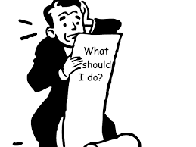
Overview
Work Package Plan - Briefing
All information must be site specific, clear and useful for the people on site
The PC’s processes, nor the content of the CPP, should be replicated in a WPP
If you do something differently to what was outlined in the CPP
You should highlight this in the WPP e.g. additional welfare facilities
But - just outline the change, don’t copy all welfare details in the CPP
What should be in a WPP is :
how the work will be done and in what order
who will be responsible for what
Names of responsible people must be provided throughout
‘TBA’ is useless - and must not be used
Notes:
The WPP contains the detail of what will happen on the work package. In essence it should contain enough information to allow a competent supervisor deliver the work.
How the site will be managed is set out in the CPP - don’t cover this ground again. Only things that are additional or different to what the CPP describes need to be mentioned in the WPP

Slide 4
Overview
Work Package Plan - Briefing
All information must be site specific, clear and useful for the people on site
When considering if something is ‘adequate’, or not, it does not matter …
… if it’s structured or phrased the way you would have said it
All that matters is - does it address the main principals of the issue
Semantics or typographical errors are irrelevant and don’t make anything inadequate
You may however point these out in an e-mail or similar but …
… the CEM should have dealt with these before submission
Notes:
A lack of clarity and understanding on the part of NR staff has contributed significantly to the amount of extraneous information in WPPs
The key point is NR’s preferences don’t matter - the documents belong to the PCs and should be written to suit their approach
If it’s full of errors we should start to question the suitability of the CEM

Slide 5
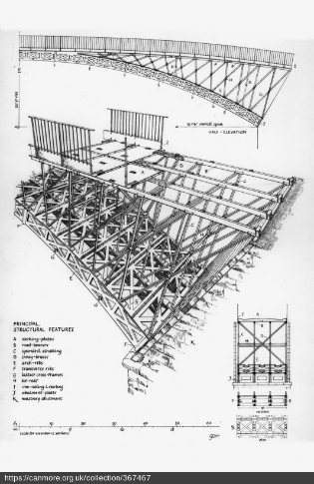
1 Introduction
Work Package Plan - Briefing
All information must be site specific, clear and useful for the people on site
This is the key part of the document - it is a method statement for the work
There should be enough detail for a competent supervisor to do the job
It should be about ¼ to a ⅓ of the document …
… but use as much space as you need to get the message across
It can be illustrated with diagrams or sketches where these would help
Notes:
This is probably the most important part of the plan and needs to contain quite a bit of detail - it should be the largest section of a WPP

Slide 6
1 Introduction
Work Package Plan - Briefing
All information must be site specific, clear and useful for the people on site
Services and isolation points
Include only those relevant to this package of work
Access restrictions - generally covered in the CPP
Only provide detail that’s different to the usual access arrangements
Asbestos - generally covered in the CPP
Include any interaction with known asbestos in this work
ALO - management of ALO operations will be in the CPP
Provide any supporting detail associated with this work
Notes:
The key theme with a WPP is that it should cover the work in the package only and not have broader information that should be in the CPP
This theme will be carried through subsequent slides

Slide 7
1 Introduction
Work Package Plan - Briefing
All information must be site specific, clear and useful for the people on site
Temporary works - management of temp. works will be in the CPP
Include details of temp. works required for this work
NR Organisation - generally covered in the CPP
Outline any differences for this package of work
PC Organisation - generally covered in the CPP
Outline any differences for this package of work
Resources - detail the resources that will be used in this work
Notes:
There needs to be enough detail on temporary works to allow it to be built
Organisations will usually be in the CPP - detail any differences on this work package here

Slide 8
2 Working together
Work Package Plan - Briefing
All information must be site specific, clear and useful for the people on site
Site Communication - detail any differences from the CPP for this work
Do not replicate details in the CPP
Contact details - detail key contacts not mentioned in the CPP
It can be more use to put these in the TBSs instead
Other parties - detail key people who will help deliver this work
Do not duplicate long lists from the CPP
Notes:
This continues the theme of having only information different to the CPP in WPPs

Slide 9
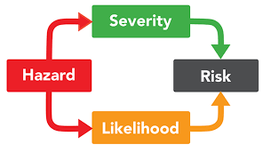
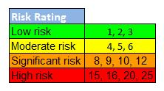
3 Hazard management
Work Package Plan - Briefing
All information must be site specific, clear and useful for the people on site
Work with particular risks - management of these will be in the CPP
Outline the specific arrangements for this package of work
Include any differences from the detail in the CPP
If the CPP already has all the info needed don’t replicate if here
Focus on genuine risks - don’t address routine or everyday issues
Significant railway and construction H&S risks
Detail how these risks will be addressed if not covered in the CPP
Note it’s significant risks - don’t cover everyday, well understood risks
This is about risks that are :
odd, unusual, unexpected or difficult to manage
Lifesaving Rules - only if particularly relevant
Don’t pad out the WPP with all the LSRs
Notes:
The risks from certain hazards may be dealt with in the CPP - if that’s the case don’t replicate those elements here, they’ve already been addressed
The key point is that the WPP should not have everyday or routine risk controls that everyone is familiar with - people need information on the difficult things, without the unnecessary clutter of ‘teaching granny to suck eggs’ type information

Slide 10
4 Environmental and waste management
Work Package Plan - Briefing
All information must be site specific, clear and useful for the people on site
Environmental management arrangements
This is usually covered in the CPP or the EMP
Detail any differences or additions for this package of work
Waste management arrangements …
Usually covered in the CPP or the EMP
Detail any differences or additions for this package of work
Notes:
These issues are usually covered in the Environmental Management Plan with some information in the CPP
The same message about not replicating sections of the CPP would apply equally to the EMP - only provide info in the WPP if what your going to do is different to what the EMP describes

Slide 11
5 Emergency arrangements
Work Package Plan - Briefing
All information must be site specific, clear and useful for the people on site
Emergency Arrangements - generally covered in the CPP
Only different or additional arrangements should be covered in a WPP
Do not replicate the information in the CPP in a WPP
Notes:
Emergency arrangements usually apply to the site as a whole and don’t change. If a particular package of work requires something different detail that here - but don’t reproduce the whole section, just describe what’s being done differently

Slide 12
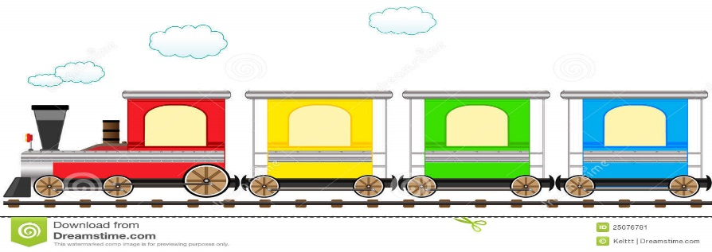
6 Work package arrangements
Work Package Plan - Briefing
All information must be site specific, clear and useful for the people on site
Things like layout plans, access arrangements and welfare …
… don’t change on many sites - so don’t mention them in a WPP
Maps, layout plans etc. should be on the site notice board
The WPP should only have this sort of info if it’s different to the norm
Rail traffic management - detail the arrangements in the WPP
Delete the section if there are none
Management of ALO should be in the CPP
Detail on ALO operations relating to the work should be in the ALO Work Plan which should be referenced in the WPP
Notes:
Things that don’t change on site do not need to be reproduced in each WPP - highlight only differences
If an ALO Work Plan is needed this must be made clear in the WPP and it must be adequately cross referenced

Slide 13
6 Work package arrangements
Work Package Plan - Briefing
All information must be site specific, clear and useful for the people on site
Road traffic management - detail any arrangements in the WPP
Delete the section if none are required …
… or the details are no different to what’s covered in the CPP
Schedule of task briefing sheets - provide details in a table
Avoid unhelpful notes such as ‘TBA’
If the work is planned properly these details will be known
Notes:
‘TBA’ doesn’t really help anyone so avoid it - work should be properly planned so there should be no need to use TBA

Slide 14
7 Hand over and handback arrangements
Work Package Plan - Briefing
All information must be site specific, clear and useful for the people on site
Detail any hand over or hand back arrangements for this work
If there are none delete this section
Notes:
This is self explanatory

Slide 15
Questions?

