Slide 1
Construction Phase Plan - Briefing

Slide 2


Overview
Construction Phase Plan - Briefing
All information must be site specific, clear and useful for the people on site
This is guidance - slavish adherence to it is not required!
CPPs may cover :
    a single project
    a group of projects
    all the work in a programme delivered by a PC
CPPs are manuals outlining how the work can be safely done
When thinking about content ask yourself :
    will the info. help the people on site?
    is the CPP the best place for it?
Notes:
This is largely background but whilst it says slavish adherence isn’t required, it’s important to emphasis that it can’t be casually ignored, people must seek the guidance of their H&S Manager if they want to deviate from it

Slide 3
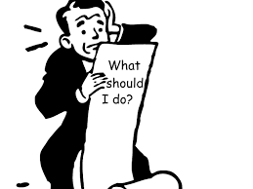
Overview
Construction Phase Plan - Briefing
All information must be site specific, clear and useful for the people on site
The PCs processes should not be replicated in a CPP
What should be in a CPP is :
    how processes will be implemented
    who will be responsible for what
CPPs must not include unhelpful or nebulous statements such as :
    ‘Welfare facilities will be provided as outlined in standard x/y/z’
    ‘Accidents shall be reported in accordance with process x/y/z’
These add nothing - and are no help to people on site
Say what you will actually do!
Names of responsible people must be provided throughout
    ‘TBA’ is useless - and must not be used
Notes:
The key point here is that once we accept a CPP the next thing that happens is that they start work - so anything like TBA and so on is just not acceptable, people on site will need to know whatever bit of info is flagged as ‘TBA’

Slide 4

Overview
Construction Phase Plan - Briefing
All information must be site specific, clear and useful for the people on site
When considering if something is ‘adequate’, or not, it does not matter …
… if it’s structured or phrased the way you would have said it
All that matters is - does it address the main principals of the issue
Semantics or typographical errors are irrelevant and don’t make anything inadequate
You may however point these out in an e-mail or similar but …
… the CEM should have dealt with these before submission
Notes:
A lack of clarity and understanding on the part of NR staff has contributed significantly to the amount of extraneous information in CPPs
The key point is NR’s preferences don’t matter - the documents belong to the PCs and should be written to suit their approach
If it’s full of errors we should start to question the suitability of the CEM

Slide 5

1 Introduction
Construction Phase Plan - Briefing
All information must be site specific, clear and useful for the people on site
This is a very brief bit of standard text and won’t usually change

Slide 6

2 Planning for the construction phase
Construction Phase Plan - Briefing
All information must be site specific, clear and useful for the people on site
Goals - H&S goals that the project can influence
  Long lists of vague aspirations are not required
Description of the work - only an outline
  Detail will be in the WPPs
ALO operations - how this issue will be managed
  Detailed plans will be in WPPs
Temporary works - how these will be managed and who will be responsible on site
CPP review - frequency should be appropriate for changes on site
Notes:
The CPP generally sets out how things will be managed - detail on specific work is usually in lower documents i.e. WPPs and TBSs

Slide 7

3 Working together
Construction Phase Plan - Briefing
All information must be site specific, clear and useful for the people on site
Changes to key personnel - description of the mechanism for doing this
CDM appointments - these must be known, ‘TBA’ isn’t allowed!
NR organisation - if multi-project include senior people here
  Junior staff for each piece of work can be in the WPPs
PC organisation - if multi-project include senior people here
  Junior staff for each piece of work can be in the WPPs
Communication during construction - outline how and who
  Details should be practicable and not overly elaborate
Notes:
Largely self explanatory - ‘outline how and who’ will become a recurring theme

Slide 8
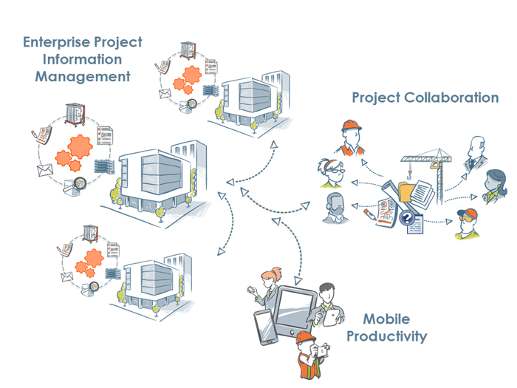
3 Working together
Construction Phase Plan - Briefing
All information must be site specific, clear and useful for the people on site
Exchange of design info. - outline how and who
  Details should be practicable and not overly elaborate
Changes to design - outline how and who
  Details should be practicable and not overly elaborate

Slide 9
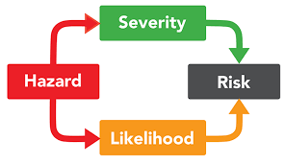
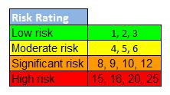
4 Hazard management
Construction Phase Plan - Briefing
All information must be site specific, clear and useful for the people on site
Work with particular risks - defined in the CDM regs
  Only include risks that exist in the work - delete others
  Detail your approach and how the risks will be controlled
  Specific controls are not needed here
  They will be in the WPPs and TBSs
Significant construction H&S risks - note it’s significant risks
  Don’t include everyday hazards competent people will know about
  This is about risks that are :
    odd,
    unusual,
    unexpected or
    difficult to manage
Notes:
The key point is that the CPP should not have everyday or routine risk controls that everyone is familiar with - people need information on the difficult things, without the unnecessary clutter of ‘teaching granny to suck eggs’ type information

Slide 10
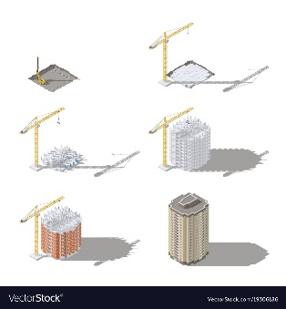

5 Organise
Construction Phase Plan - Briefing
All information must be site specific, clear and useful for the people on site
Outline of work method - brief, high level outline of your approach
  Not a detailed method statement - these will be in the WPPs
Management of WPPs - how they’ll be prepared, submitted …
  … and approved, if appropriate
  Including who will be responsible for doing what
Schedule for the production of WPPs - in a table
  Key dates for preparation, submission and approval of all WPPs
Site emergency arrangements - for all foreseeable emergencies
  Detail what will happen and who will make sure it does
  All detail should be in the CPP
  Nothing should be left to WPPs or TBSs
Notes:
Approval of WPPs is only for those NR will need to review - some won’t need this
Emergency arrangements different to the norm can be included in WPPs or TBSs but the vast majority of info should be in the CPP as it usually doesn’t change on any particular site

Slide 11
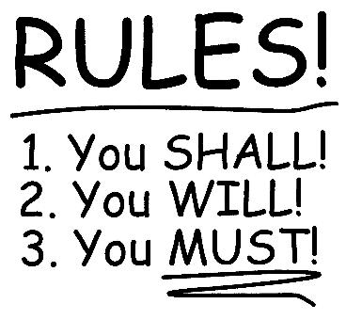
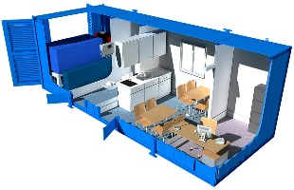
5 Organise
Construction Phase Plan - Briefing
All information must be site specific, clear and useful for the people on site
HS&E event reporting and recording - outline of on-site mechanism
  Include who will be responsible for each aspect of the mechanism
Site rules - short, punchy and written as instructions
  Don’t include routine, generic or vague aims
Induction - how briefings will be managed and who will be responsible
  ‘One size fits all’ is unlikely to work - don’t include content in the CPP
Welfare - detail what will be provided and where it will be
  Include how often they’ll be cleaned, replenished and inspected …
  … and who will be responsible for each task

Slide 12

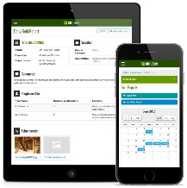
5 Organise
Construction Phase Plan - Briefing
All information must be site specific, clear and useful for the people on site
Monitoring arrangements - site tours, inspections, audits etc.
  These could be done by :
    site based staff
    visiting head office staff
    3rd parties
  Include how frequently each will be done and who will do them
  Also detail who will be responsible for addressing any findings
  Checklists or plans used as prompts are not required in the CPP
Management Reporting - detail routine reporting of the work
  Include the frequency of each and who will be involved in and responsible for meetings, preparing reports etc.

Slide 13

6 Health and Safety file
Construction Phase Plan - Briefing
All information must be site specific, clear and useful for the people on site
Describe the arrangements for identifying and gathering information
  Detail :
    who will be responsible for the information
    where it will be stored
    at what stages it will be handed over

Slide 14

Questions?

