Slide 1
Overview of the CPP, WPPs and TBSs

Slide 2


Where we are now
Overview of the CPP, WPPs and TBSs
Construction Phase Plans (CPPs) are a requirement of the CDM regs
Generally the construction industry supports CPPs with task Risk Assessments to identify hazards and control risks …
… which in turn lead to Method Statements to describe how a task may be safely done
These are colloquially known as RAMS
NR has introduced Work Package Plans (WPPs) and Task Briefing Sheets (TBSs) in place of the more commonly used RAMS
Notes:
This is just a bit of background information
This was trialled on a live job with excellent results - WPP 20 pages not 50 and 10 pages were about the job!

Slide 3

Where we are now
Overview of the CPP, WPPs and TBSs
CPP
WPP
WPP
WPP
TBS
TBS
TBS
TBS
TBS
TBS
TBS
TBS
TBS
The CPP is the parent document, supported by WPPs and TBSs
WPPs and TBSs are effectively elements of the overall CPP
Notes:
A bit more background - basically explaining just as risk assessments and method statements form part of the overall CPP so do WPPs and TBSs

Slide 4

Suite of documents
Overview of the CPP, WPPs and TBSs
The documents are not intended, nor should they be able, to be used on their own
They form a suite of mutually supporting documents
The CPP is a safety management system for the project
WPPs outline how discrete packages of work will be done
TBSs contain key safety information for the tasks comprising the work package
Notes:
This is the start of the key message that not absolutely every aspect of every topic mentioned will be contained in all documents e.g. welfare :
CPP - will describe the welfare facilities for the site
WPP - will describe any additional or different arrangements for this work package e.g. additional facilities at a remote work site
TBS - will describe anything that is additional or different to the provision outlined in the CPP or WPP for this task e.g. a welfare van nearer to the task site than the main facilities

Slide 5

‘One Truth’ concept
Overview of the CPP, WPPs and TBSs
If the same information is provided in more than one place …
… in time it will become contradictory
All information should be provided only once
We need to establish the most effective place for all information …
… and then go back to that source each time
Do not replicate it elsewhere - where it may not be kept up to date!
Notes:
This is an established concept in management systems and is used to prevent contradictory information being provided for staff
It doesn’t mean that everything to do with a particular issue will be in one place e.g.
CPPs may outline how PPE will be issued, stored, cleaned, maintained, repaired and replaced - although this is often in a PC’s SMS
WPPs will outline any PPE over and above the site minimum that is needed for this work package
TBSs will contain a list of PPE needed for the task with, perhaps, a few tips on how to use anything out of the ordinary
All documents will have info on PPE in them, but the type and level of information in each will be quite different

Slide 6
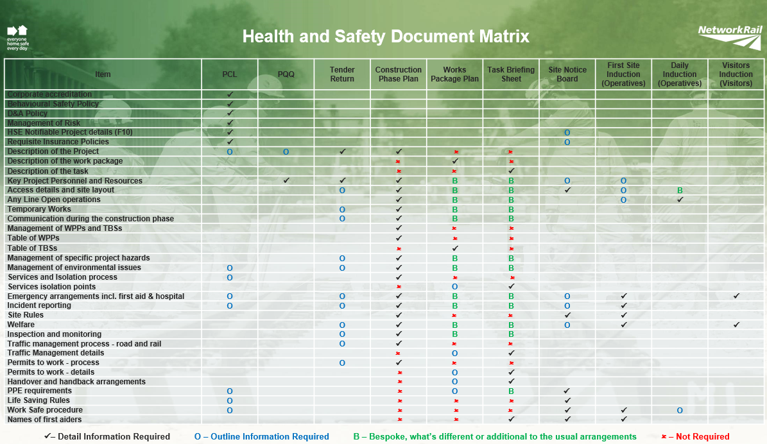
Overview of the CPP, WPPs and TBSs
Notes:
This slide is just to show the matrix so people will know what it looks like - there’s no need to try and read or go through it in any detail
It would be worth describing the different classifications of information i.e. Detail, Outline, Bespoke and Not Required
This, like all other docs outlined, is on the IMS and Safety Central

Slide 7
Currently we prepare information because :
Overview of the CPP, WPPs and TBSs

it’s a legal requirement
to keep Network Rail happy
to tick a box or cover your backside … but
The focus of the information should be :
to make sure the guys at the sharp end go home safe everyday!
So the information must get to them and their supervisors
Notes:
This is a key slide - the bullet points could well be reasons why documents get prepared - but the whole point, and the focus of what we do, is to make sure everyone gets home safe everyday

Slide 8

Information flow
Overview of the CPP, WPPs and TBSs
Who is accountable to produce in contractor’s organisation
By the MD
By the Business Development Director
NR reviews and accepts PCL, PQQ, Tender & CPP. NR will only review WPPs by exception
Principal Contractors License
By the Bid Manager
Pre -
Qualification
By the CEM
RSSB
RISQS
Tender Submission
By the Engineer/Senior Supervisor
Construction Phase Plan
By the Frontline Supervisor
Works Package Plan
By the Frontline Supervisor
CSCS
Accreditation
Task Briefing Sheet
Sentinel
Accreditation
Site
Induction
Daily
Briefing
SWL/COSS
Briefing
Notes:
Quickly click through the elements of this slide without much elaboration - the purpose of the slide it to show that there’s a vast amount of information on any project

Slide 9

Information flow
Overview of the CPP, WPPs and TBSs
It’s a long route for a variety of information …
… to get to the guys on the ground
They can only absorb so much
We need to carefully select what we tell them - don’t tell them :
  saws are sharp
  welding tools are hot
  you can fall off anything that’s high
Tell them what they might not already know e.g. there’s an old mine shaft near the site boundary
Notes:
We need to distil information from all that on the previous slide and select the info the guys on the ground really need - they can only take in so much so let’s make sure what we give them is relevant

Slide 10


Project specific and proportionate
Overview of the CPP, WPPs and TBSs
All documents must be written specifically for the project they relate to
Do not try to ‘re-badge’ or ‘tweak’ documents from other projects
That would only work if they were rubbish in the first place!
Information should be proportionate to the risk
Don’t go into great detail on routine risks everyone is familiar with
Conversely, provide adequate information on odd, or unusual, risks that a competent contractor may not be familiar with
Notes:
This is HSE’s key philosophy for information - prepared specifically for the particular project and proportionate to the risk
Don’t spend ages telling them concrete can cause dermatitis - they know this!

Slide 11
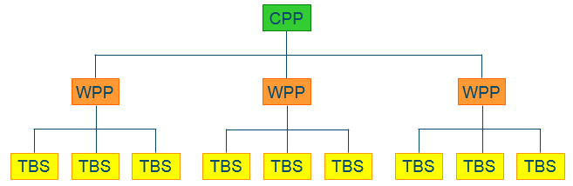
Move information up
Overview of the CPP, WPPs and TBSs
Move Up
Aim - to move info to the highest level so there’s less duplication
  incident reporting - in CPP
  emergency procedure - in CPP
  welfare facilities - in CPP
Only differences need mentioning in lower docs
Don’t replicate sections of the CPP in other docs - there’s no point!
Notes:
The more info there is in the CPP the more WPPs can focus on the actual work - similarly, the more we pick up package specific detail in a WPP the more TBSs can actually be Brief
This is a key element of reducing duplication - put common information in the highest document practicable

Slide 12

Reviewing documents
Overview of the CPP, WPPs and TBSs
Documents are produced by contractors - they own them
NR review the CPP and some WPPs - to confirm they’re adequate
It doesn’t matter if you’d have done it differently - as long as it’s adequate
The format is not important as long as it covers all relevant points
NR shouldn’t tell contractors how to make their documents adequate …
… they’re not a checking service!
If documents are poor NR need to review the capabilities of the authors and checkers - not fix it for them!
Notes:
A lack of clarity and understanding on the part of NR staff has contributed significantly to the amount of extraneous information in the documentation
The key point is NR’s preferences don’t matter - the documents belong to the PCs and should be written to suit their approach

Slide 13



What’s adequate?
Overview of the CPP, WPPs and TBSs
When deciding if something is adequate it’s sometimes useful to keep in mind who the information is for :
Generally CPP site managers
WPP foreman/supervisors
TBS operatives
Keep the language simple - it’s about getting info. across, not showing off!
Remember, the ‘B’ in TBS is for ‘Briefing’ - so be brief!
Notes:
This slide is self explanatory - just something that may help
Don’t get hung up on who uses which document - anyone can use any of them but this is generally where the focus lies

Slide 14
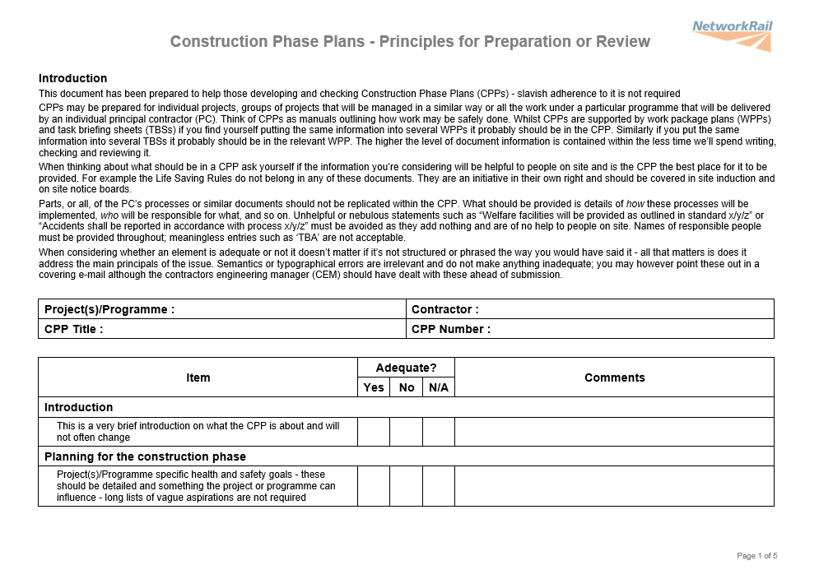
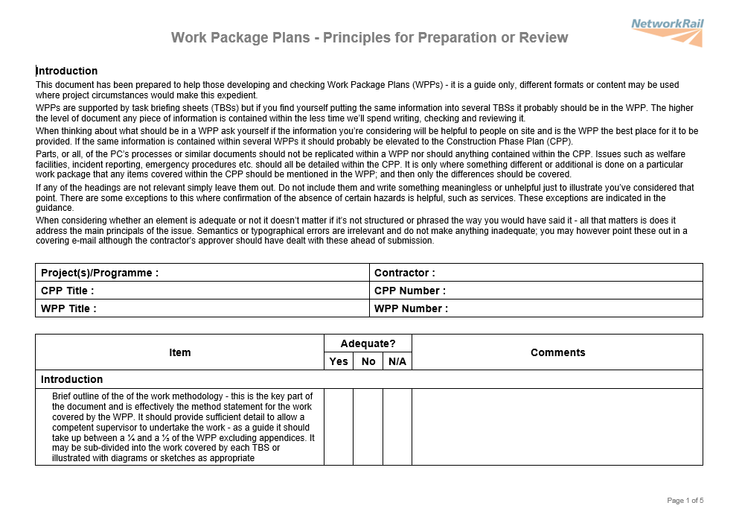
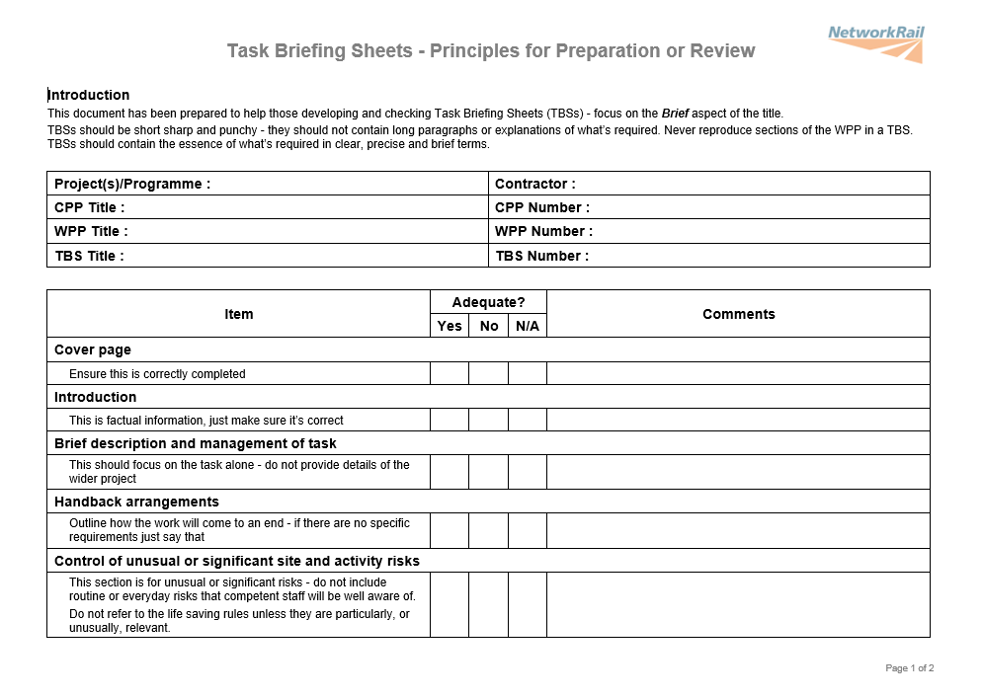
Help and support
Overview of the CPP, WPPs and TBSs
To help in the preparation and review we’ve produced various guides :
Notes:
This slide just shows the documents that have been produced

Slide 15

Questions?

