Slide 1
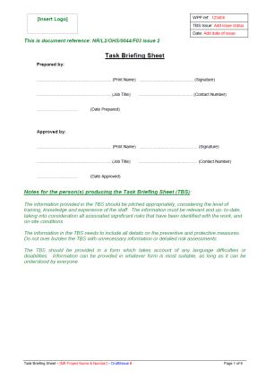
Technical Brief: Part 4 Task Briefing Sheet (TBS)
Issue 2 - A guide to completion
January 2017

Slide 2
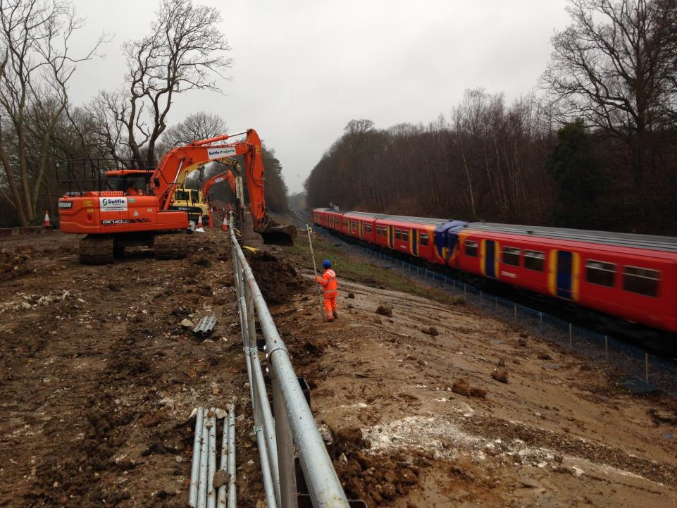
Task Briefing Sheet – Issue 2
The requirements for the Task Briefing Sheet have been updated to reflect:
changes in CDM 2015, and;
recent changes to the Construction Phase Plan and Work Package Plan templates
Must be used for all construction work - the level of detail required should relate to the complexity of the work
Issued at least a shift in advance to the person leading the workgroup
The Deliverer can decide the format it is issued in (paper, digital); however, a copy must be available at the site of work at all times

Slide 3
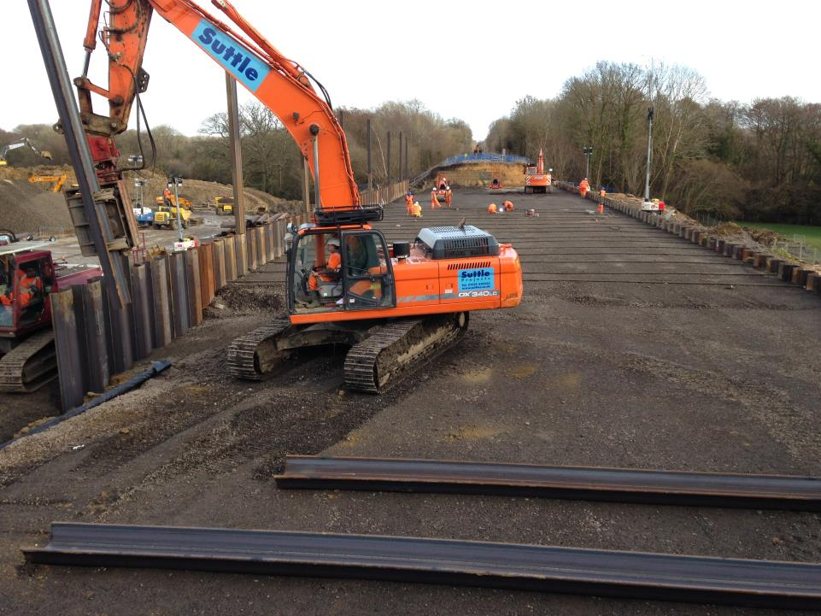
Task Briefing Sheet – What is it?
A document for front line operatives that sets out:
An outline of the work to be undertaken
The available resources
Site specific arrangements for managing health and safety risks
i.e. preventive and protective measures
Site specific emergency arrangements

Slide 4
Task Briefing Sheet
Information provided should:
Be audience appropriate (considering level of training, knowledge and experience)
Relevant and up to date
Consider all significant risks
Be task and site specific
Take account of language difficulties or disabilities
Any format (hard copy, electronic) can be used provided:
It can be understood by everyone
Has all the information in the relevant sections in the template

Slide 5
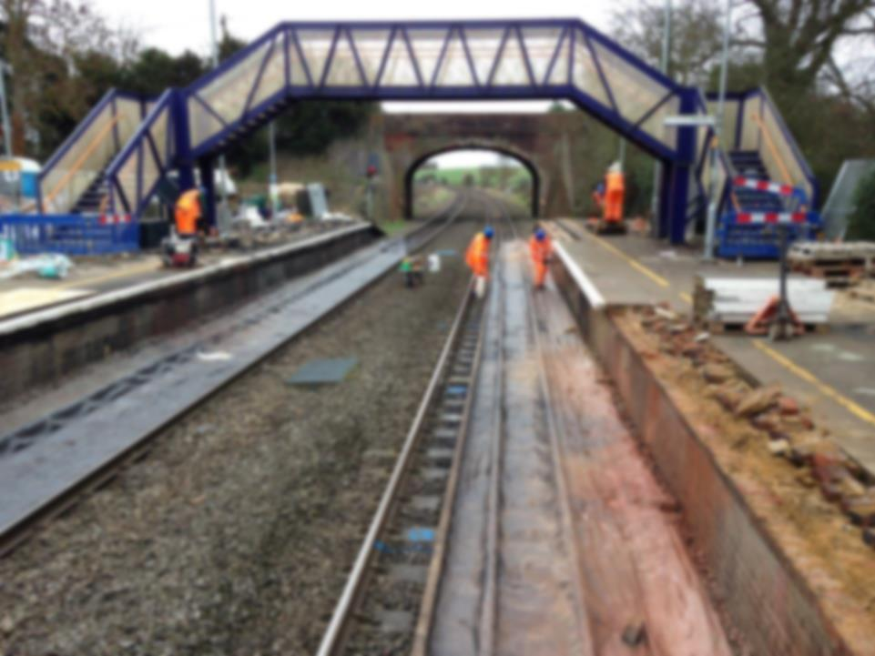
Task Briefing Sheet Template
The TBS must:
Provide a reference back to the relevant WPP
Provide sections for the date when prepared or approved, a signature, job title and contact number for both:
The person who prepared the document
The person who approved the document
Note: the arrangements for detailing who can sign off the TBS are documented in the CPP
Wet (not electronic) signatures must be used on the original document which is retained by the deliverer

Slide 6
Part A

Slide 7
Task Briefing Sheet Template
Section 1 – Introduction
In this section provide
The time span for the task briefing (i.e. start and finish)
Document expiry date
Note – a review date must be provided if the TBS will be in place longer than 14 days
Notes:
Use of TBS for cyclical activity or where the same activity is taking place in the same geographical area over a period of time. Note that the risks, resources, parameters etc assumed must be assessed as comparable by the work group leader prior to each shift and changes made where appropriate.

Slide 8
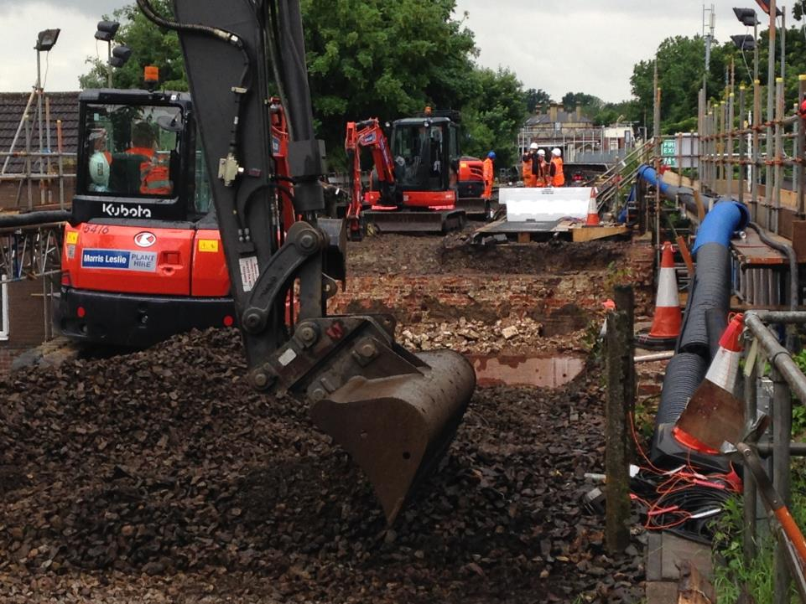
Task Briefing Sheet Template
Section 2 – Brief Description and Management of Task
Provide a brief description of the task and location
Detail how the work will be authorised to start and finish, and by whom (position)
Provide details on any contingencies arrangements if the task does not go as expected i.e.:
Task needs to change
Task is not as expected
Task does not go as expected
Requirements to stand down if necessary
Notes:
Task details – this is not a ‘how to’ guide for the workgroup as competence in the task delivery is assumed by sending them to work in the first place. The task information should be unambiguous to enable a clear understanding to be reached by all
Location details – this is key to avoiding confusion over line, access, presence of risks and hazards relative to the location

Slide 9
Task Briefing Sheet Template
Section 3
Handover and Handback Arrangements
This section should detail any handover arrangements (if they are applicable) i.e.:
Shift handover arrangements
Hand-back on the completion of the task (i.e. to asset owner)
Specific arrangements e.g. security arrangements when site is vacated

Slide 10
Task Briefing Sheet Template
Section 4 – Control of Site & Activity Risks
Detail in this section:
the particular and significant
site specific risks, and;
task activity risks
the relevant control measures
(note: this is not a repeat of the risk assessment)
Refer back to Section 3.1/3.2 of the Work Package Plan for the particular and significant risks
Notes:
Key element of the document – this is the basis on which the safe system of work and safe working of the activity will be based. It must be location specific and must enable the team to understand the environment in which they will operate.

Slide 11
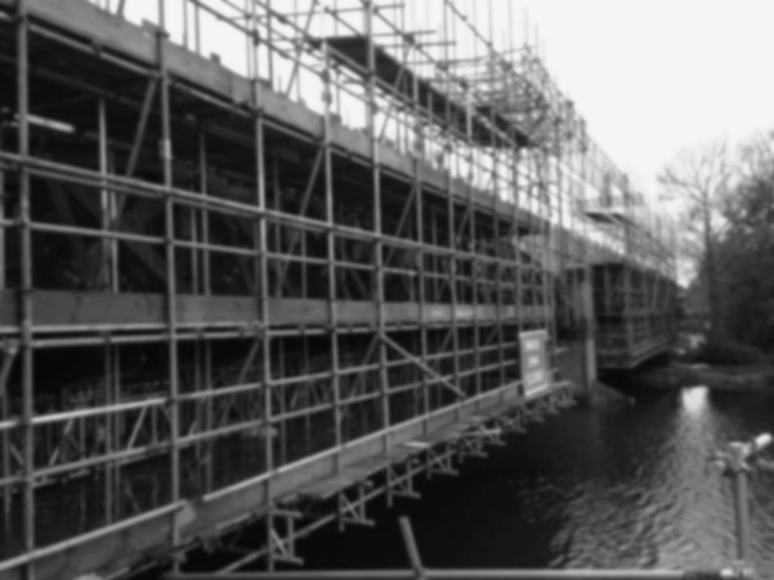
Task Briefing Sheet Template
Section 5 – Resources
Detail the resources required to undertake the task (See section 1.3 of the WPP)
Document the minimum number of people (and competencies) required to undertake the task safely
This should also consider operators of plant, machinery, engineering trains, etc.
Detail any specialist PPE requirements (what is required and by whom)
Document the quantity of plant, equipment and tools to complete the task
Document the quantity of materials to complete the task
Notes:
Frequently in investigations we have reached the conclusion that changes in the resource profile at the point of work will influence the work group leader to continue with the task in a sub optimal or potentially unsafe way to avoid losing the work activity. Where LOSC resources do not show up or are not to the level of competence we expect, this can put an undue burden on the remaining team to alter working practice. If we provide details of the resources assumed in the planning process, it enables the work group leader to assess the task in light of the assumption and propose changes within the amendments section of this document

Slide 12
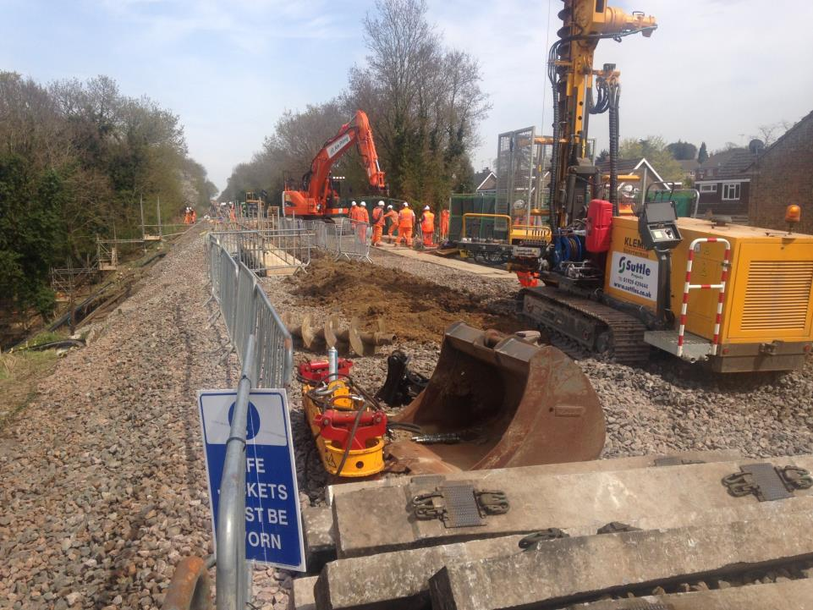
Task Briefing Sheet Template
Section 6 – Site details
Location - This section should provide any additional details of the location of the task i.e. line, mileage. The use of photos or plans of the site is useful here
Safest access/egress point – This section should detail:
the locations to access and egress the site of work
routes to / from the point of access / egress
Additional protection arrangements for access / egress
Consider the need for:
Carrying tools and equipment
Plant i.e. RRV or road vehicles

Slide 13
Task Briefing Sheet Template
Section 6 – Site details (continued)
Our workforce protection arrangements
Describe the protection arrangements for the safe delivery of the work
Consider:
Track protection arrangements i.e. possessions / isolations
This can refer to the SSOWP – no need to repeat!
Traffic management – both rail and road
Service isolations – (see section e) for permit requirements)

Slide 14
Task Briefing Sheet Template
Section 6 – Site details (continued)
Safeguarding others from our work
Provide information on the arrangements to safeguard those affected by the work
Consider:
Members of the public (i.e. at stations, foot crossings)
Neighbours (i.e. noise / vibration)
Other workgroups at the location / or that may pass through
The environment
Notes:
Frequently missed in TBSs of the past – this is especially prevalent where buildings teams are working in stations or close proximity to the public and where suitable in work and post works protection is required. How do we protect people from falling debris, prevent unauthorised access to the site etc.

Slide 15
Task Briefing Sheet Template
Section 6 – Site details (continued)
Permits
Detail all permits required for the task
Detail who is responsible for issuing and cancelling each permit
Plant and machinery movements
Provide information on any (rail or road) plant or machinery movements that could affect the work prior to, during and after the work – including those used by other parties
Provide information on how exclusion zones and traffic routes will be managed during the work

Slide 16
Task Briefing Sheet Template
Section 6 – Site details (continued)
Communication
Provide information on:
the means of communication during the work (i.e. duplex or back-to-back radio systems)
Back-up systems or restrictions should it fail

Slide 17
Task Briefing Sheet Template
Section 6 – Site details (continued)
Emergency arrangements
Consider what the foreseeable emergencies might be (refer back to the CPP and WPP)
Provide information on the arrangements for those foreseeable emergencies (i.e. those who have specific responsibilities, what equipment is required)
Consider:
First aid and fire safety arrangements
Environmental incidents
Other emergencies i.e. working at height, confined spaces, working over water
Notes:
Again, this document is relative to the moment and location in time and must not be a generic approach to documenting the risk or responsibility.

Slide 18
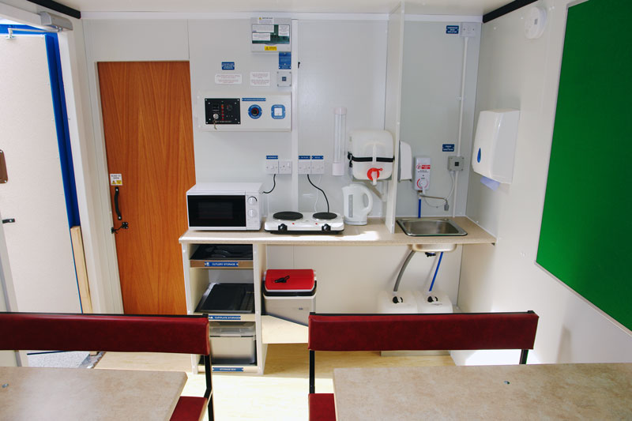
Task Briefing Sheet Template
Section 6 – Site details (continued)
Welfare
Summarise any welfare arrangements specific to this task
Refer back to the general site safety briefing if there is no difference from these arrangements.

Slide 19
Task Briefing Sheet Template
Section 7 – Changes to the Task Briefing Sheet
This section is to be completed by the person in charge of the task to record any changes that may have to be made to the Task Briefing Sheet (i.e. if things on site are different from that recorded)
Note – this needs to be authorised by a responsible person and an authorisation reference issued BEFORE the task starts, or continues (so it is important that the contact details and communication arrangements are in place)
Notes:
Per earlier comments around the potential for change in the assumed parameters – this is where the person in charge of the work can reflect changes in the plan at the point of work that drive them to make a risk assessment and therefore decision on whether or not the work can or should continue. The ‘difficulty’ with this element of the pack is whether or not the WGL decides to act based on his own experience and does not seek authority. This is a common position and asks questions around how much responsibility we invest in our people versus what predetermined approach we require them to take.
Responsible person – defined in CPP/WPP and subject to pre-existing on call arrangements as appropriate

Slide 20
Task Briefing Sheet
What do you aim to achieve once you have briefed the operative on site?
Extract from NR/L2/OHS/0044 section 9.2:
The Task Briefing Sheet is a vital tool for the communication of risk and helps you discharge legal duties.
When used effectively it can also act as an important tool to help manage and understand the competency arrangements and levels of competency of those who work for you while undertaking construction work.
Notes:
Discuss The Management of Health and Safety at Work Regulations 1999 (specifically reg 10), CDM 2015, and HASAW Act section 2 (information, instruction and training). The TBS is one of the final “domino’s” to prevent an accident. Ask the audience what else is there after the TBS brief; reliance on competence and PPE.

