Slide 1
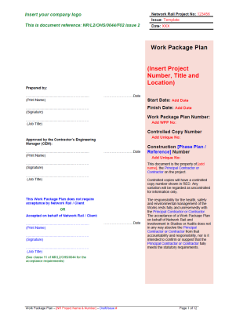
Technical Brief: Part 3 Work Package Plan (WPP)
Issue 2 - A guide to completion
January 2017

Slide 2
Work Package Plan – Issue 2
The new Network Rail template has been updated to reflect changes in CDM 2015 and recent changes to the Construction Phase Plan template
Must be used for all construction work - the level of detail required must relate to the complexity of the work

Slide 3
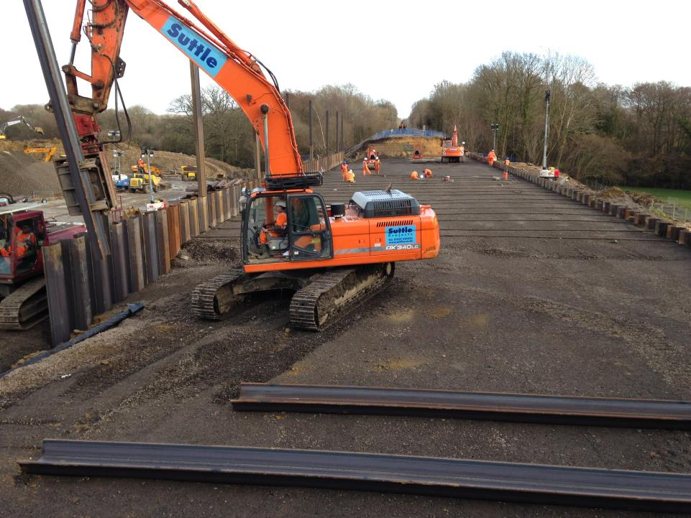
Work Package Plan – What is it?
A document that details:
the methodology of how the work will be undertaken
arrangements for managing health and safety risks
emergency arrangements

Slide 4
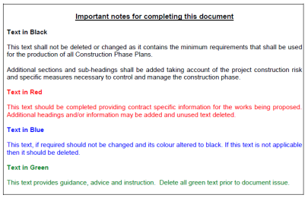
Work Package Plan – Rules for use
Text has been specifically coloured to aid the construction of the document – green text provides guidance throughout
Never re-badge a previous WPP – always use a new template
This is a LIVE document that needs to be maintained/updated for as long as the work package is required

Slide 5
Work Package Plan Template
Front page
The WPP must:
Detail the start and finish date
Reference back to the CPP
be approved by the Contractor’s Engineering Manager (or as agreed and authorised in the CDM Plan and documented in the CPP)
if applicable, be accepted on behalf of Network Rail / Client (normally the Network Rail Project Manager)
(delete the relevant section if acceptance by Network Rail is not required)
Approved and accepted each time that significant changes are made
Wet (not electronic) signatures must be used

Slide 6
Section 1
Introduction

Slide 7
Work Package Plan Template
Section 1.1 – Brief outline of work methodology
This section should provide an outline of the work methodology
This should not be a complex description, but provide sufficient detail to assess the risk control measures, for example:
Working arrangements with organisations other than Network Rail (e.g. Station Operators, trackside neighbours)
Indicate how restrictions might affect the execution of the work and how the work will be planned to take account of these (e.g. possession and isolation requirements, neighbouring buildings, utility services)
List the tasks that will be undertaken during the work package

Slide 8
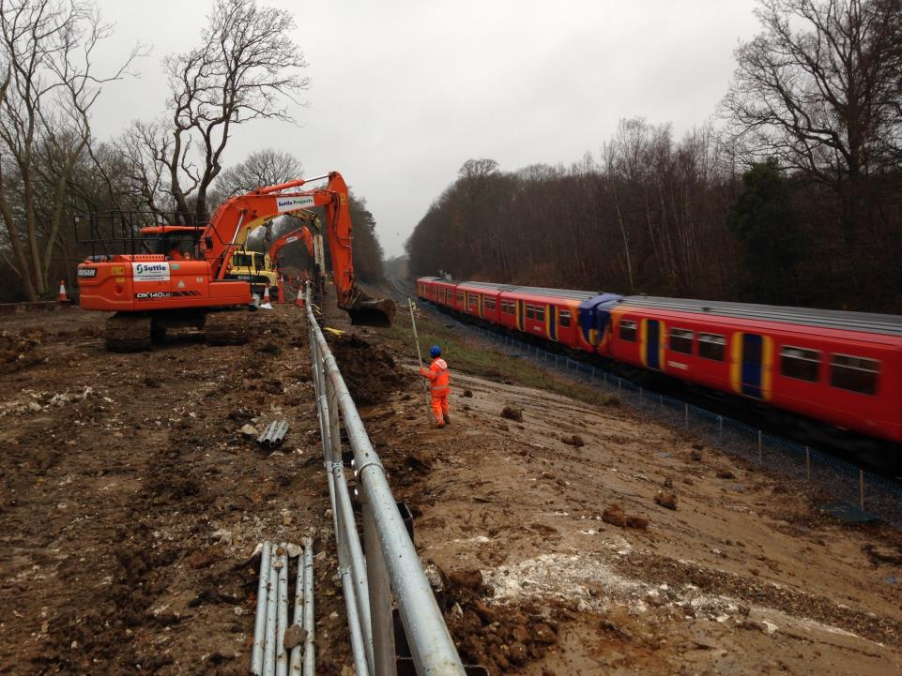
Work Package Plan Template
Section 1.2 – (Principal) Contractor’s delivery organisation
Delete “Principal” if only one contractor
1.2.1 – details can be taken from the CPP
Note – only suggested titles; the equivalent titles (and details) should be added
Note – specific roles relating to Any line Open (ALO) activities or temporary works should be included in this section
1.2.2 – details can be taken from the CPP
Details the companies, specialist contractors and/or individuals, appointed by the PC, involved during the construction phase

Slide 9
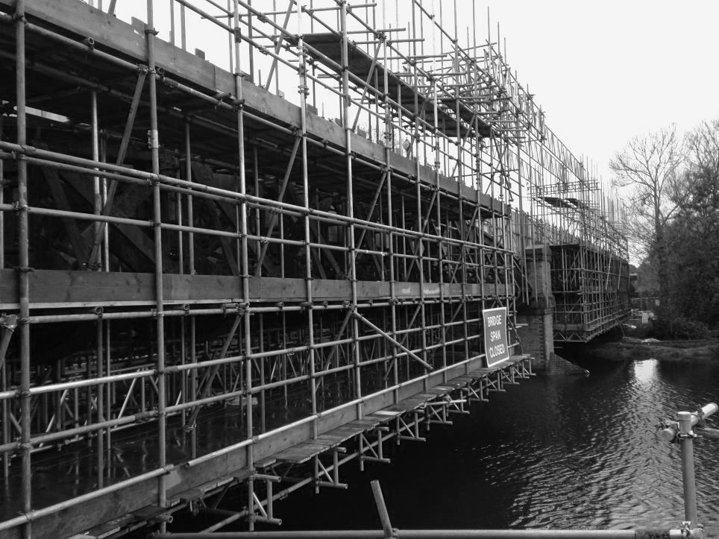
Work Package Plan Template
Section 1.3 – Resources
Delete “Principal” if only one contractor
Detail documents that provide detail of the work being undertaken.
Document applicable “Approved for Construction (AFC)” design documents, including title and document reference.
Document the number of people and their competences to complete each task safely
This should also consider operators of plant, machinery, engineering trains, etc.
Document the quantity of plant, equipment and tools to complete each task
Document the quantity of materials to complete each task

Slide 10
Section 2
Working Together

Slide 11
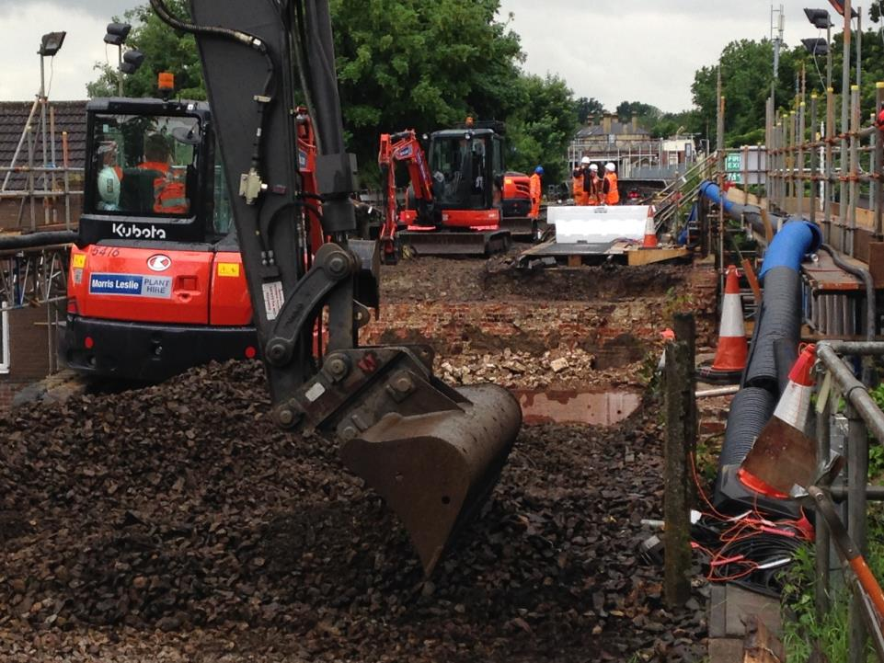
Work Package Plan Template
Section 2.1 – At site communication
Detail the means of communication for undertaking each task safely, including:
Systems to be made available and back up systems where required
the conditions where communication failures might require work to be stopped or restricted;
means of communication at site within work groups and outside parties; and,
alternative means of communication in areas of poor coverage for mobile phones.

Slide 12
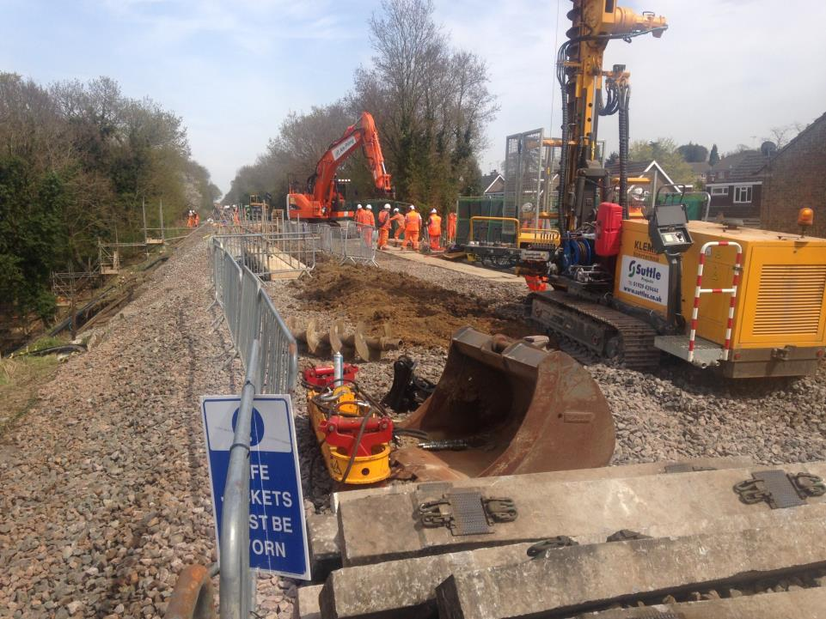
Work Package Plan Template
Section 2.2 – Contact details
Detail the main contacts for the work package.
Section 2.3 – Other parties (interfaces)
Identify the interfacing organisations (i.e. other Network Rail teams, Train or Freight Operating Companies or external parties)
Detail the interface point and the point of contact
Document the interface arrangements i.e.:
Who is accountable / responsible for communicating at each stage
How information will be provided on the work
How work will be coordinated (i.e. de-confliction meetings, possession / white-board meetings)
How you will keep them updated of any changes
Who will make the key decisions about how the work will be done

Slide 13
Section 3
Hazard Management

Slide 14
Work Package Plan Template
Section 3.1 – Work involving particular risks
Refer back to Section 4 of the CPP.
Were particular risks for this work package identified?
If no, then delete the second section and table
If yes, then document which risks are applicable; then,
Detail when and where the risk will be present
Detail any permits required
Then detail how each of the risk will be controlled
NOTE – if any of these particular risks are considered significant (post mitigation controls) then the Work Package Plan will require acceptance by Network Rail

Slide 15
Work Package Plan Template
Section 3.2 – Significant railway and construction risks
Refer back to Section 4 of the CPP.
These hazards should be:
site and activity specific
supported by an associated risk assessment
Detail when and where the risk will be present
Detail any permits required
Then detail how each of the risk will be controlled

Slide 16
Work Package Plan Template
Section 3.2 – Significant railway and construction risks
NOTE – The Work Package Plan will require acceptance by Network Rail if:
Hazards are present that give rise to risks that are assessed to have a significant impact (post mitigation) on the safe operation of the railway and/ or the health and safety of workers.
The mitigation measures put in place to control risk are unusual, complex, or rely on a high level of engagement or competence within the workforce or other stakeholders.
There is the likelihood of a significant level of change to the assessed risks due to emerging conditions on site or the immature level of detail presented in the design documentation.

Slide 17
Section 4
Environmental and Waste Management Arrangements

Slide 18
Work Package Plan Template
Section 4.1 – Environmental management arrangements
Refer to the environment management plan and detail the arrangements for protecting the environment.
The contact details for the (Principal) Contractor’s environment advisor should be added to the contacts section of the WPP
If there are no specific environment management arrangements, state that not relevant.
Section 4.2 – Waste management arrangements
Refer to the site waste management plan and detail the arrangements for managing waste
If there are no specific waste management arrangements, state that not relevant.

Slide 19
Section 5
Emergency Arrangements

Slide 20
Work Package Plan Template
Section 5.1 – Site emergency arrangements
Details should be provided based on the results of a project specific assessment of the likely emergencies and arrangements detailed in the CPP
Additional sections must be added for other emergency arrangements not detailed i.e. working over water; working in confined spaces
The information detailed should provide greater, but more specific, detail than that documented in the CPP
Note – nothing needs to be added in Section 5.1. The detail needs to be added in Sections 5.1.1 to 5.1.8.

Slide 21
Work Package Plan Template
Section 5.1.1 – First aid arrangements
This should be based on the type and level of injuries that could arise on the site
Should consider non-accident events (i.e. heart attacks) and the ability and ease for emergency services to attend
Confined spaces; remote locations
Must not just be directions to the local hospital
Detail must include:
the number and qualifications of first aiders
the amount and location of equipment required
Specialist first aid equipment i.e. rescue stretchers, burns kits
Can be provided as an appendix

Slide 22
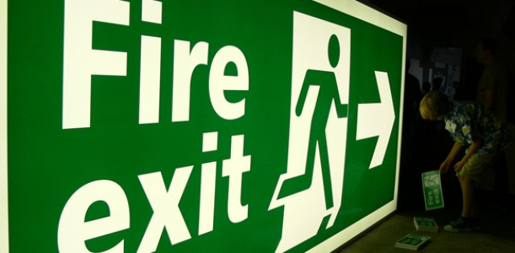
Work Package Plan Template
Section 5.1.2 – Evacuation arrangements
This should be based on the type and level of work activities that are taking place
Should consider:
evacuation of the entire site or an individual casualty
potential changes to the site layout
The maximum number of people on site at any one time (including any lone workers, such as security guards)
means for accounting for all persons present on site
Must not just be directions to the local hospital
Should consider evacuation for security reasons
Can be provided as an appendix

Slide 23
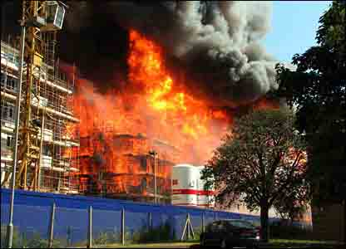
Work Package Plan Template
Section 5.1.3 – Fire safety
This should be based on the actual risk of fire present during the construction phase
Should consider:
measures to prevent fires starting (e.g. control of hot works, smoking or re-fuelling activities
Methods for raising the alarm
Fire-fighting arrangements
Details for temporary fire alarm panels or connections to permanent fire alarm systems
Locating existing fire alarm equipment (i.e. smoke or heat detectors) that might be affected during construction
Can be provided as an appendix

Slide 24
Work Package Plan Template
Section 5.1.4 – Security
Should consider:
Arrangements for preventing unauthorised access to:
the construction site
the operational railway (and associated infrastructure)
Security arrangements, such as security guards, cameras
Potential terrorism threats
For activities and sites that are likely to attract unwelcome attention then contact the British Transport Police and/or Railway Route Crime Prevention Specialist.

Slide 25
Work Package Plan Template
Section 5.1.5 – Summoning emergency services
Detail:
How emergency services will be summoned
Who will call the emergency services
Who will meet the emergency services, and where
How the emergency services will access the site
Who will escort the emergency services
Consider prior contact with the emergency services and possible simulated emergency exercises
Consider other emergency services i.e. bomb disposal; mountain rescue; coastguard and lifeboat; utilities
Can be provided as an appendix

Slide 26
Work Package Plan Template
Section 5.1.6 – Railway emergency
This section should consider the specific arrangements for:
Stopping trains in an emergency
Isolating the hazard of electricity
Contact details for each Signaller, Electrical Control Room (where applicable) and Route Control
Note - checks should be made in advance to confirm the correct contact details (including any placed on information boards at access points)

Slide 27
Work Package Plan Template
Section 5.1.7 – Asbestos
Detail the arrangements for responding to the unexpected discovery of asbestos containing materials
Even if asbestos has not been identified in any surveys
Include the arrangements for :
Informing workers on stopping work if suspected
Isolating and securing the affected area

Slide 28
Work Package Plan Template
Section 5.1.8 – Utilities
Detail the arrangements for responding to the unexpected discovery of utilities - even if utilities has not been identified in any surveys
Include:
Emergency contact details for all utilities operating in the location of construction
Arrangements for isolating and securing the affected area

Slide 29
Work Package Plan Template
Other emergency arrangements
Additional sections must be added to detail the arrangements for any other emergencies that could potentially arise during construction, for instance:
working over water;
working in confined spaces;
working in excavations
working at height
unexploded ordinance
flooding
environmental events

Slide 30
Section 6
Work Package Arrangements

Slide 31
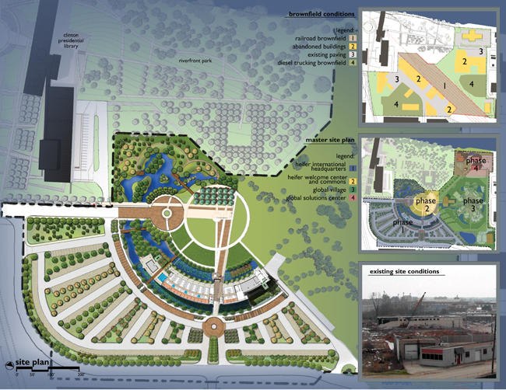
Work Package Plan Template
Section 6.1 – Site Layout
Provide details of the site layout
This can include:
Photographs;
Diagrams / maps;
Plans
This should not just detail the location of the site welfare facilities, but all work areas

Slide 32
Work Package Plan Template
Section 6.2 – Access and Egress
Provide details of the arrangements for access and egress
Include all routes to each site of work for:
People, tools, plant (including rail plant), equipment and materials
Include diagrams / photographs where possible

Slide 33
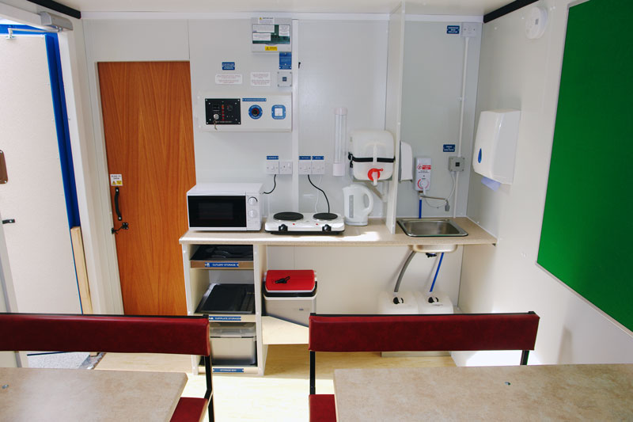
Work Package Plan Template
Section 6.3 – Welfare
Provide details on site specific arrangements, for instance:
The maximum number of people on site at any one time during the construction phase
The number of toilets, wash hand basins, eating facilities, etc
PPE and personal storage arrangements
Network Rail standard NR/L3/INI/CP0036 provides a form for quantifying welfare arrangements – this should be used as an appendix

Slide 34
Work Package Plan Template
Section 6.4 – Rail Traffic Management
If no rail movements (including those by others) then state “no rail traffic during this work package”.
Provide details on the arrangements for managing rail traffic, including:
How rail vehicles movements will be managed;
How interfaces and means of communication will be managed with other contractors and Network Rail teams within possessions/worksites;
Details of planned rail movements including engineering trains, on-track machines/plant
All ALO operations (with the ALO Plan attached as an appendix)
If ALO is covered by a specific Work Package Plan then this should be detailed.

Slide 35
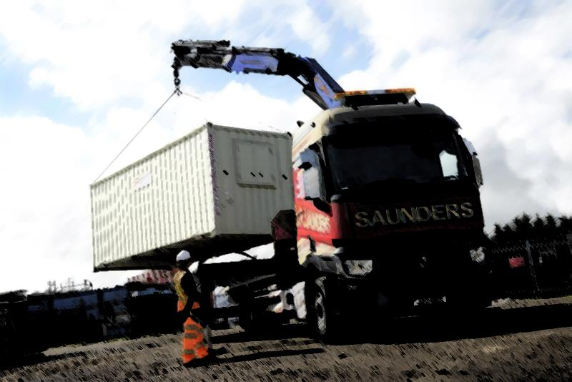
Work Package Plan Template
Section 6.5 – Road Traffic Management
If no road traffic arrangements then state “no road traffic arrangements during this work package”.
Provide details on the arrangements for managing road traffic, including:
How road vehicles, including parking, will be managed;
How pedestrians and vehicles will be segregated
Arrangements when affecting the normal operation of all types of levels crossings (including foot, occupation and accommodation crossings)
All ALO operations, including deliveries (with the ALO Plan attached as an appendix)
If ALO is covered by a specific Work Package Plan then this should be detailed.

Slide 36
Section 7
Hand over and hand back Arrangements

Slide 37
Work Package Plan Template
Section 7.1 – Hand over and hand back arrangements
This section should detail the arrangements for:
Handing the site over to another contractor (or between contractors working under the same Principal Contractor)
Hand back to the asset owner at the end of the work

