Slide 1

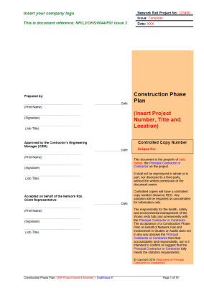
Technical Brief: Part 2
Construction Phase Plan (CPP)
Issue 3 - A guide to completion
January 2017

Slide 2
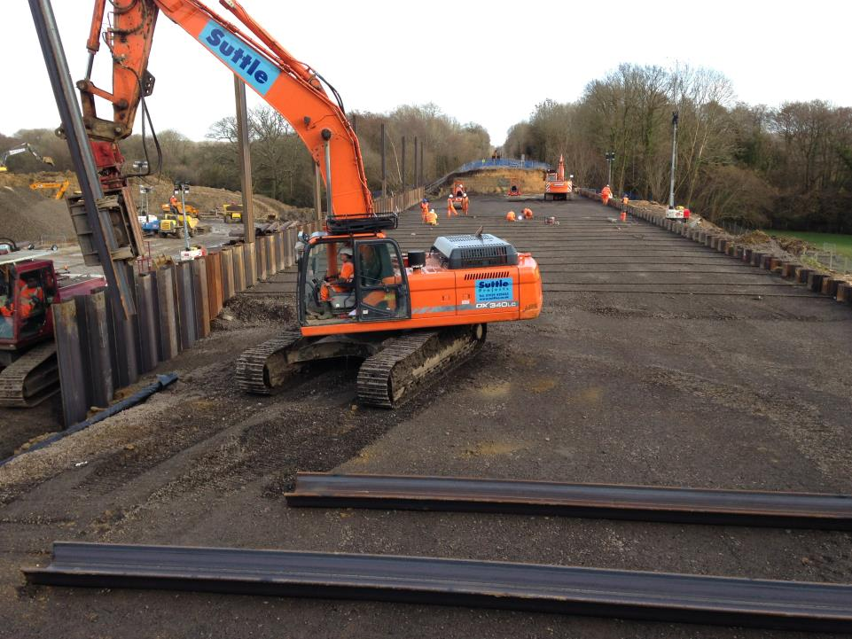

Construction Phase Plan – What is it?
A document that must record the:
  health and safety arrangements for the construction phase
  site rules
  specific measures concerning work that falls within one or more of the categories listed in Schedule 3
  arrangements for managing the significant health and safety risks

Slide 3
Construction Phase Plan – What is it?
The emphasis is that it:
  is relevant to the project
  has sufficient detail to clearly set out the arrangements, site rules and special measures needed to manage the construction phase; but
  is still proportionate to the scale and complexity of the project and the risks involved
Click here for the HSE Guidance to CDM Regulations 2015

Slide 4
Construction Phase Plan – Legal Duties
The Client must ensure that
  a construction phase plan is drawn up before the construction phase begins
  the (principal) contractor is provided with all the available relevant information they need to draw up the plan, e.g. the pre-construction information
  the plan adequately addresses the arrangements for managing the risks
  the principal contractor (or contractor) regularly reviews and revises the plan to ensure it takes account of any changes that occur as construction progresses and continues to be fit for purpose

Slide 5
Construction Phase Plan – Legal Duties
The Designer must
  take all reasonable steps to provide with the design sufficient information about aspects of the design to help contractors (including principal contractors) to comply with their duties e.g. information about significant risks that cannot be eliminated
The Principal Designer
  must help the principal contractor to prepare the construction phase plan by providing any relevant information they hold
  should regularly check that the principal contractor has the information needed to prepare the plan

Slide 6
Construction Phase Plan – Legal Duties
The Principal Contractor must
  (where more than one contractor) take the lead in preparing, reviewing, updating and revising the construction phase plan
  draw up the plan or make arrangements for it to be drawn up during the pre-construction phase and before the construction site is set up
  liaise with the contractors to ensure that the plan takes into account their views on the arrangements for managing the construction phase
  ensure that the construction phase plan is appropriately reviewed, updated and revised from time to time

Slide 7
Construction Phase Plan – Legal Duties
The Contractor
  must (where more than one contractor) follow the parts of the construction phase plan prepared by the principal contractor that are relevant to their work
  for single contractor projects, ensure that a construction phase plan is drawn up

Slide 8
Construction Phase Plan – Issue 3
The new Network Rail template has been updated to reflect changes in CDM 2015
Must be used for all construction work - the level of detail required must relate to the complexity of the work
Replaces the Low Level Risk CPP Issue 4

Slide 9
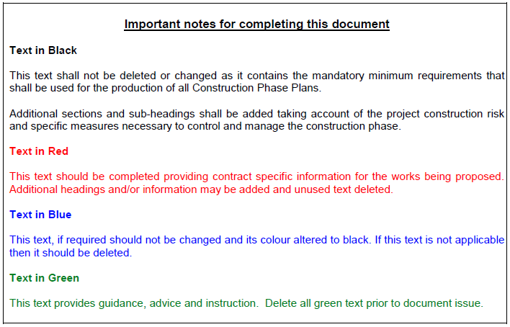
Construction Phase Plan – Rules for use
Text has been specifically coloured to aid the construction of the document – green text provides guidance throughout
Never re-badge a previous CPP – always use a new template
This is a LIVE document that needs to be maintained throughout the construction phase

Slide 10
Construction Phase Plan Template
Front page
  The CPP must be
    approved by the Contractor’s Engineering Manager (or as agreed and authorised in the CDM Plan)
    accepted on behalf of the Network Rail Client Representative (as detailed in the CDM Plan)
    Approved and accepted each time that significant changes are made
  Wet (not electronic) signatures must be used

Slide 11
Section 2
Planning for the Construction Phase

Slide 12
Construction Phase Plan Template
Section 2.1
  This section should detail specific H&S goals that have been agreed with the Client
  Some H&S goals may have been defined as part of pre-construction information or the project safety plan and should be included
  Goals should be proactive and promote safe working and wellbeing, rather than lagging targets relating to zero accidents or accident rate targets

Slide 13
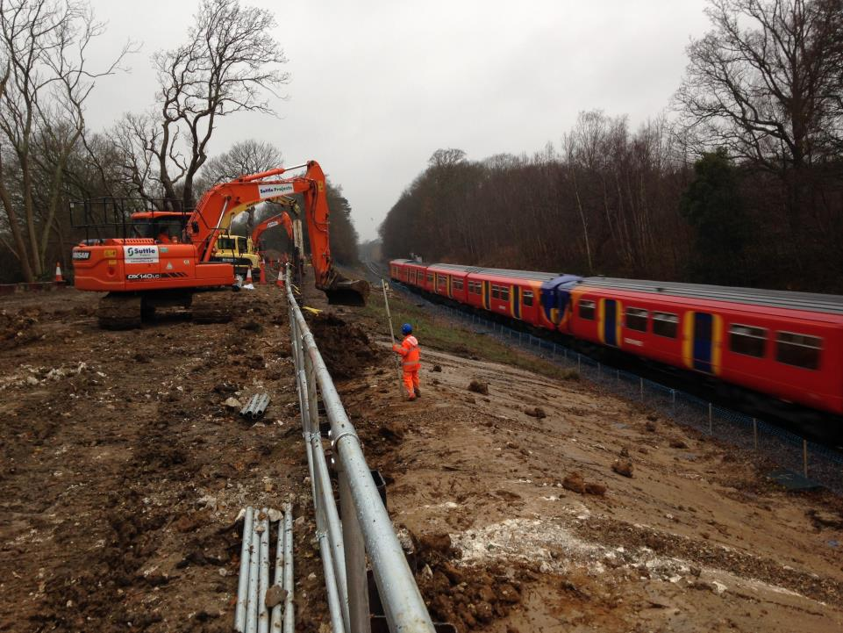
Construction Phase Plan Template
Section 2.2
  Brief description of work
    This only needs to be an overview of the main works; not full detail of each stage or methodology
  Key construction stages
    Detail the main key stages, including start / end date and WPP reference that are known at the time
    If the exact dates and WPP reference are not known then this can be updated later

Slide 14
Construction Phase Plan Template
Section 2.3
  Service and isolation points
    Detail any services that might need to be disconnected or connected before construction work starts
    This can be signposted to a separate table in an appendix if necessary
    This section can be updated as the project progresses
Section 2.4
  Access Restrictions
    Detail any access restrictions i.e. no-go areas
    This section is not for detailing how access / egress is gained!

Slide 15
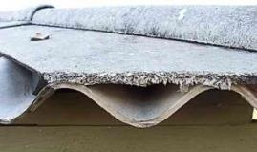
Construction Phase Plan Template
Section 2.5 Asbestos
  Delete the relevant section depending on whether asbestos has or has not been identified.
  If asbestos has been identified then details shall be provided on exactly where it is located
    This can be signposted to an appendix if necessary

Slide 16
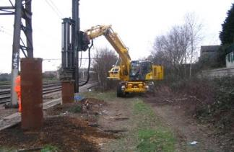
Construction Phase Plan Template
Section 2.6 Any line open operations
  Delete the relevant section depending on whether ALO activities are proposed or not
  If ALO is being proposed then details shall be provided on exactly when and what ALO activities will take place - this can be signposted to an appendix if necessary
  Include the names of all those accountable for the safe planning and delivery of ALO activities
  Click here for guidance on ALO

Slide 17
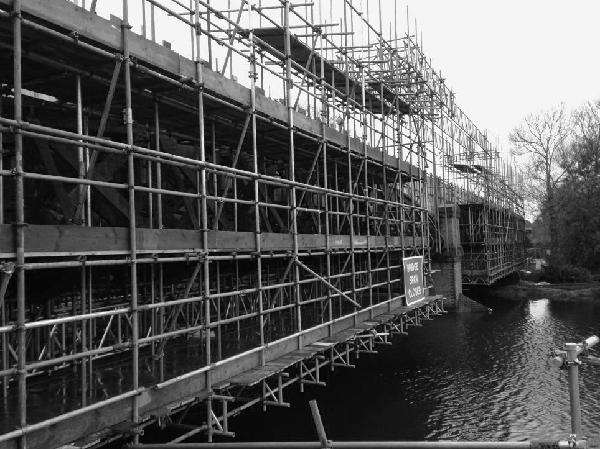
Construction Phase Plan Template
Section 2.7 Temporary Works
  Delete the relevant section depending on whether temporary works are required or not
  If temporary works are required then a summary of the proposed temporary works shall be provided
    This can be signposted to an appendix if necessary
  Include the names of all those accountable for the safe design, planning and implementation of temporary works

Slide 18
Construction Phase Plan Template
Section 2.7 Temporary Works
Temporary works include (not an exhaustive list)
    Earthworks
      Trenches, excavations, temporary slopes and stockpiles, cofferdams
    Structures
      Formwork, falsework, propping, façade retention, needling, shoring, edge protection, temporary bridges, site hoarding and signage, site fencing
    Equipment/plant foundations
      Tower crane bases, supports, anchors and ties for hoists, crane and piling platforms
    Electrification & Plant
      Temporary substation and cable arrangements

Slide 19
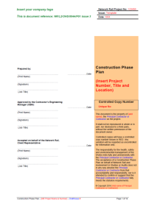
Construction Phase Plan Template
Section 2.8 – Review
  Describe how you will review, revise and refine the CPP throughout the construction phase, for example:
    Changes to the scope of works
    Changes to key personnel
    Newly identified significant hazards
    Findings of inspections or audits requiring changes to risk control measures
    Following H&S events
    Periodically i.e. monthly
  Remember any significant changes will require the Construction Phase Plan to be accepted again by the Client Representative

Slide 20
Section 3
Working together

Slide 21
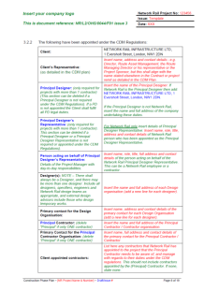
Construction Phase Plan Template
Section 3.1 – Changes to key personnel
  Details on how Network Rail and other parties will be advised of changes to key personnel
Section 3.2 – CDM Appointments
  Duty holders – detailed within pre-construction information
  Delete relevant sections i.e. Principal Designer if not relevant
  Client appointed contractors – those appointed by the Client, not the Principal Contractor
Section 3.3 – Network Rail project organisation
  Note that these are only suggested titles, but the equivalent titles (and details) should be added. This should be provided as pre-construction information

Slide 22
Construction Phase Plan Template
Section 3.4 – Principal Contractor’s delivery organisation
  Delete “Principal” if only one contractor
  Note – only suggested titles; the equivalent titles (and details) should be added
  Contractor’s Responsible Engineer
    This section should list the CRE for each discipline that will apply during the construction phase
  Authorised signatories
    Details those authorised to sign on behalf of the CRE for documentation such as Task Briefing Sheets
  Specialist contractors and/or individuals
    Details the companies, specialist contractors and/or individuals, appointed by the PC, involved during the construction phase

Slide 23
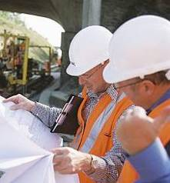

Construction Phase Plan Template
Section 3.5 – Communication
  You need to identify the stakeholders that will be involved or affected throughout the construction phase
  You need to define the strategy for communicating with each of the stakeholders, for example:
    who is accountable and responsible for communicating at each stage?
    how often you will communicate?
    how you should provide information on the job?
    how you will coordinate the work?

Slide 24
Construction Phase Plan Template
Section 3.6/3.7 – Design
  Detail the process for exchanging design information between relevant parties i.e. Principal Designer / Contractor (if relevant), Contractors and Designers
  Detail how changes to the design (once the construction phase has started) will be managed and formally accepted by those accountable and responsible for design.
  Both sections should make reference to Network Rail standard NR/L2/INI/02009 – Engineering Management of Projects

Slide 25
Section 4
Hazard Management

Slide 26
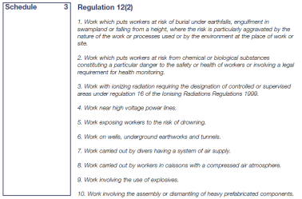
Construction Phase Plan Template
Section 4.1 – Work involving particular risks
  Will the work on your project involve any of these risks? If, no delete the table.
  If yes, then identify which risks are involved and delete the risks that do not apply.
  Then detail how each of the risk will be controlled throughout the construction phase and the Work Package Plan that it relates to.
  A separate appendix can be used to document the controls.

Slide 27

Construction Phase Plan Template
Section 4.2 – Significant construction H&S risks
  The hazards must be project and site specific – not generic
  The hazards must be present and give rise to risks that are assessed to have a significant impact (post mitigation) on:
    the safe operation of the railway; and/or
    The health and safety of workers
  Detail when and where they will be present and how the risk will be controlled, and the Work Package Plan that it relates to

Slide 28
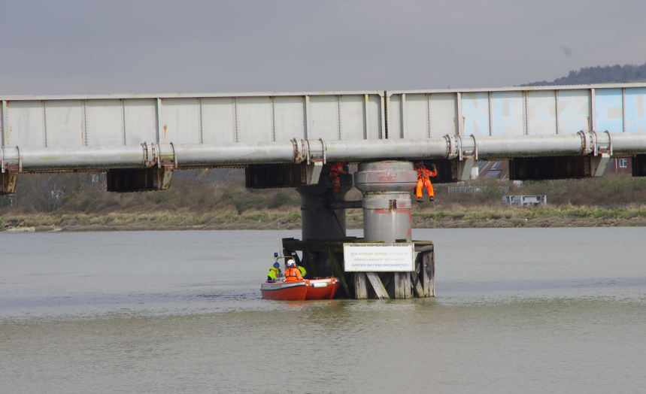
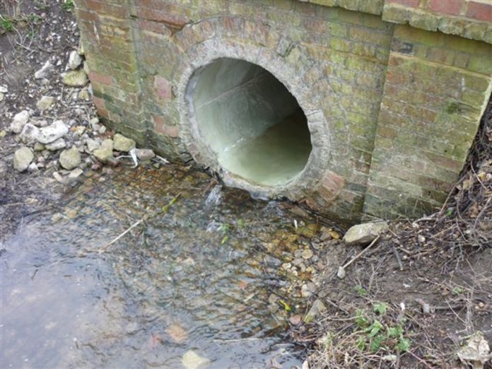
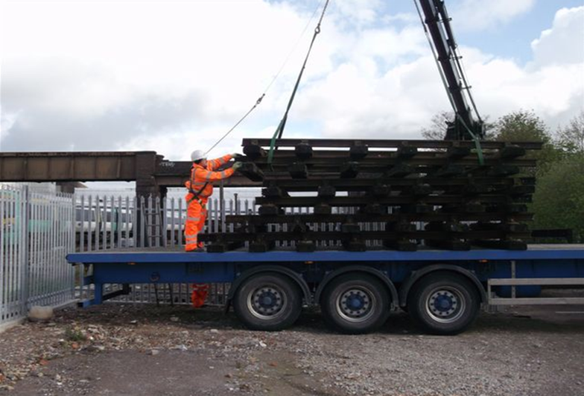
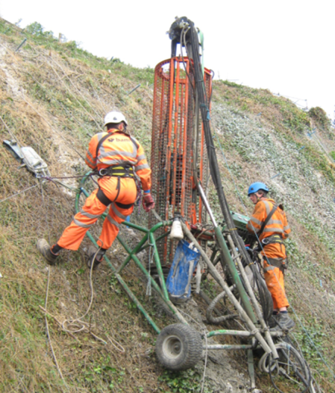
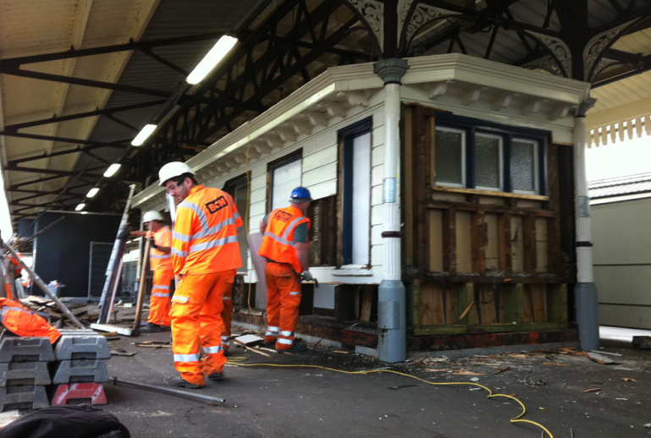
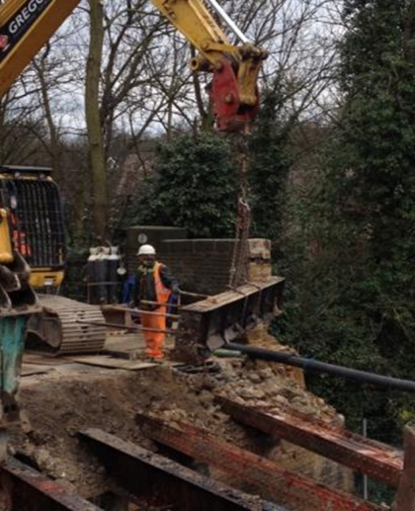
What are Significant construction H&S risks

Slide 29
Section 5
Organise

Slide 30
Construction Phase Plan Template
Brief outline of work methodology – Good or Bad?
Project is a bridge replacement. Methodology is to demolish and remove existing structure utilising disruptive possessions and isolations. The replacement bridge is to be pre-fabricated off-site, transported to site via road – requiring convoy escort. Once at site the structure is to be lifted into position using two pre-positioned 500t cranes in a tandem lifting operation. Local roads will be closed. HV cabling will be re-routed prior to demolition.
Site set-up
De-veg
Brickworks
Demobilise
The project is to stabilise the embankment at 32 miles and 48 chains between Ash Vale and Aldershot. The work involves the de-vegetation of the site before building of a piling platform. The work then includes the installation of sheet piling on the down line embankment, at 4 metres from the nearest running line, using a Movax type high frequency vibrating piling hammer on a 12 tonne excavator. Due to the close proximity to the running line all work will be undertaken during line blockages or possession to eliminate any line open (ALO) operations.
Plain line track renewal between 126 miles and 130 miles on the Down line

Slide 31
Construction Phase Plan Template
Section 5.1 – Brief outline of work methodology
  This must not be:
    a copy of the brief description of the project
    a list of Work Package Plans and/or Task Briefing Sheets
  The methodology must provide sufficient detail to:
    determine how the work will be undertaken i.e. the plant to be used; requirements for temporary works; ALO
    help identify what significant risks may be involved

Slide 32
Construction Phase Plan Template
Section 5.2 – Management of Work Package Plans
  This section should detail:
    How WPPs will be managed from production through to acceptance, incl. document control and review
    Those persons responsible for review and approval of WPPs
  This section should also:
    outline how additional WPPs are identified (once the construction phase starts)
    Highlight the parties involved in making decisions on risks and the methodology and criteria that was used

Slide 33
Construction Phase Plan Template
Section 5.3 – Work Package Plans Schedule
  A separate appendix can be used for multiple plans
  Needs to specify dates for preparation, review and approval by the (Principal) Contractor and if necessary acceptance by Network Rail
  Work Package Plans, for review and acceptance by Network Rail need to be provided:
    a minimum of 21 consecutive days prior to the work commencing;
    or an agreed alternative timescale, as detailed in the CDM Plan

Slide 34
Construction Phase Plan Template
Section 5.3 – Work Package Plans Schedule
  Acceptance by Network Rail:
    Work involving any of the particular risk(s), as detailed in Regulation 12 (2), (Schedule 3) of the CDM Regulations 2015
    Hazards are present that give rise to risks that are assessed to have a significant impact (post mitigation) on the safe operation of the railway and / or the health and safety of workers
    The mitigation measures put in place to control risk are unusual, complex, or rely on a high level of engagement or competence within the workforce or other stakeholders
    There is the likelihood of a significant level of change to the assessed risks due to emerging conditions on site or the immature level of detail presented in the design documentation

Slide 35

Construction Phase Plan Template
Section 5.4 – Site emergency arrangements
  Details should be provided based on the results of a project specific assessment of the likely emergencies
  Additional sections must be added for other emergency arrangements not detailed i.e. working over water; working in confined spaces

Slide 36

Construction Phase Plan Template
Section 5.4.1 – First aid arrangements
  This should be based on the type and level of injuries that could arise on the site
  Should consider non-accident events (i.e. heart attacks) and the ability and ease for emergency services to attend
    Confined spaces; remote locations
  Must not just be directions to the local hospital
  Detail must include:
    the number and qualifications of first aiders
    the amount and location of equipment required
    Specialist first aid equipment i.e. rescue stretchers, burns kits
  Can be provided as an appendix

Slide 37
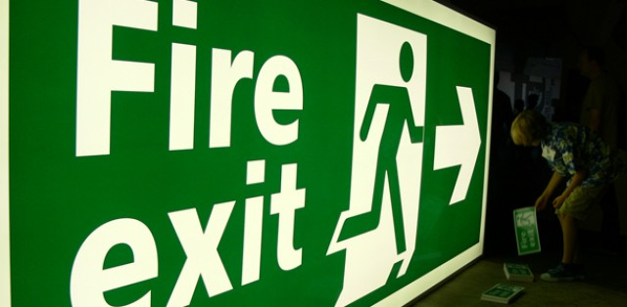
Construction Phase Plan Template
Section 5.4.2 – Evacuation procedure
  This should be based on the type and level of work activities that are taking place
  Should consider:
    evacuation of the entire site and/or an individual casualty
    potential changes to the site layout
    The maximum number of people on site at any one time (including any lone workers, such as security guards)
    means for accounting for all persons present on site
  Must not just be directions to the local hospital
  Should consider evacuation for security reasons
  Can be provided as an appendix

Slide 38
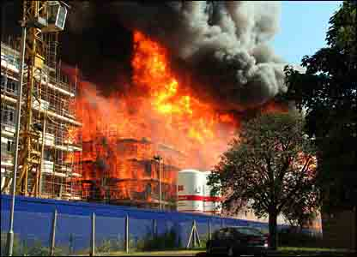
Construction Phase Plan Template
Section 5.4.3 – Fire safety
  This should be based on the actual risk of fire present during the construction phase
  Should consider:
    measures to prevent fires starting (e.g. control of hot works, smoking or re-fuelling activities
    Methods for raising the alarm
    Fire-fighting arrangements
    Details for temporary fire alarm panels or connections to permanent fire alarm systems
    Locating existing fire alarm equipment (i.e. smoke or heat detectors) that might be affected during construction
  Can be provided as an appendix

Slide 39

Construction Phase Plan Template
Section 5.4.4 – Security
  Based on pre-construction information and other site surveys
  Should consider:
    Arrangements for preventing unauthorised access to:
      the construction site
      the operational railway (and associated infrastructure)
    Security arrangements, such as security guards, cameras
    Potential terrorism threats
  For activities and sites that are likely to attract unwelcome attention then contact the British Transport Police and/or Railway Route Crime Prevention Specialist.

Slide 40

Construction Phase Plan Template
Section 5.4.5 – Summoning emergency services
  Detail:
    How emergency services will be summoned
    Who will call the emergency services
    Who will meet the emergency services, and where
    How the emergency services will access the site
    Who will escort the emergency services
  Consider prior contact with the emergency services and possible simulated emergency exercises
  Consider other emergency services i.e. bomb disposal; mountain rescue; coastguard and lifeboat; utilities
  Can be provided as an appendix

Slide 41

Construction Phase Plan Template
Section 5.4.6 – Railway emergency
  This section should consider the specific arrangements for:
    Stopping trains in an emergency
    Isolating the hazard of electricity
    Contact details for each Signaller, Electrical Control Room (where applicable) and Route Control
  Note - checks should be made in advance to confirm the correct contact details (including any placed on information boards at access points)

Slide 42

Construction Phase Plan Template
Section 5.4.7 – Asbestos
  Detail the arrangements for responding to the unexpected discovery of asbestos containing materials
    Even if asbestos has not been identified in any surveys
  Include the arrangements for :
    Informing workers on stopping work if suspected
    Isolating and securing the affected area

Slide 43

Construction Phase Plan Template
Section 5.4.8 – Utilities
  Detail the arrangements for responding to the unexpected discovery of utilities - even if utilities has not been identified in any surveys
  Include:
    Emergency contact details for all utilities operating in the location of construction
    Arrangements for isolating and securing the affected area

Slide 44

Construction Phase Plan Template
Section 5.4.9 – Other emergency arrangements
  Detail arrangements for any other emergencies that could potentially arise during construction, for instance:
    working over water;
    working in confined spaces;
    working in excavations
    working at height
    unexploded ordinance
    flooding
  Note environmental emergencies will detailed in your Environment Management Plan and Work Package Plans

Slide 45
Construction Phase Plan Template
Section 5.5 – S&E event reporting and recording
  Detail the arrangements for reporting and recording safety and environmental events, including:
    Accidents, incidents (i.e. buried service strikes), Operational Close Calls, environmental incidents, close calls
    Contact details for reporting within Network Rail
    Investigation process, including:
      those responsible for undertaking the initial and further investigations
      Process for completing actions from investigations

Slide 46

Construction Phase Plan Template
Section 5.6 – Site specific rules
  Not generic i.e. general PPE requirements
  Must be those not expected by workers, for instance:
    Restrictions on site working
    Specific hazards and controls for the site
    Restricted areas
  Must be included in site specific inductions and communicated to everyone

Slide 47

Construction Phase Plan Template
Section 5.7 – Induction
  Provide details on site specific arrangements, for instance:
    How the induction will be delivered, including briefing of the CPP, Work Package Plans and Task Briefing Sheets
    Who will deliver the induction
    How it will be recorded
    Arrangements for site workers and visitors
  Delete relevant section on Industry Common Induction

Slide 48
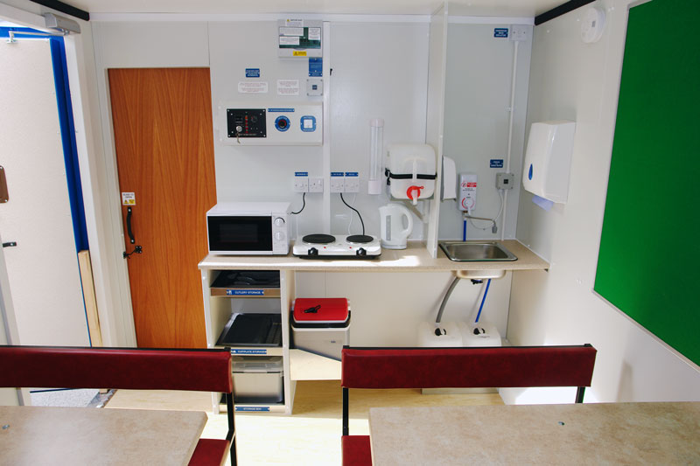
Construction Phase Plan Template
Section 5.8 – Welfare
  Provide details on site specific arrangements, for instance:
    The maximum number of people on site at any one time during the construction phase
    The number of toilets, wash hand basins, eating facilities, etc
    PPE and personal storage arrangements
  Network Rail standard NR/L3/INI/CP0036 provides a form for quantifying welfare arrangements – this should be used as an appendix and displayed on site

Slide 49
Construction Phase Plan Template
Section 5.9.1 – Monitoring arrangements
  Provide details on how the construction phase will be monitored, including (but not limited to):
    Site management inspections of all work areas
    Inspections by other e.g. company HSEA specialists
    Safety tours / safety conversations by senior managers
    Specific inspections in relation to works being undertaken e.g. temporary works, scaffolding, encapsulations etc.
    Medical interventions required for legal compliance e.g. hearing testing, blood tests for lead, HAVs, etc.
    Drug and alcohol monitoring/testing
    Periodic reviews and audits of the site and its management by persons external to the site team

Slide 50
Construction Phase Plan Template
Section 5.9.2 – Monitoring arrangements
  Provide details on monitoring activities by Network Rail, including (but not limited to):
    Inspections of the site, work area etc.
    Safety tours / safety conversations by senior managers
    Inspections following safety events
  Monitoring may be undertaken by specialists from project management, engineering, construction management, health and safety, audit and assurance disciplines
  These arrangements must be discussed and agreed with the Network Rail Project Manager (or equivalent)

Slide 51
Construction Phase Plan Template
Section 5.10 – Management reporting arrangements
  Provide details on the reporting arrangements, including (but not limited to):
    Project start up meeting
    Periodic project progress meetings
    Readiness reviews
    Design review meetings
    Client update meetings
    Method of calling other meetings, as required for dealing with specific issues relating to the project
  The (Principal) Contractor and the Network Rail nominated person authorised to deal with issues will agree the reporting arrangements for the project

Slide 52
Section 6
Health and Safety File

Slide 53
Construction Phase Plan Template
Section 6 – H&S File arrangements
  Provide details on the arrangements for providing H&S information during and at the end of the construction phase, including:
    The information that will be needed relating to the asset(s) being worked on (this should be requested via the QF705 form) or in writing to the Client Representative
    How the H&S File will be compiled (as agreed in QF703 form)
  On large projects or projects that involve a number of separate sites it may be possible to update the health and safety information as each distinct part of the project is completed.

