Slide 1

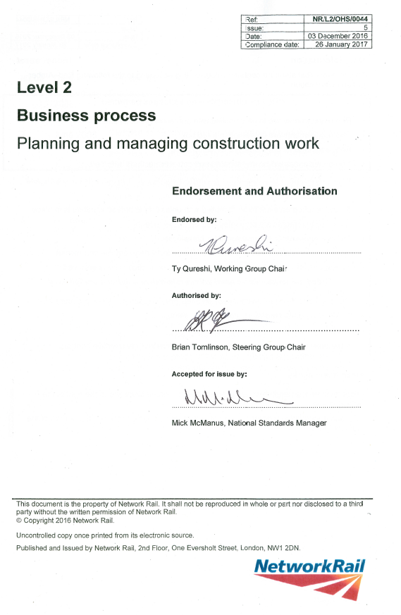

Technical Brief: Part 1
Planning & managing construction work
Key changes to Standard NR/L3/INI/CP0044 & associated templates
January 2017.

Slide 2
Background
The previous IP standard was called “Work Package Planning” and was a Level 3 standard (NR/L3/INI/CP0044), which was primarily designed to support:
Our Principal Contractor community;
Help with the implementation of the previous Construction and Management Regulations 2007, that introduced the role CDM-C role.
Refresh the use of method statement and introduced Task Briefing Sheets (TBS) as a briefing tool.
Introduced a standard approach for IP and “project work”

Slide 3
What’s new …..
If you were already working with the previous standard, this revised standard does not introduce any radically new concepts.
It focuses on more robust management processes. While doing this the standard keeps in line with CDM 2015, and builds on planning effectively with WORKER SAFETY in mind.
The purpose is largely the same: (extract from new NR/L2/OHS/0044)
“The implementation of this standard:
a. allows for the right information to reach the right people at the right time for them to do their job safely;
b. contributes to the safe management, control of work and tasks at a site of work;
c. provides a consistent layout, content and information headings for Construction Phase Plans, Work Package Plans and Task Briefing Sheets.”

Slide 4
Why have we revised the standard?
To incorporate the changes in the Construction (Design and Management) Regulations 2015 (CDM 2015)
To reflect increased clarity in the requirement for all construction activity to be compliance with these regulations including NR Net Ops/Maintenance.
Action and implement top level requirements from NRRP.
Definition of construction: (extract from CDM 2015)
“the carrying out of any building, civil engineering or engineering construction work and includes:
the construction, alteration, conversion, fitting out, commissioning, renovation, repair, upkeep, redecoration or other maintenance (including cleaning which involves the use of water or an abrasive at high pressure, or the use of corrosive or toxic substances), de-commissioning, demolition or dismantling of a structure;”

Slide 5

Key NR Standards
NR/L1/CPR/103 Supplier Assurance Framework
NR/L3/INI/CP0064 Delivering work in a possession
NR/L2/INI/02009 Engineering Management for Projects
NR/L2/OHS/0047 Application of the Construction (Design and Management) Regulations to Network Rail Construction Projects
NR/L2/OHS/0044 Planning and Managing Construction Work
NR/L2/OHS/019 Safety of people at work on or near the line.
NR/L3/MTC/RCS0216 – Infrastructure Maintenance Risk
Control Manual.
……any others that should be one here
…..please add on the flipchart.
Notes:
CPR/103
Supplier assurance, Link-up and PC License are about competence of our suppliers and contractors.
02009
Undertake competence assessments and appoint DPEs and CREs.
Establish process for designers to identify, mitigate and communicate risks.
Establish arrangements for co-operation and co-ordination between designers and construction organisations.
CP0047
How NR complies with the CDM Regs ACOP, must be read in conjunction with the ACOP.
Details accountabilities and responsibilities for all functions (Refer to Responsibilities table).
Provides requirements for training, competence and assessment of duty holders.
Pre-construction Information template available.
Project Documents
How we manage safety on the Programme.

Slide 6

To who does this standard apply?
What do you think?
Please refer to section 6 (page)
Notes:
It apply to anyone who is undertaking construction work.

Slide 7
Introduction
This standard applies to all construction work undertaken by or on behalf of Network Rail and covers any asset owned, managed, or occupied by Network Rail.
This standard does not apply to the planning and management of works that are not defined as construction work (non-construction work) under the Construction (Design and Management) Regulations 2015. This standard provides a framework for recording arrangements made during the planning and management of construction work and specifies the content, order and minimum information headings for:
Construction Phase Plans (CPP);
Work Package Plans (WPP); and
Task Briefing Sheets (TBS).

Slide 8
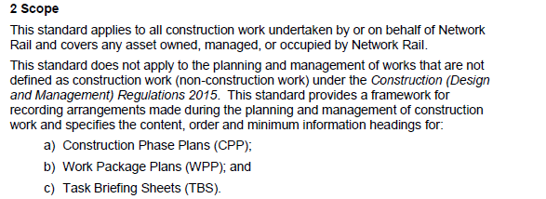
Key Changes
1. Standard is now Level 2; new reference: NR/L2/OHS/0044
2. Re-defined its scope, and now explicitly applies to all construction work, and helps us comply with CDM 2015 (also refer to section 4)

Slide 9
3. Provides a means for cross functional working. This applies to the whole of Network Rail, and contracting community. It also gives a means for the use of the Risk Control Manual.

Slide 10
4. It now cross references the NR CDM Plan, and Engineering Standard NR/L2/INI/02009, and NR/L2/OHS/0047:
5. It has the previous job titles removed. The standard, CPP and WPP templates allow for a flexible approach to managing the construction work without ‘ridged’ job titles.
6. Provides more guidance to what significant risk is through the use of the Hazard Management Process, and CDM 2015, and the use of special supervision (also refer to CPP template guidance)

Slide 11
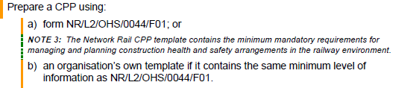
7. Although the templates are not mandated, there is a cascade of information from CPP, WPP and the TBS. Because of this “clear line of sight” between these 3 documents using them is strongly recommended:
8. Mandated significant risk WPP’s are submitted 21 consecutive days in advance of the work commencing or otherwise agreed in advance at CPP preparation stage.

Slide 12

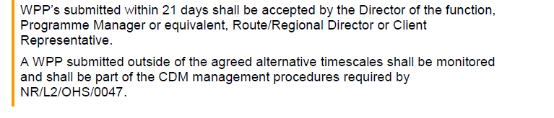
9. The standard gives more emphasis on planning; mandates Business Units measure the 21 day criteria, while giving flexibility in a devolved business to manage its own risk and set its own requirement/s.

Slide 13
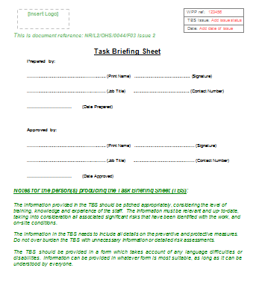
10. Mandated TBS’s are provided a shift in advance of the work.
11. TBS requires ‘preparer’ to add details so they can be contacted by site staff
12. Changed the process for coping with changing/emerging risks by providing a more robust process for escalation, including site condition amendments.

Slide 14


13. The standard gives greater emphasis on collaborative working and those preparing documents to consult others, during and before ‘accepting’ the document(s).
(extract from section 7 - CPP)
(extract from section 11 – Acceptance of WPPs)
This is a move away from “job titles” sign off documents, and a step towards the right people working together to review documents before signing off.

Slide 15
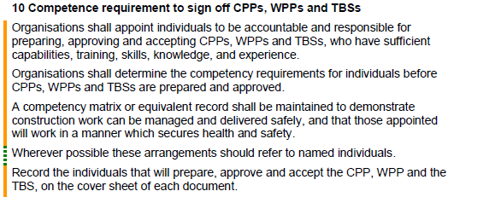
14. The standard gives greater emphasis on competence management and document control.
Appoint individuals to be accountable and responsible for all documents
Competency matrix

Slide 16


15. The standard now requires new management controls and monitoring for timescales not being met. Specifically, when agreed at CPP stage, WPPs should be ‘accepted’ 21 days in advance of the work, if this does not happen:
(extract from section 11 – Acceptance of WPPs)

Slide 17
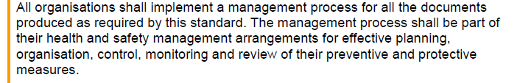
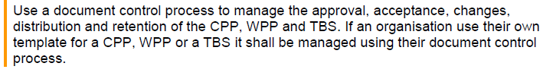
Continued…
The standard now requires a documented procedure/s for managing its arrangements for implementing this standard:
(extract from section 12 – Document review and management)
16. Although the CPP, WPP and TBS are not mandated, they contain the minimum requirements for managing and planning construction health and safety arrangements in the railway environment. If you choose to use your own:
(extract from section 12 – Document review and management)

Slide 18
Summary
Standard is now Level 2; new reference: NR/L2/OHS/0044
Re-defined its scope, and now explicitly applies to all construction work, and helps us comply with CDM 2015
Provides a means for cross functional working. This applies to the whole of Network Rail, and contracting community.
It has the previous job titles removed. It now cross references the NR CDM Plan, and Engineering Standard NR/L2/INI/02009, and NR/L2/OHS/0047
Provides clearer guidance to what significant risk is through the use of the Hazard Management Process, and CDM 2015, and the use of special supervision.
Although all the templates are not mandated, they contain the minimum requirements for managing and planning construction health and safety arrangements in the railway environment. If you choose to use your own you must use a formal document control process.
Reviewed and revised the Construction Phase Plan (CPP) template
Reviewed and revised the Work Package Plan (WPP) template
Reviewed and revised the Task Briefing Sheet (TBS)

Slide 19
Summary continued…
Provided a structure for significant risk WPP’s to be identified and scheduled early on in the planning process.
Mandated significant risk WPP’s are submitted 21 consecutive days in advance of the work commencing or otherwise agreed in advance.
Mandated TBS’s are provided a shift in advance of the work.
TBS requires ‘preparer’ to add details so they can be contacted by site staff
Removed the risk assessment process in the old TBS template, and provided a more robust process for escalation, including site condition amendments.
The standard gives greater emphasis on collaborative working and those preparing documents to consult others, during and before accepting the document(s).
The standard gives greater emphasis on competence management and document control.
The standard give more emphasis on planning; mandates Business Units measure the 21 day criteria, while giving flexibility in a devolved business to manage its own risk and set its own requirement/s.

Slide 20

Thank you
ty.qureshi@networkrail.co.uk

