Slide 1




What is stress?
How to spot signs and symptoms and common causes of pressure
Putting a spotlight on mental wellbeing

Slide 2
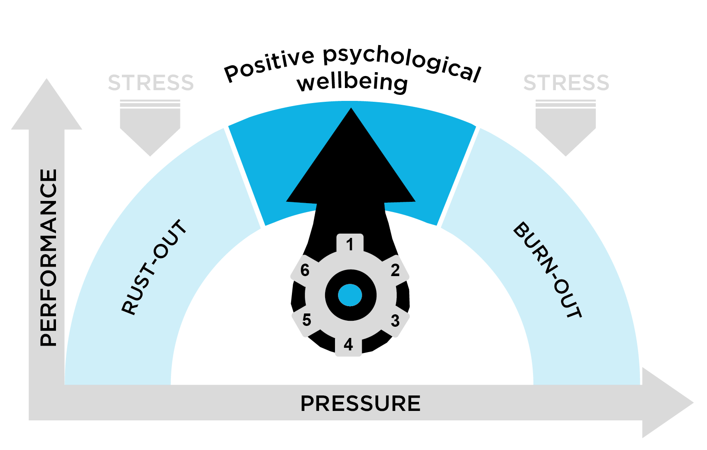
What is stress?
To maintain positive mental wellbeing, we all need a certain amount of pressure to thrive.
The right amount of pressure gives us energy, improves our confidence and allows us to feel and perform at our best.
If the pressure becomes excessive, or alternatively is insufficient, this can lead to stress and have a negative impact on performance and health.
Stress occurs when the perceived demands placed upon an individual exceed their perceived ability to cope.

Slide 3
Why is mental wellbeing important?
2017/2018
2015-2018
2017/2018
1 in 6
74%
46%
1 in 6 workers will experience a mental health issue every year
Increase in reported stress-related absences at Network Rail
Of all mental health related Occupational Health referrals were recorded as work or part work related

Slide 4


How do you recognise stress?
Discussion point 1 (10 minutes)
Think of a time that you have felt stressed.
What signs and symptoms did you experience and how did it make you feel?
In pairs, list as many
of these as you can
Think about how long these feelings lasted
What was the cause and how did you manage to overcome the stress?

Slide 5


How do you recognise stress?
Always look out for the signs and symptoms, not only in yourself, but in those around you.
Think about:
Behaviours
Mood and Emotions
Physical Changes
Thinking Style
The next four slides aim to consolidate Discussion point 1 and tell you more about the above signs and symptoms.

Slide 6
Behaviours often linked to stress
Tearful
Performance problems at work
Isolation
Avoiding places and people
Working longer hours
Strained home and work relationships
Turning up to meetings and work late
Irritability, aggression and outbursts

Slide 7
Mood and emotions linked to stress
Low mood and sadness
Lack of motivation
Helpless and hopeless
No enjoyment in life
Low self-esteem
Anxious
Tearful
Worrying
Guilt
Suicidal thoughts/ self-harm
Irritable and intolerant

Slide 8
Physical changes linked to stress
Speaking more slowly/quickly
Headaches
Moving more slowly/quickly
Unexplained aches and pains
Stomach problems
Change to menstrual cycle
Lack of energy
Loss of libido
Skin problems
Disturbed sleep pattern
Change in weight

Slide 9
Thinking styles often linked to stress
Increase in negative thoughts
Confused thinking
Getting things out
of perspective
Worrying excessively
Dwelling on problems
or mistakes
Difficulty making decisions

Slide 10
Common causes of stress
Discussion point 2 (10 minutes)
Step One
Being able to spot common signs and symptoms of stress is an important first step.
Step Two
By understanding what can cause and contribute to stress, you can learn ways to manage stress more effectively and also look to create a positive culture of wellbeing at work.
As a group, list as many causes of stress you can think of, including those from both inside and outside of work.
Please proceed to the next slide where you will further consolidate your knowledge and understanding of the common causes.

Slide 11
Common causes of stress
Stress can be caused by many external influences that include both inside and outside of work problems. There are, however, internal influences that can contribute as well.
Being aware of these can help you identify potential causes and become a more resilient person. Reflect on the list below as they are read out during this session.
Can you identify with any of these?
Some internal influences
Setting standards too high
Trying to please everyone
Being afraid to say ‘no’
Never being satisfied
Always running around
Personality characteristics
Pre-existing health conditions
Some external influences
Pressure to meet tight deadlines
Challenging relationships
Peer pressure
Financial worries
Commute to work
Work-life balance
Family difficulties

Slide 12
What support services are available?
Organisation Validium (NR) | Description Network Rail’s Employee Assistance Programme. Calls are answered by professional counsellors. | Telephone 0800 358 48 58 | Website www.Validium.com Username: NetworkRail Password: onlinesupport
OH Assist (NR) | Network Rail’s Occupational Health referrals, including those relating to mental wellbeing, and to access: Medication Enquiry Line Physiotherapy with Rehab Works | 0330 008 5105 | https://networkrail.ohassist.com/ http://connectdocs/NetworkRail/ Documents/CorporateServices/HR/ HRSharedServices/OH%20Provider.pdf
Employee helpline (NR) | This is provided by HR Direct and is available for all NR employees. | 0844 371 0115 | https://networkrail.sharepoint.com/ sites/myconnect/hr/Pages/HR-for- Employees.aspx
Mind | Guide for seeking help for mental health problems. | 0300 123 3393 9am-6pm Mon-Fri or text 86463 | https://www.mind.org.uk/information-support/guides-to-support-and-services/seeking-help-for-a-mental-health-problem/where-to-start/?o=24608#.W9AsmLD2apr
Rethink | Have advice on what to do in a crisis. | 0300 5000 927 | https://www.rethink.org/helpnow
Saneline | National mental health helpline providing information and support to people with mental health problems and those who support them. | 0300 304 7000 | www.sane.org.uk/whatwedo/ support/helpline
The Mix | Provides information and support for young people ages 13-25 on a range of issues, including mental health. | 0808 808 4994 Text ‘THEMIX’ to 85258 for crisis support | www.themix.org.uk/get-support
Samaritans | Provides confidential, non-judgement emotional support for people experiencing or feeling distress or despair. | 116 123 (24 hrs a day, free to call) | www.samaritans.org
ChildLine | Private and confidential service for children and young people up to the age of 19. | 0800 1111 | www.childline.org.uk
Elefriends | Supportive online community where you can be yourself, its run by Mind. | N/A | http://www.elefriends.org.uk/
Safety Central (NR) | A wealth of information on how to support your own mental wellbeing and, if you’re a manager, how you can support the mental wellbeing of people in your team. | N/A | https://safety.networkrail.co.uk/ healthandwellbeing/

Slide 13
Any Questions
Please contact:
healthandwellness@networkrail.co.uk
This mailbox is monitored by the central Health and Wellbeing team and all correspondence will be treated in confidence

