Slide 1
Supporting Bowel Cancer Awareness Month April 2019
Safety Hour Discussion

Slide 2
Purpose of the discussion
Bowel cancer is the fourth most common cancer, in the UK and April (1-30) is bowel cancer awareness month.
1 in 14 men and 1 in 19 women are at risk of being diagnosed with bowel cancer with almost 42,000 people in the UK are diagnosed a year equating to one every 15 minutes.
If you are aged 50 or over then you have a higher chance of being diagnosed than if you are aged below 50.
Bowel cancer is the second biggest cancer killer in the UK, following lung cancer.
Bowel cancer is treatable and curable especially if diagnosed early. Nearly everyone survives bowel cancer if diagnosed at the earliest stage.

Slide 3
What is bowel cancer?
Bowel cancer can also be called colorectal, colon or rectal cancer.
It affects the large bowel, which is made up of the colon and rectum.
The bowel is part of the digestive system processing all the food and fluids we eat and drink - turning them into energy for the body to use.
The large bowel is made up of the colon and rectum and is approximately 1½ metres (5 feet) long, and 6½ centimetres (2½ inches wide). Most bowel cancers (about two thirds) occur in the colon, and about a third occur in the rectum.
More than 90% of bowel cancers start as polyps (non-cancerous growths)
Question: How many people are diagnosed with bowel cancer every year in the UK?
a) 4,200 b) 42,000 c) 24, 000 d) 420

Slide 4
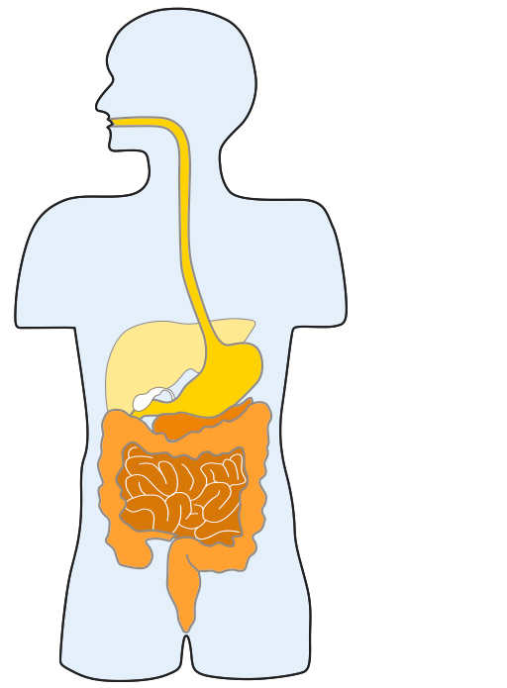
Where is the bowel?
Oesophagus (gullet)
Stomach
Colon
Small bowel
Large bowel
Rectum
Anus

Slide 5
What are the symptoms?
Bleeding from your bottom and/or blood in your poo. Bleeding is never normal and should always be reported to your GP whether it is small amounts of bright-red blood on the toilet paper or darker in colour.
Change in bowel habit. Tell your GP if you have noticed any persistent and unexplained changes in your bowel habit.
Unexplained weight loss is less common than some of the other symptoms. Speak to your GP if you have lost weight and you don’t know why.
Extreme tiredness. Bleeding from a bowel cancer may lead to a lack of iron in the body, which can cause anaemia. If you have anaemia, you are likely to feel very tired and your skin may look pale.
Any unusual pains or a lump in your tummy must be checked out by a doctor.

Slide 6
How do you reduce your risk?
An estimated 54% of bowel cancers in the UK are linked to lifestyle related factors which are preventable.
Lifestyle changes which can reduce your risk include:
Limiting your intake of red meat to 500g (cooked) per week. An 80g serving is roughly the size of a deck of cards
Avoiding processed meat. Avoid processed meats such as bacon, ham, sausages and salami as much as possible. Choose them as an occasional treat rather than every day
Eating plenty of wholegrain, pulses, vegetables and fruit
Question: Which of the following foods are high in fibre, and therefore helpful in lowering risk of bowel cancer?
a) Steak
b) Apples
c) Baked beans
d) Semi-skimmed milk

Slide 7
How do you reduce your risk?
Being more physically active. Try to do at least 150 minutes (or two and a half hours) of physical activity over one week. One way to approach this is to do 30 minutes on at least 5 days a week. If you don’t do much exercise, try starting with 10 minutes and increase the time gradually. Exercise doesn't have to be about working out in a gym.
Taking action to be a healthy body weight. Keep to a healthy body weight and reduce fat around the middle
Limiting our intake of alcohol. Keep to a maximum limit of 14 units of alcohol per week
Stopping smoking
Question: Which one of the following statements is true?
a) Bowel cancer is the tenth biggest cancer killer in the UK
b) Bowel cancer rarely kills
c) Bowel cancer is the second biggest cancer killer in the UK
d) Bowel cancer kills as many people as lung cancer

Slide 8
What support is there at Network Rail?
Employee Assistance Programme (Validium) Call 0800 358 4858
Occupational Health (Optima)- support regarding adjustments in the workplace click here
Can Do - Network Rail employee support group for employees with disabilities click here
Business Disability Forum- Advice on managing disabilities in the workplace, reasonable adjustments, policies. (advice@businessdisabilityforum.org.uk, Monday to Friday, 9am – 5pm.+44-(0)20-7403-3020)
Other General Support
Take part in screening, if invited (for more information on screening visit https://www.nhs.uk/conditions/bowel-cancer-screening)
Visit your doctor if you have any symptoms

Slide 9
For further information please visit:
bowelcanceruk.org.uk
Visit bowelcanceruk.org.uk/forum (a welcoming online community for everyone affected by bowel cancer to ask questions, read about people’s experiences and support each other)
NHS- www.nhs.uk/conditions/bowel-cancer/ and www.nhsinform.scot/illnesses-and-conditions/cancer/cancer-types-in-adults/bowel-cancer

